Slide 1
100,000 Genomes Project & Mainstreaming Genomic Medicine
Tracie Miles RGN , PhD.

Slide 2
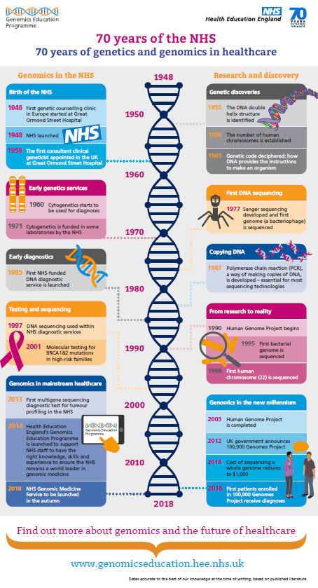

Slide 3
NHS Genomic Medicine Centres
NHS Genomic Medicine Centres (NHS GMCs) : mapped against AHSN boundaries
NHS GMCs work in partnership with academia, patients and industry through the AHSNs
Notes:
Emphasis national coverage – not all providers contributing but aim was national coverage

Slide 4
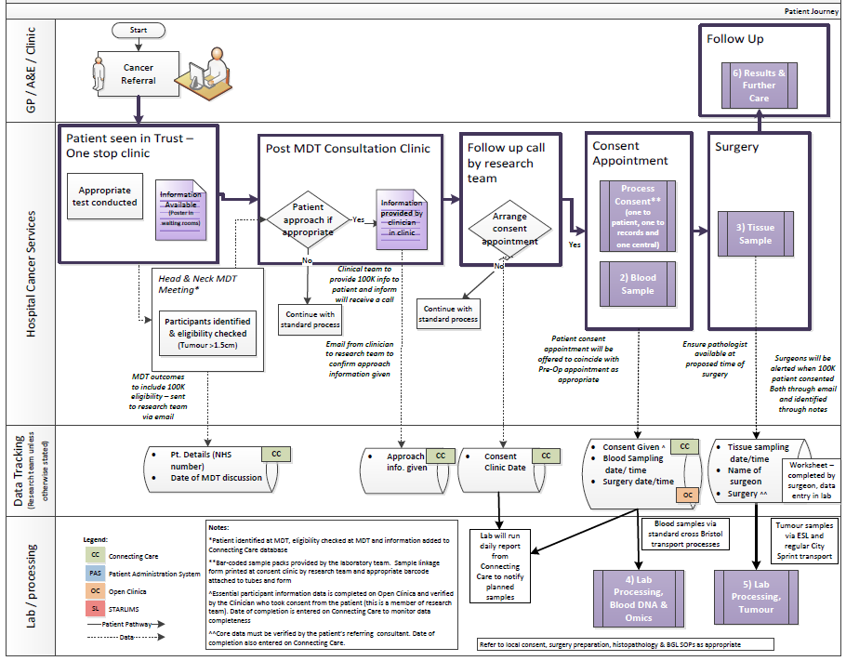
What did it mean for staff to support the 100,000 Genomes Project?
Patient
GPs
Pathology
Imaging
Surgeons
Consultants
Nursing staff
Specialists
Breast Care Nurses
Research team
Clinic management
Theatre team
MDT co-ordinators
Specimen transport team
IT experts
How do you develop a pathway? – the key is engagement at every step of the pathway…..
Blood laboratory
Tumour laboratory
Managers
Introduction to the 100,000 Genomes Project
4
Reception
Processing
Notes:
Stress importance of all individuals involved in the pathway being involved

Slide 5
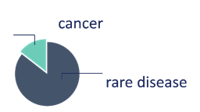
100,000 Genomes Project: National Update – September 2018
Samples
Genomes
Analysis and Reports
>90,000
81,179
Reports for
10,000
Samples collected from NHS GMCs
families sent to GMCs
(equivalent to over 20,000 genomes)
genomes sequenced
25,126
Scaling up
6,000
65,064
genomes from cancer patients available for review
~20% actionable findings
Improving Turnaround Time
rapidly increasing whole genome sequencing capacity
Research
data available in anonymised fashion
10.0
As of 24/09/2018
Updated from Genomics England & NHS England

Slide 6
The national infrastructure for genomic medicine
Political oversight: Dept. of Health & Ministerial Board
Slide reproduced from NHS England SRO team
NHS Genomic Medicine Service
Strategic Oversight
Genomic Medicine Centres & Genomic Clinical Services
National Network of Genomic Laboratories
National Testing Directory
Informatics systems & data store
Whole Genome Sequencing Provision
Genomics Data Interpretation
with Genomics England
Workforce development
upskilling of existing staff & ongoing professional engagement in conjunction with Health Education England
Industry/ academic/ international partnerships
supporting ongoing research & development through clinical care
Advances in genomic & informatics technologies & other next generation diagnostics informing policy, strategy & regulation

Slide 7
Mainstreaming genomic medicine - Beyond 1st October 2018
Genomic Medicine Service
Genetics Laboratory Hubs:
7 nationally commissioned laboratory hubs
National Directory for all genetic & genomic testing
Genomic Laboratory Hubs
Clinical Genetics Services
Genomic Medicine Centres
Cancer Services
Genomic Medicine Centres:
Support transition from project to clinical practice
Clinical Genetics Services:
- Review of services to ensure support and equity
Cancer Services:
- Supporting 100,000 Genomes patients and future genomics pathways
Notes:
As of 1st October there are:
7 Genomic Laboratory Hubs
A national directory of tests dictating which tests will be funded nationally
GMCs will exist with a transformation, governance and potential project based remit
To support this there is a review of clinical genetics services as potential impact on their work will be critical

Slide 8
National Genomic Laboratory Hubs
7 Genomic Laboratory Hubs commissioned to deliver a national genomic test directory
Whole genome sequencing in place for a limited number of tumours
Sarcoma, paediatric and acute leukaemia (from Jan19)
Nationally standardised panels for somatic (tumour) variants
Nationally standardised commissioning for germline variants to test cancer susceptibility
Annual review of test directory to update at national level test provision across country

Slide 9
Developing the return of results pathway
Locally Genomic Medicine Centres are developing pathways to return results to patients. Many of the cancer patients are post treatment and on follow up.
WE GMC draft results return pathway
Notes:
Emphasis we tried to map this at the start but this is a pilot/development project and until we get a real result it is very hypothetical.
Results come back centrally to the Bristol Genetics laboratory
All germline are reviewed
Focus on defined gene panel actionable in cancer
Patient clinical situation will be reviewed to identify if potentially actionable
Emphasis clinical support on decision making on actionability critical and ensure that patient is 100,000 Genomes patient should go back in notes to support decision making in future as appropriate..

Slide 10
Return of Results Pathway – Key Principles
All patients will have their germline variants assessed (to check for inherited cancer susceptibility)
Clinical colleagues to define which 100,0000 Genomes patients are on ‘active pathways’ when results are returned (this will determine analysis of tumour genome)
Patients on active pathway somatic (tumour) variants reviewed
Patients not on active pathway feedback to clinical team and patient ‘no actionable findings at this time’
If patient relapses clinical team can request analysis of the sampled tumour genome if likely to impact clinical care

Slide 11
Return of Results Pathway - Practical Support
Genomic Practitioner for legacy support until March 2018
Support clinical liaison
Feedback to patients that are not on active pathways
Liaison with clinical team to ensure results are understood and available in notes

Slide 12
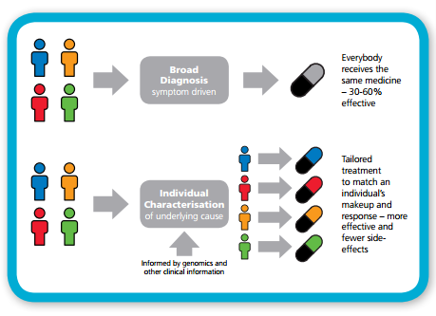
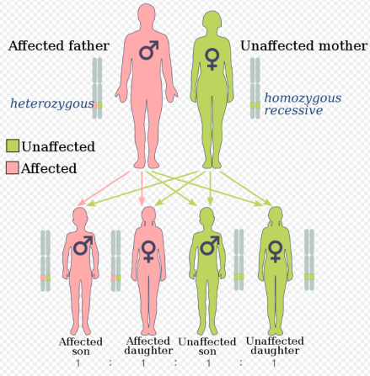
Providing actionable information for cancer patients
Format adapted from Genomics England
Prognosis
Diagnosis
Clinical Trials
Cancer Molecular Markers
Image taken from Wikipedia
Therapy selection
Image taken from NHS E
Cancer susceptibility
Notes:
This is adapted from an Genomics England slide and identifies potential uses for results return:

Slide 13
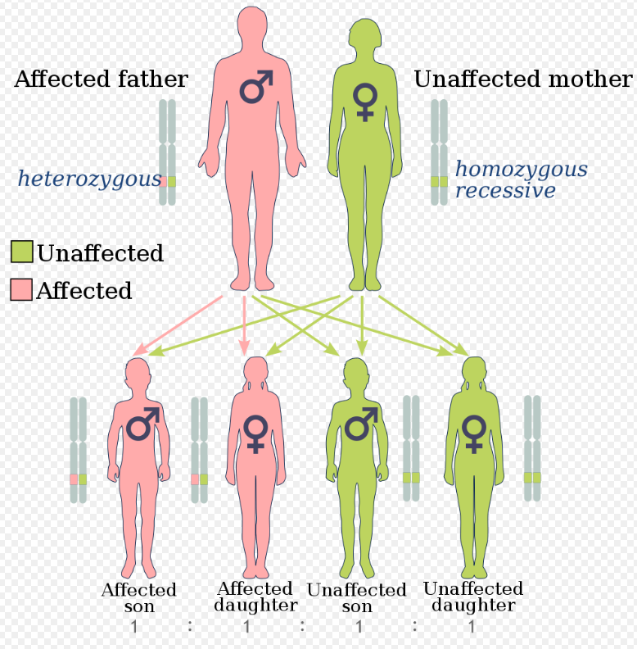
Providing information regarding cancer susceptibility
Identify patients with germline variants (BRCA)
Significance for wider family
Support and referral to genetics teams
Notes:
Locally identified patients with cancer susceptibility genes – anticipate only 1 or 2% but important for wider family and ensure linked into genetics team

Slide 14
Providing personalised medicine
NHSE: Improving Outcomes through Personalised Medicine, September 2016
Notes:
Locally one patient who has gone on to have PARP inhibitors due to findings from project
Notes below from NHS I: Currently drugs are developed for a particular condition and there is the assumption that everyone will respond in the same manner. All patients with the same condition are given the same first line treatment however it is thought this is only effective for between 30 and 60% of patients.
Looking and the genomic and diagnostic characterisation different subtypes of patients within a condition can be identified, and a treatment can be tailored to the underlying cause.
For cancer this is an approach which is more commonly in place. Offering a genomic or molecular diagnosis - we can better understand the genetic basis and select the most appropriate treatment – improving survival chances.
It means that cancer patients can be stratified according to what is the most effective for their condition. May also mean that patients with different types of cancer may on the genomic diagnosis receive similar treatments.

