Slide 1

100,000 Genomes Project & Mainstreaming
Genomic Medicine
Update Session

Slide 2
Contents
Genetics and genomics
Background to 100,000 Genomes Project
Project progress
What next? Mainstreaming Genomic Medicine

Slide 3
Contents
Genetics and genomics
Background to 100,000 Genomes Project
Project progress
What next? Mainstreaming Genomic Medicine

Slide 4
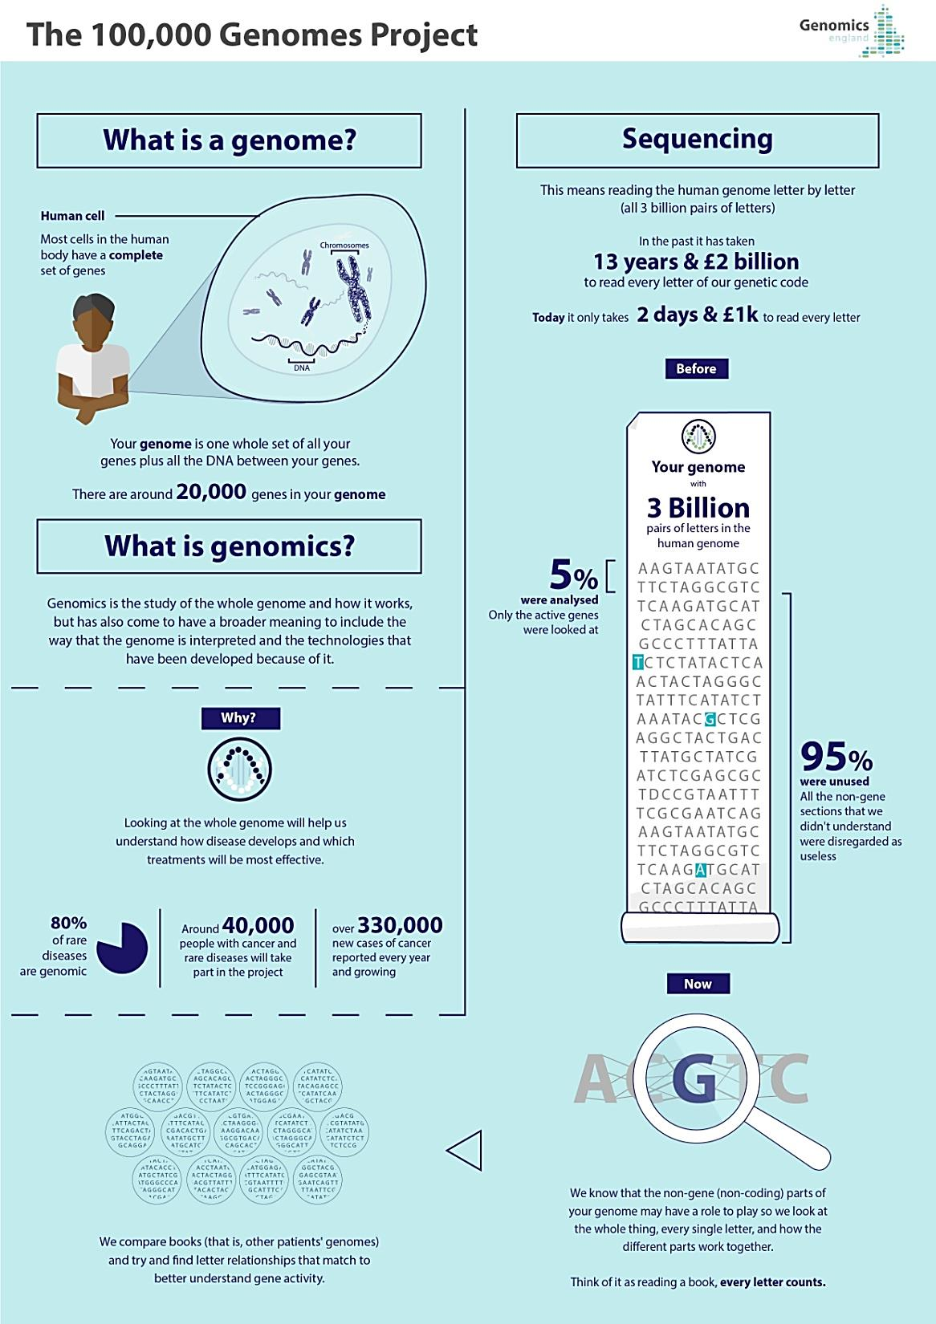

Slide 5
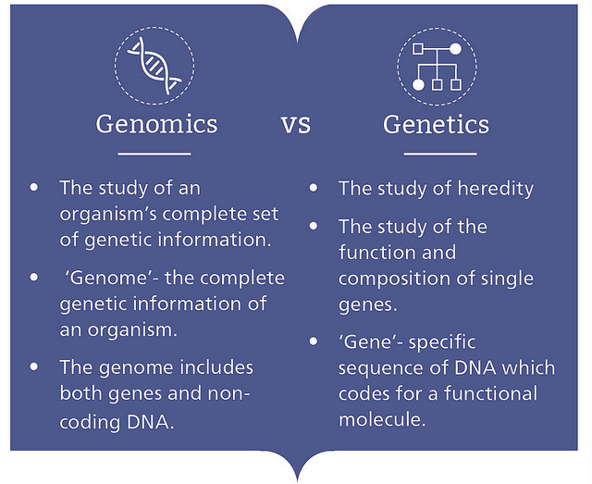
Genetics vs. Genomics
  Genomics
  Involves the entire genome, including coding (genes) and noncoding DNA
  Relates to disorders with complex inheritance
  Recognises complexity of gene-gene and environmental interactions
  Arises from new genomic technologies
Genetics
  Involves a single gene pair or chromosomal region
  Relates to single gene disorders
  Observes Mendelian inheritance
  Arises from clinical observation
Courtesy of Genomics Education Programme

Slide 6
Genetics vs Genomics
Genetic testing = single genes or panels (Sanger sequencing)
Exome sequencing = all coding DNA (Next-Gen Sequencing)
Genomic sequencing = all coding and non-coding DNA (NGS)
Single gene
Small panel (5-10)
Larger panel (50-100)
Clinical exome
Whole exome
Whole genome
Courtesy of HEE E&T Group

Slide 7
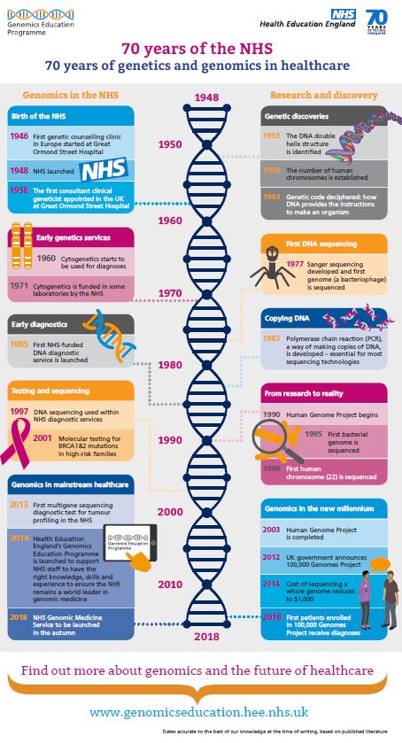

Slide 8
Contents
Genetics and genomics
Background to 100,000 Genomes Project
Project progress
What next? Mainstreaming Genomic Medicine

Slide 9


The Human Genome Project
Commenced in 1990 - completed in April 2001/2003
First genome costs $2.7 billion in total
First time the human genetic blueprint had been completely read
Enabled the discovery of genes which cause disease
Allowed genetic diagnostics to progress
Paved the way for large-scale diagnostic sequencing programmes
Courtesy of HEE E&T Group
Notes:
Reference genome created…..version 38 now causing issues!

Slide 10
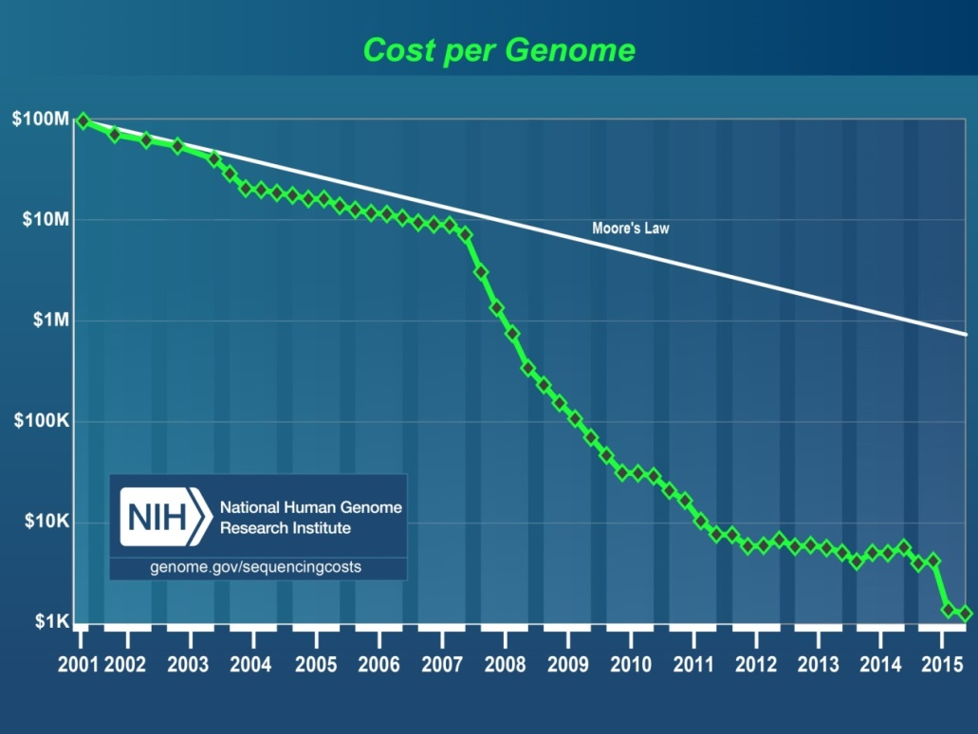
100,000 Genomes Project:
How did we get here?
Human Genome Project generates reference sequence at an estimated cost of $2.7 billion
Development of new technologies drives down the cost of Whole Genome Sequencing – the $1000 genome is now a reality
Graph from NHGRI
Now potential to bring real benefits to patients, drive research and drug development, and develop personalised medicine for the NHS, in the NHS, by the NHS
Courtesy of HEE E&T Group
Notes:
The $1000 genome was talked about as the holy grail of genomics – the point at which it became possible to offer WGS at a parallel cost to standard diagnostics.
These two things made it possible, but the biggest drive for the 100K programme was the potential to bring benefits to current and future patients in the form of personalised medicine – a one size does not fit all model. Recognising that we are not identical, that tumours are not identical, some drugs work better in some than others (especially so in cancer) and that targeting therapies to individuals is a possibility – that no one alive is youer that you.

Slide 11

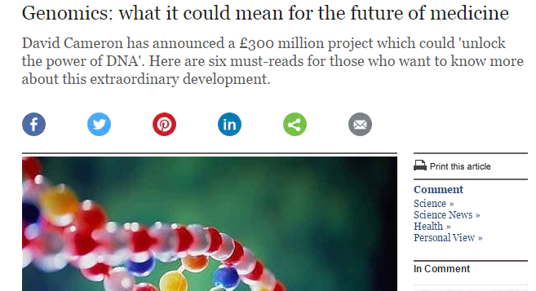
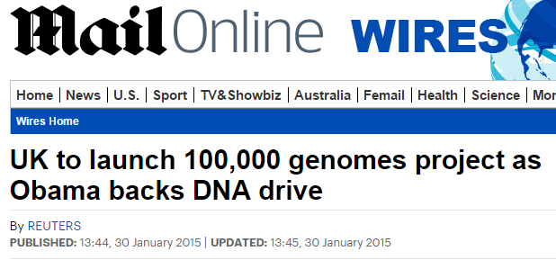
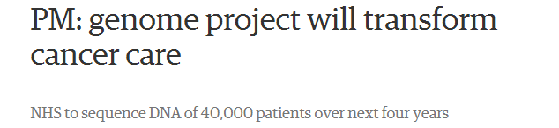
100,000 Genomes Project: Setting up
December 2012: David Cameron announces plans for the 100,000 Genomes Project as part of the Olympic legacy
July 2013: Jeremy Hunt launches Genomics England, a company established to deliver the 100,000 Genomes Project
December 2014: 11 NHS Genomic Medicine Centres are announced
December 2015: WE GMC announced as one of 2 final NHS Genomic Medicine Centres
Courtesy of HEE E&T Group

Slide 12
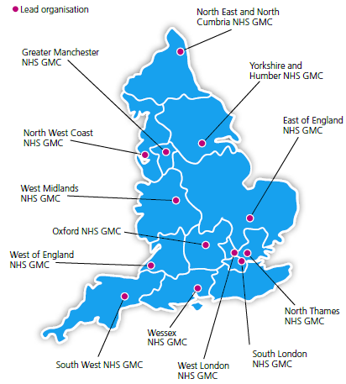
NHS Genomic Medicine Centres
NHS Genomic Medicine Centres (NHS GMCs) : mapped against AHSN boundaries
NHS GMCs work in partnership with academia, patients and industry through the AHSNs
Notes:
Emphasis national coverage – not all providers contributing but aim was national coverage

Slide 13
What is a Genomic Medicine Centre (GMC)?
A group of NHS providers (and other key local organisations) who have come together to support delivery of the 100,000 Genomes Project
We are ordinary NHS staff seconded to work on the project and set it up alongside existing clinical practice
We are not building a big new centre or working outside of existing NHS structures

Slide 14
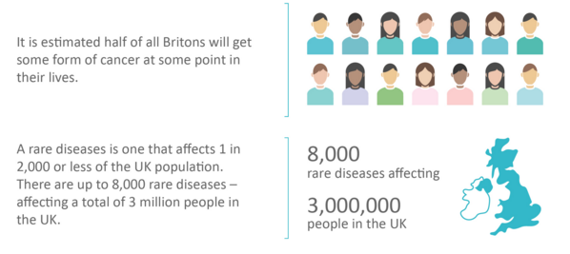
100,000 Genomes Project: eligibility
Cancer: 17 cancer groups with tumour size and type requirements
Rare diseases: >250 different conditions
Minimal diagnostic criteria and prior genetic testing
No causal variant identified

Slide 15
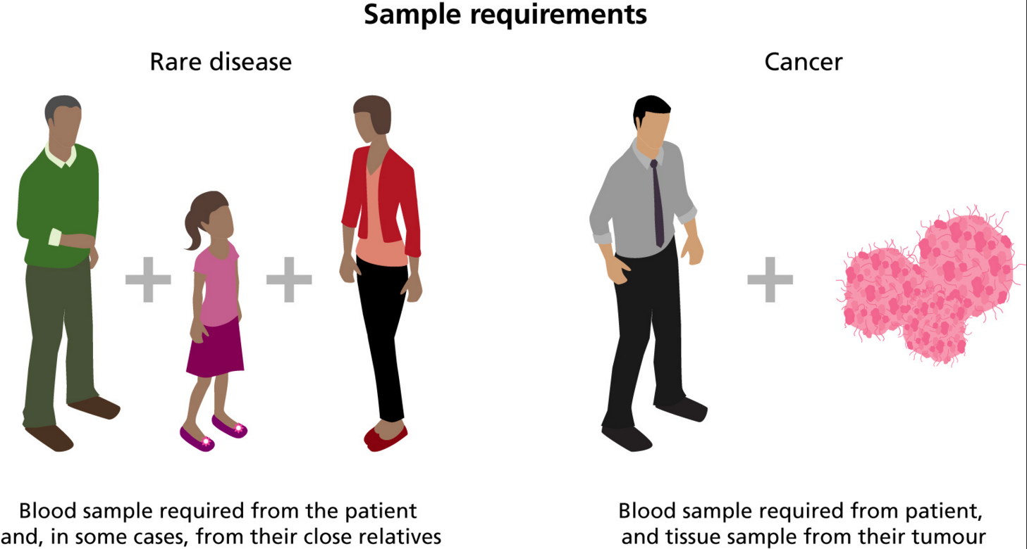
What samples were taken?

Slide 16



Types of cancer eligible for inclusion
Brain
Head & Neck
Breast
Upper GI
Lung
Prostate
Renal
Endometrium
Testicular
Bladder
Ovarian
Colorectal
Haematological
Melanoma
Paediatric
Sarcoma
Carcinoma Unknown Primary

Slide 17
Contents
Genetics and genomics
Background to 100,000 Genomes Project
Project progress
What next? Mainstreaming Genomic Medicine

Slide 18
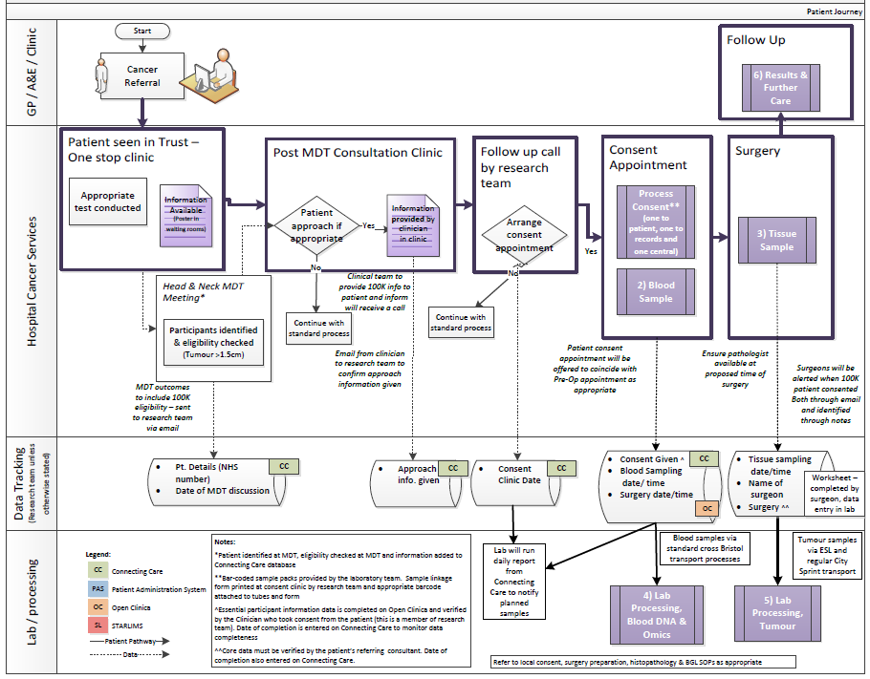
What did it mean for staff to support the
100,000 Genomes Project?
Patient
Notes:
Example of how 100,000 Genomes Project pathways were developed and highlight the need for additional staffing to conduct consent and take additional blood samples

Slide 19
What did it mean for staff to support the
100,000 Genomes Project?
Patient
Notes:
Highlight need for additional data capture

Slide 20
What did it mean for staff to support the
100,000 Genomes Project?
Patient
Notes:
Highlight pathways for processing blood to extract DNA and to ensure tumour samples were collected in a Fresh Frozen manner

Slide 21
What did it mean for staff to support the
100,000 Genomes Project?
Patient
GPs
Pathology
Imaging
Surgeons
Consultants
Nursing staff
Specialists
Breast Care Nurses
Research team
Clinic management
Theatre team
MDT co-ordinators
Specimen transport team
IT experts
How do you develop a pathway? – the key is engagement at every step of the pathway…..
Blood laboratory
Tumour laboratory
Managers
Introduction to the 100,000 Genomes Project
21
Reception
Processing
Notes:
Stress importance of all individuals involved in the pathway being involved

Slide 22
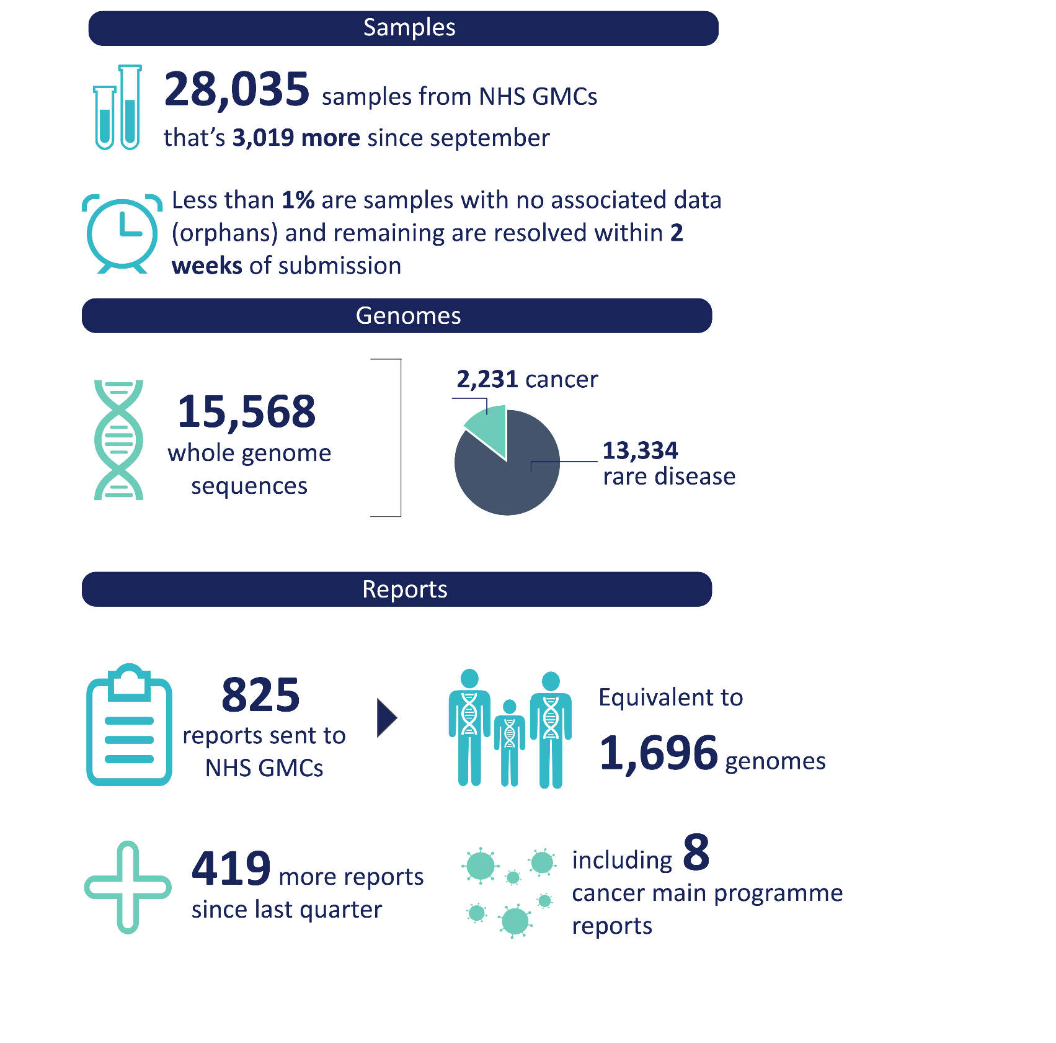
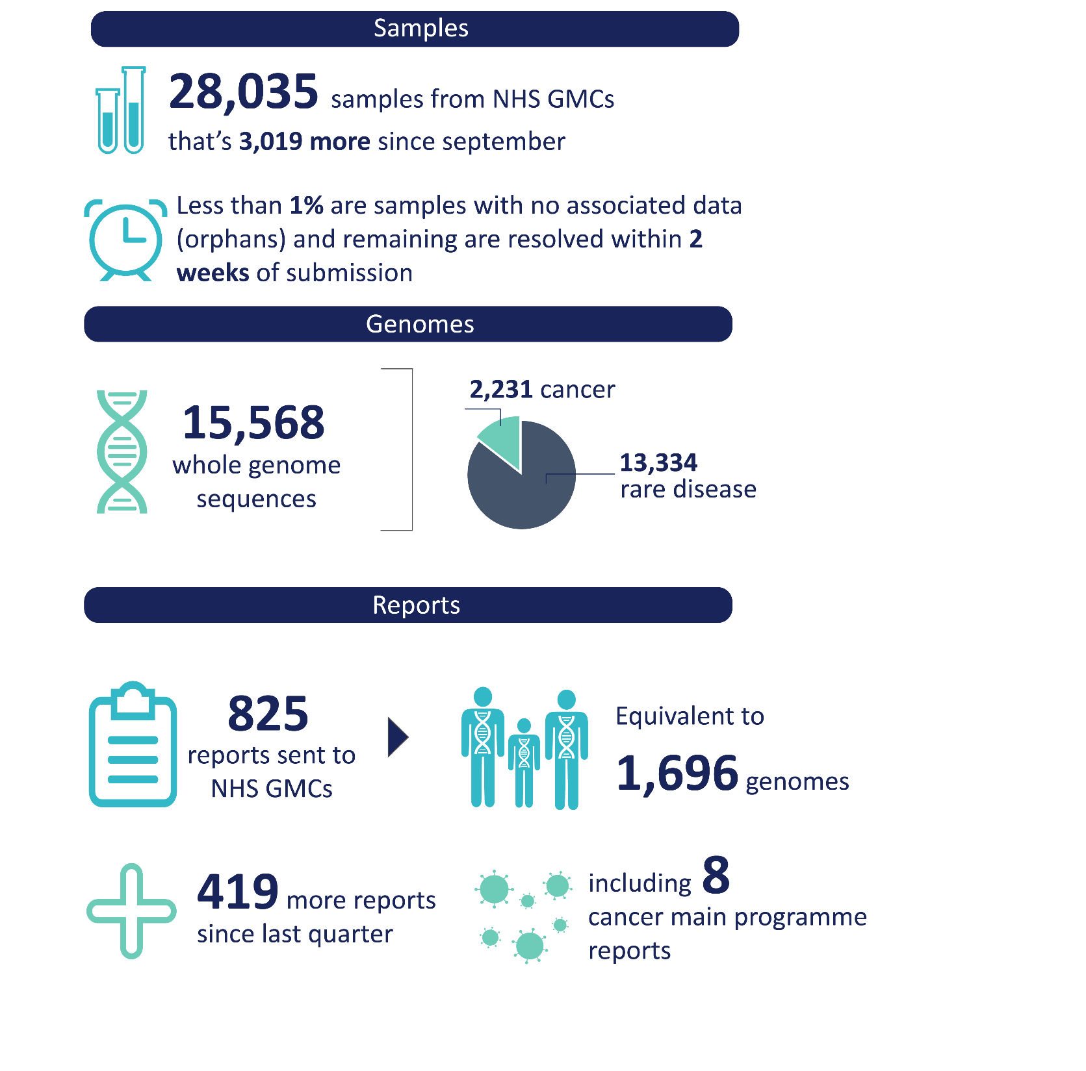

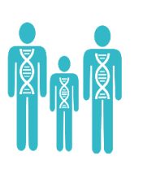
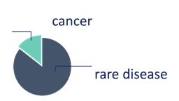

100,000 Genomes Project: National Update
– September 2018
Samples
Genomes
Analysis and Reports
>90,000
81,179
Reports for
10,000
Samples collected from NHS GMCs
families sent to GMCs
(equivalent to
over 20,000
genomes)
genomes sequenced
25,126
Scaling up
6,000
65,064
genomes from cancer patients available for review
~20% actionable findings
Improving Turnaround Time
rapidly increasing whole genome sequencing capacity
Research
data available in anonymised fashion
10.0
As of 24/09/2018
Updated from Genomics England & NHS England

Slide 23
100,000 Genomes Project: National Update
As of 31st August 2018 - Courtesy of Genomics England & NHS England
Notes:
Emphasis on pathways across tumour types and across areas – 100 hospitals out of possible approx. 200 been involved in cancer arm of the project

Slide 24
Contents
Genetics and genomics
Background to 100,000 Genomes Project
Project progress
What next? Mainstreaming Genomic Medicine

Slide 25
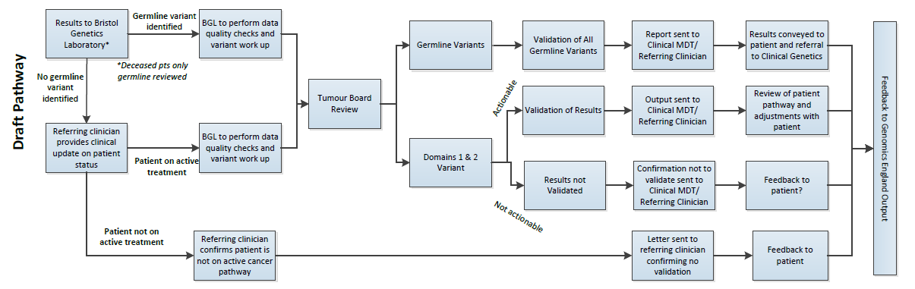
Developing the return of results pathway
Locally Genomic Medicine Centres are developing pathways to return results to patients. Many of the cancer patients are post treatment and on follow up.
WE GMC draft results return pathway
Notes:
Emphasis we tried to map this at the start but this is a pilot/development project and until we get a real result it is very hypothetical.
Results come back centrally to the Bristol Genetics laboratory
All germline are reviewed
Focus on defined gene panel actionable in cancer
Patient clinical situation will be reviewed to identify if potentially actionable
Emphasis clinical support on decision making on actionability critical and ensure that patient is 100,000 Genomes patient should go back in notes to support decision making in future as appropriate..

Slide 26
Return of Results Pathway
– Key Principles
All patients will have their germline variants assessed
(to check for inherited cancer susceptibility)
Clinical colleagues to define which 100,0000 Genomes patients are on ‘active pathways’ when results are returned (this will determine analysis of tumour genome)
  Patients on active pathway somatic (tumour) variants reviewed
  Patients not on active pathway feedback to clinical team and patient ‘no actionable findings at this time’
If patient relapses clinical team can request analysis of the sampled tumour genome if likely to impact clinical care

Slide 27
Return of Results Pathway
- Practical Support
Genomic Practitioner for legacy support until March 2018
  Support clinical liaison
  Feedback to patients that are not on active pathways
Liaison with clinical team to ensure results are understood and available in notes

Slide 28



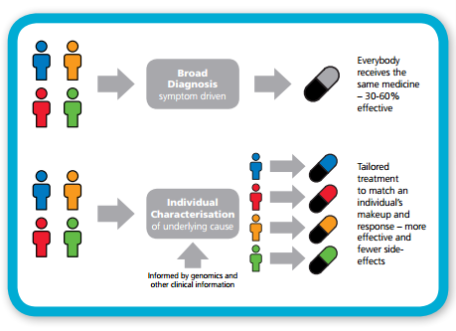
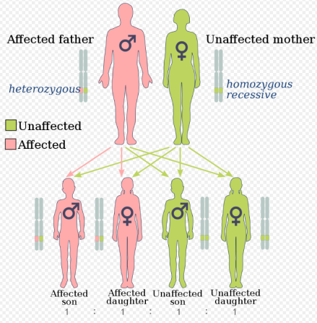
Providing actionable information for cancer patients
Format adapted from Genomics England
Prognosis
Diagnosis
Clinical Trials
Cancer Molecular Markers
Image taken from Wikipedia
Therapy selection
Image taken from NHS E
Cancer susceptibility
Notes:
This is adapted from an Genomics England slide and identifies potential uses for results return:

Slide 29
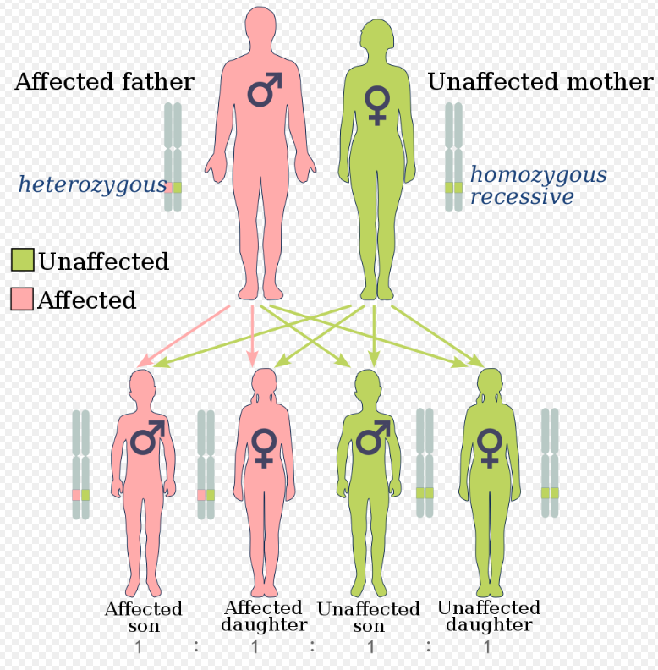
Providing information regarding cancer susceptibility
Identify patients with germline variants (BRCA)
Significance for wider family
Support and referral to genetics teams
Notes:
Locally identified patients with cancer susceptibility genes – anticipate only 1 or 2% but important for wider family and ensure linked into genetics team

Slide 30
Providing personalised medicine
NHSE: Improving Outcomes through Personalised Medicine, September 2016
Notes:
Locally one patient who has gone on to have PARP inhibitors due to findings from project
Notes below from NHS I: Currently drugs are developed for a particular condition and there is the assumption that everyone will respond in the same manner. All patients with the same condition are given the same first line treatment however it is thought this is only effective for between 30 and 60% of patients.
Looking and the genomic and diagnostic characterisation different subtypes of patients within a condition can be identified, and a treatment can be tailored to the underlying cause.
For cancer this is an approach which is more commonly in place. Offering a genomic or molecular diagnosis - we can better understand the genetic basis and select the most appropriate treatment – improving survival chances.
It means that cancer patients can be stratified according to what is the most effective for their condition. May also mean that patients with different types of cancer may on the genomic diagnosis receive similar treatments.

Slide 31
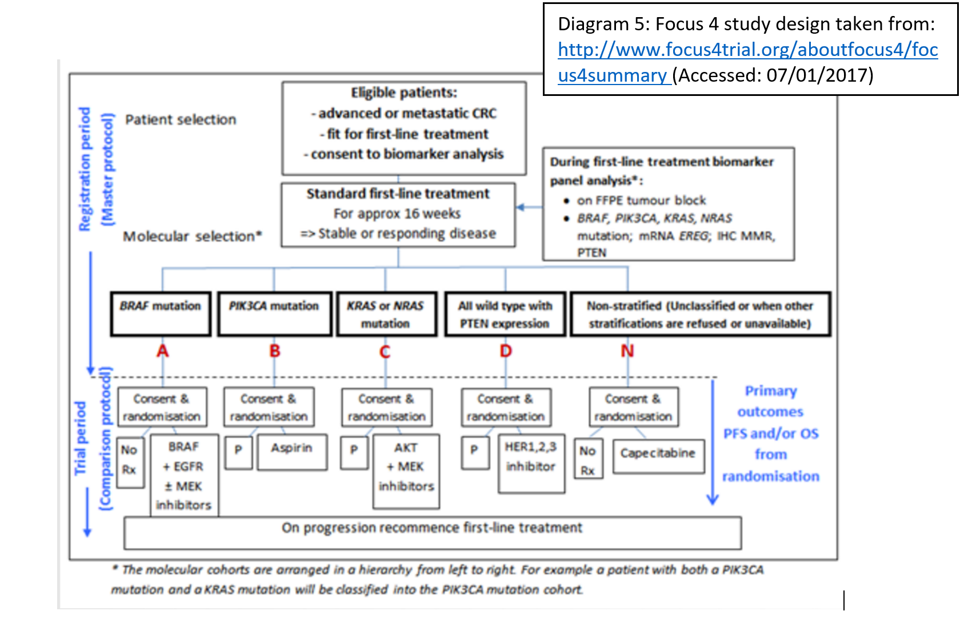
Providing access to targeted research
Notes:
Clinical trials have for a long time used mutation status to stratify cohorts – will this assist further in tailored research and entry into trials?

Slide 32
Contents
Genetics and genomics
Background to 100,000 Genomes Project
Project progress
What next? Mainstreaming Genomic Medicine

Slide 33
Mainstreaming genomic medicine - Beyond 1st October 2018
Genomic Medicine Service
Genetics Laboratory Hubs:
7 nationally commissioned laboratory hubs
National Directory for all genetic & genomic testing
Genomic Laboratory Hubs
Clinical Genetics Services
Genomic Medicine Centres
Cancer Services
Genomic Medicine Centres:
Support transition from project to clinical practice
Clinical Genetics Services:
- Review of services to ensure support and equity
Cancer Services:
- Supporting 100,000 Genomes patients and future genomics pathways
Notes:
As of 1st October there are:
7 Genomic Laboratory Hubs
A national directory of tests dictating which tests will be funded nationally
GMCs will exist with a transformation, governance and potential project based remit
To support this there is a review of clinical genetics services as potential impact on their work will be critical

Slide 34


The national infrastructure for genomic medicine
Political oversight:
Dept. of Health & Ministerial Board
Slide reproduced from NHS England SRO team
NHS
Genomic Medicine Service
Strategic Oversight
Genomic Medicine Centres & Genomic Clinical Services
National
Network of Genomic Laboratories
National Testing Directory
Informatics systems
& data store
Whole Genome Sequencing Provision
Genomics Data Interpretation
with Genomics England
Workforce development
upskilling of existing staff & ongoing professional engagement in conjunction with Health Education England
Industry/ academic/ international partnerships
supporting ongoing research & development through clinical care
Advances in genomic & informatics technologies
& other next generation diagnostics informing policy, strategy & regulation

Slide 35
National Genomic Laboratory Hubs
7 Genomic Laboratory Hubs commissioned to deliver a national genomic test directory
Whole genome sequencing in place for a limited number of tumours
  Sarcoma, paediatric and acute leukaemia (from Jan19)
Nationally standardised panels for somatic (tumour) variants
Nationally standardised commissioning for germline variants to test cancer susceptibility
Annual review of test directory to update at national level test provision across country

Slide 36
Insert slide on future test directory for tumour type?

Slide 37
Thanks and any questions
Catherine Carpenter-Clawson
Programme Manager, WE GMC
07732 561067
Catherine.Carpenter-Clawson@nbt.nhs.uk
or
Ubh-tr.wegmc@nhs.net

