Slide 1
Clinical Research Network
West of England
SWAG SSG Breast Cancer Meeting
Friday 26th January 2017
Research Report

Slide 2
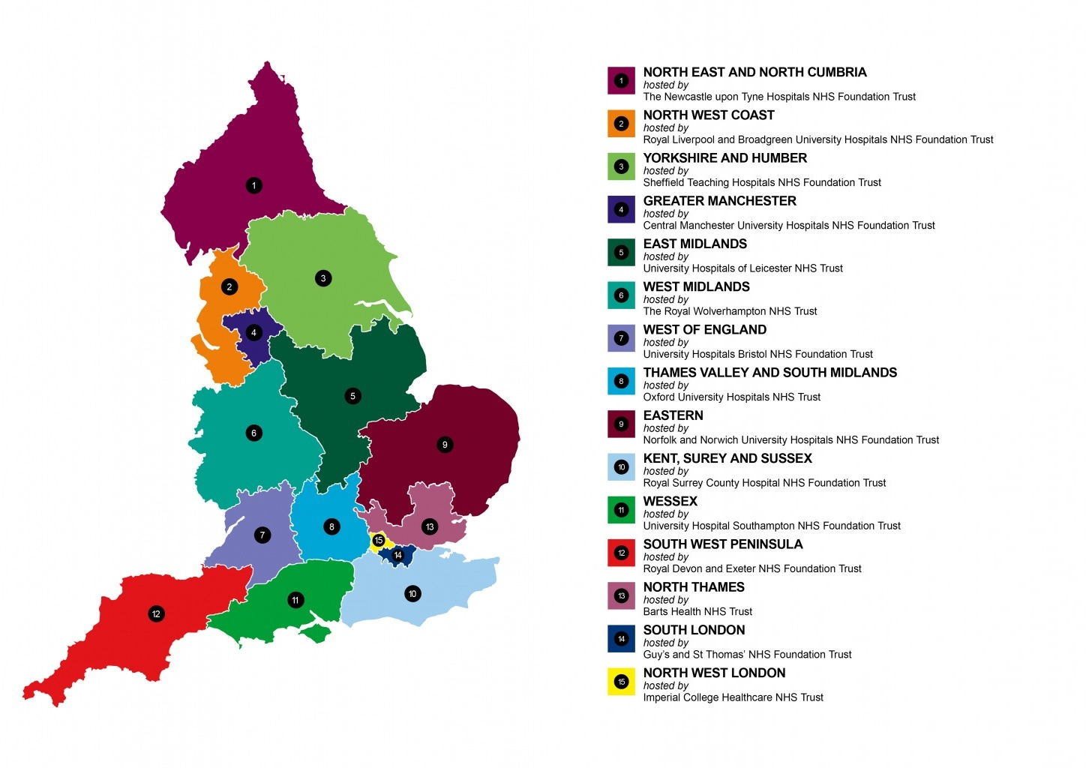
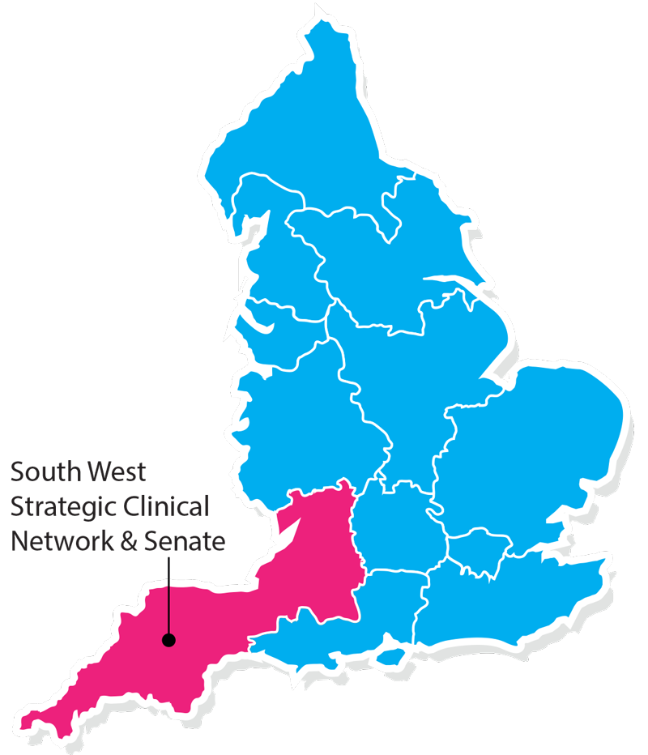
Clinical Research Network & Cancer Services
West ofEngland
SWAG - Somerset Wiltshire Avon & Gloucestershire
South West Children’s Cancer & Leukaemia
Research Network

Slide 3
NIHR CRN High Level Objectives 2017-18
Increase number of participants into NIHR CRN portfolio studies
650,000 in England
21,477 in West of England
Increase the number of studies that deliver to time and target
Target 80%
Increase number of commercial studies delivered through network
Reduce NHS study set up times
Reduce time taken to recruit first participant

Slide 4
Cancer specialty objective for 2017-18
Networks achieving on-target recruitment into at least 8 of the 13 Cancer subspecialties.
"on-target" means either improving recruitment by 10% from 2016/17 or meeting the following recruitment targets per 100,000 population served:
a) Brain & CNS: 0.2; b) Breast: 8; c) Colorectal: 3; d) Paediatrics: 3; e) Gynae: 3; f) Head & Neck: 1; g) Haematology: 7; h) Lung: 4; i) Sarcoma: 0.1; j) Skin: 0.2; k) Supportive & Palliative Care and Psychosocial Oncology & Survivorship: 3; l) Upper GI: 3; m) Urology: 8.
Notes:
8/100,000 population for Breast cancer

Slide 5
Notes:
Network population is 2.4million
Surpassed the target, going on last years figures
Early to tell, but on target as it stands

Slide 7
Notes:
2015/16

Slide 8
Notes:
Working with R&D’s and delivery teams to improve RTT , as this is important when it comes to attracting commercial work

Slide 11
Useful links
https://www.crn.nihr.ac.uk/
National and local network information including training programmes templates, tools, contacts, videos etc
https://odp.nihr.ac.ukOpen data platform. Look at performance across whole CRN including all specialty areas
http://csg.ncri.org.uk/portfolio/portfolio-maps/
View current national portfolio of open, closed and ‘in set up’ cancer studies
https://www.ukctg.nihr.ac.uk/
See where a study is open across the country
http://public-odp.nihr.ac.uk/
Search for a study to fit criteria. Good for horizon scanning, eligibility criteria

Slide 12
Contacts
Research Delivery Manager – david.rea@nihr.ac.uk
Cancer Portfolio Facilitator – jessica.bartlett@nihr.ac.uk
Breast research leads – Mark.Beresford@nhs.net
- Zenon.Rayter@nbt.nhs.uk

Slide 13
Current Issues with Cancer Research
Gaps in the portfolio
Clinical pressures with some trial treatments
Pharmacy capacity issues
Extra time for administration of infusions
Extra length of treatment courses
Clinic space to see patients
Affordability to the NHS of the drugs we are researching
What should our regional portfolio look like?
Should we consider the whole region population when forecasting for trials?
Should we encourage more cross referral of patients for studies?
Should we select studies that will be more useful to the NHS?

