Slide 1




South West Prostate Dashboard (SWPD)
Change Request and Project Progress

Slide 2

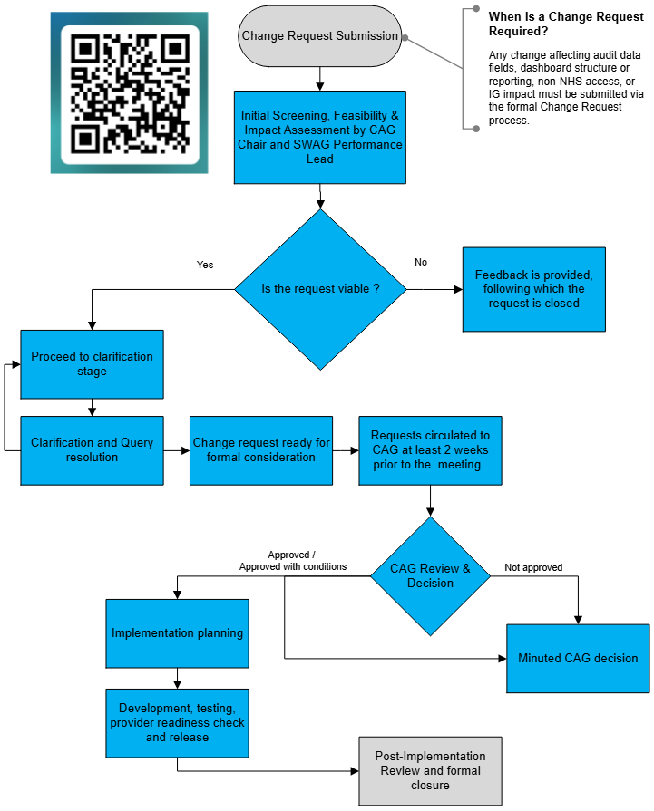
Change Request and CAG Approval Process for SWPD
Change request form Link

Slide 3
Southwest Prostate cancer diagnostic dashboard
Update
Jan 29 2026
Aim
Local Data Driven improvement in Performance, equality, efficiency and Quality.

Slide 4
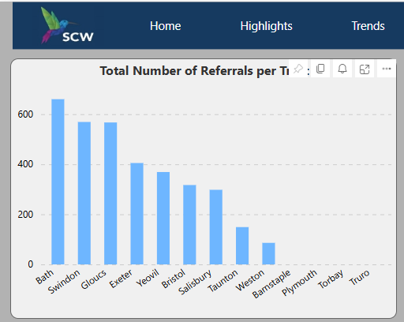
SWAG all providers submitting
Last 12 months

Slide 5
Introduction of the Script (automated submission)
Manual inputting of data time consuming
Large amounts of data inputted to cancer registers . Never utilised clinically.
3 year collaboration between SCR, Southern clinical support unit, local IT departments, SWAG and cancer team, Paul Burn.
50-70% of data for dashboard in the SCR.
A novel project requiring problem solving and significant amounts of testing and retesting for accuracy and validation.
Completed in Taunton/Yeovil and now Bristol with Bath and Swindon about to start to use

Slide 6
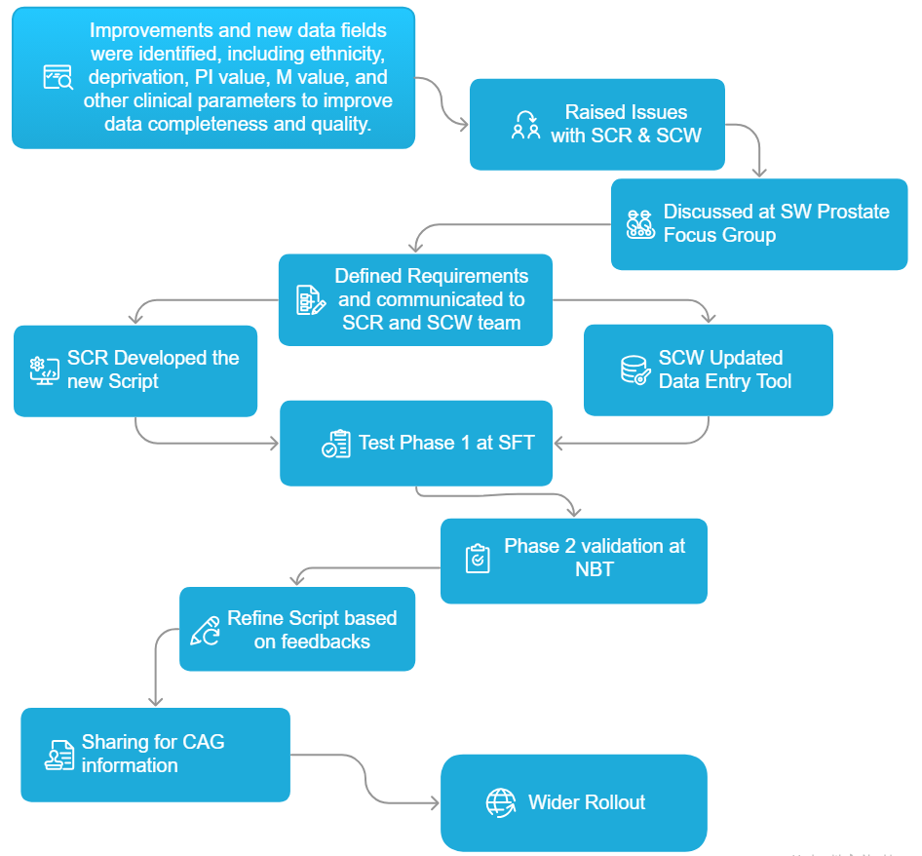
Current SWPD SCR Script roll out project progress

Slide 7
The Script project. Findings
Incomplete data on the SCR . Opportunity to improve quality and completeness.
Data being changed in the SCR by a ‘robot’ that was incorrect . Date of first seen.
Data eg Gleason score in multiple places
Some data not recorded eg personalised , magnet strength,
Trus, hip replacement
Often the date of prostate cancer diagnosis is before the biopsy date.
Clear need for some data to still be put in manually ie Targetted biopsy data , AI, personnel etc

Slide 8
New fields
Deprivation and ethnicity.
Equality of provision identification of high risk groups
AI page

Slide 9
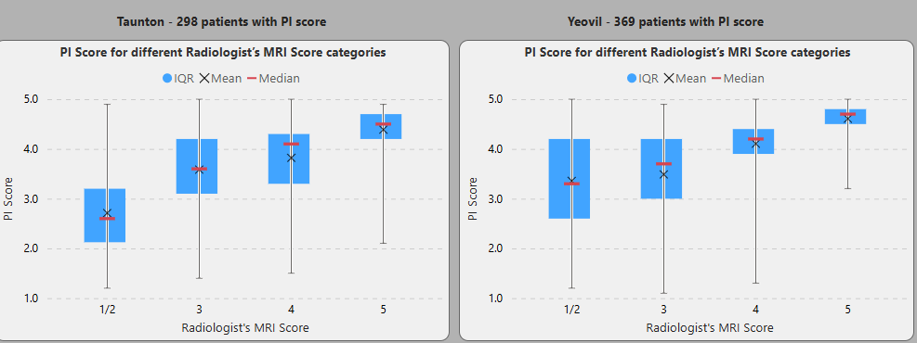
AI page MRI score vs PI score

Slide 10
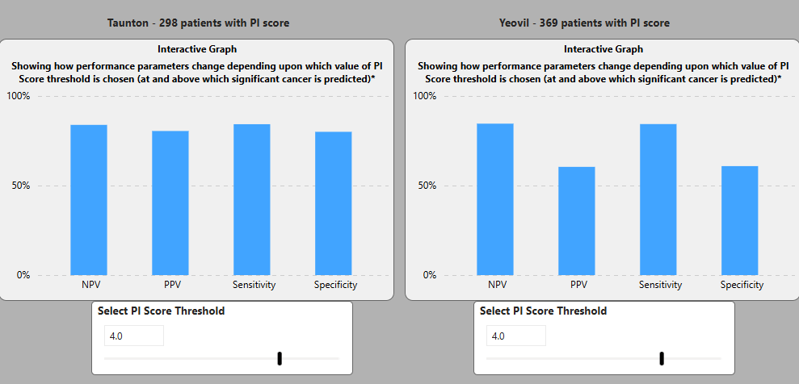
Performance PPV taunton 80% YDH 60 % at a PI threshold of 4

Slide 11
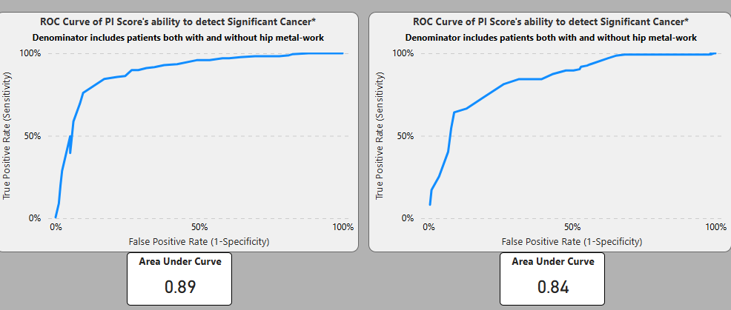
Accuracy ROC Curves .
? Significant variable performance in different providers . AI ? Non generalisable need local data.

Slide 12
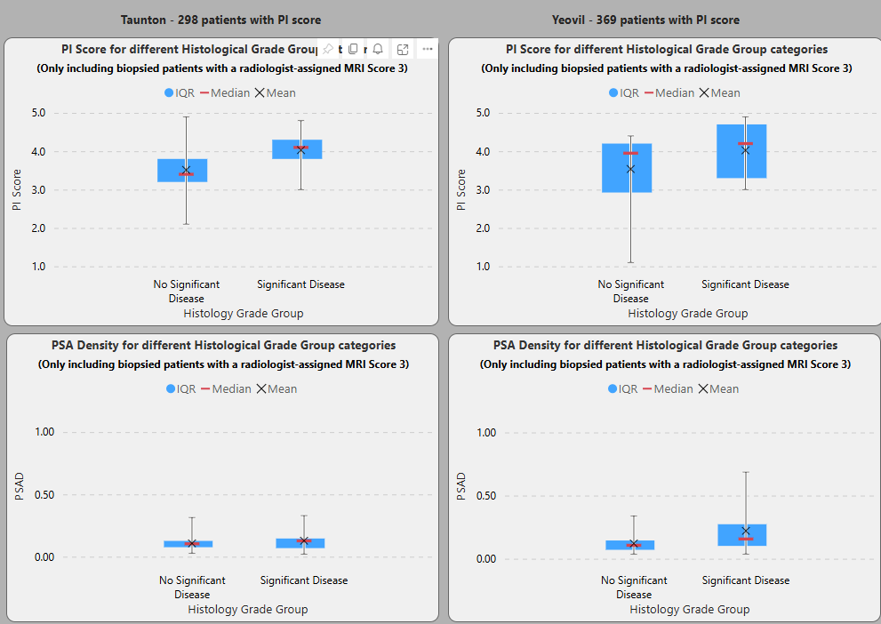
Pirad 3 (n= about 50) ?more discriminative than PSAD

Slide 13
Very significant progress
Great example of collaboration
Thankyou for support from Niki’ s team and SWAG
Dashboards applicable to other cancer sites ie gynae etc if using SCR
A great source of data to improve care but also for QI and research for SWAG.

Slide 14
Thankyou all
Discussion.

