Slide 1
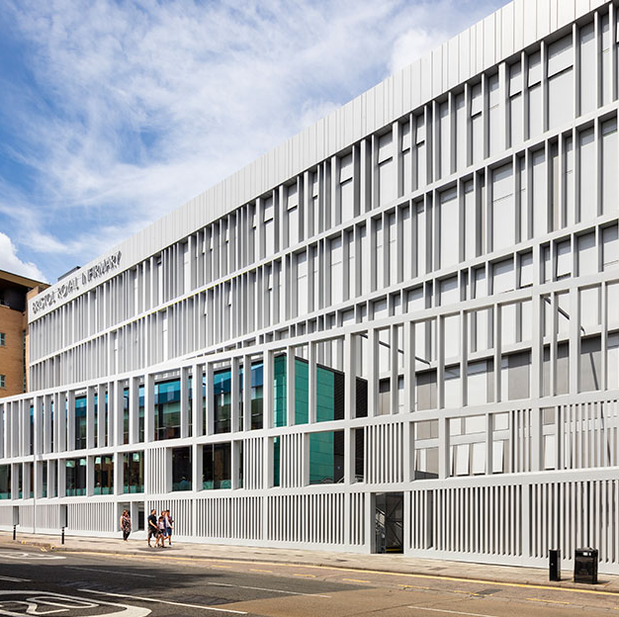
BRI Thoracic surgery service update
Stylianos Gaitanakis
Consultant Thoracic Surgeon
Bristol Royal Infirmary

Slide 2
Team Expansion and Service Growth
Current team: 6 Consultants, 5 Doctors in Training, 5 Lung CNSs
Planned additions: 1 Thoracic Fellows, X CNSs, 1 ANP
Additional 5 operating lists from September 2025
4 Consultants are currently Robotic surgeons

Slide 3
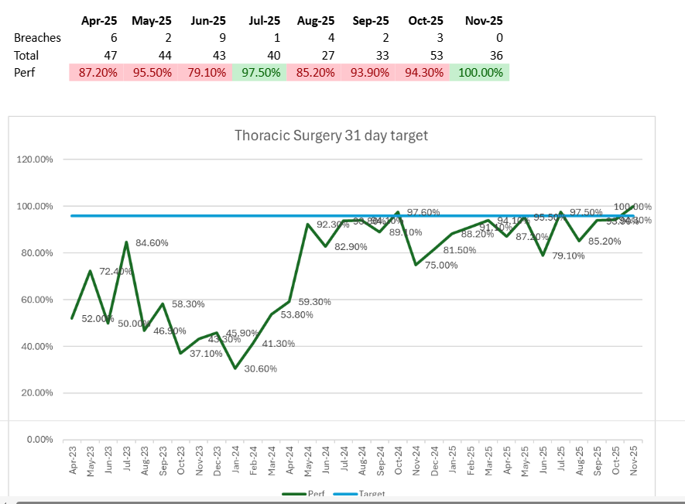
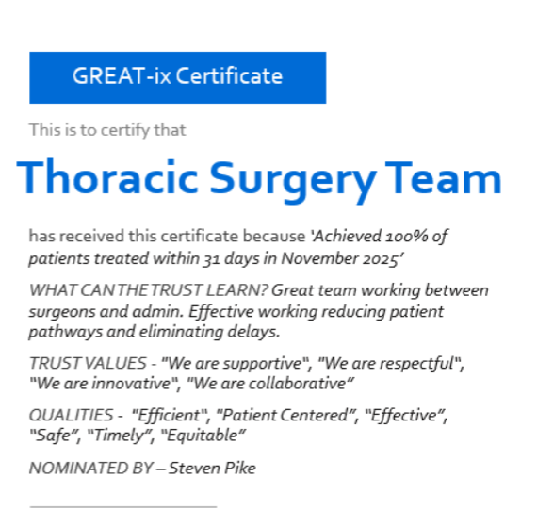

Slide 4
Measures employed
Extended lists: Are here to stay
Glanso lists only when TLHC referrals increase
Additional lists enhanced the 4th Robotic surgeon
Changes in consultant job plans now and in the future
3rd Robot to arrive...

Slide 5
Theatre
1 More surgeon will be trained in Robotics by the end of the year
3D operative preplanning (for segmentectomies)
Robotic surgery led to initial decrease of LOS
First 200+ Robotic cases done with no major issues
Anatomic Lung resections with drain removal on Day 0
Nav Bronch vs ION
Theatre refurbishment

Slide 6
Patient Outcomes and Enhanced Recovery
Early Drain Removal Audit
Audit shows reduction in length of stay from 4 to 2 days
Supported by early drain removal and ERAS protocols

Slide 7
Research, Audit, and Collaborative Learning
Key programmes: FIT for Surgery, LARCS, Pro Seal , MIST 4
Audits: ERAS audits, Navigational Bronchoscopy audit, Physiotherapy audit, Neo adjuvant audits, Octogenarian audit, Patient satisfaction audit
Joint audit meetings with anaesthetists, radiologists, CNSs, and respiratory physicians

Slide 8
Education and International Collaboration
Continued delivery of international VATS segmentectomy courses
Cadaveric and live surgery course scheduled for May 2026 (funded)

Slide 9
Technology and Surgical Innovation
Training all surgeons in Robotics
Establish robotic fellowship programme in 2026

Slide 10
Pathway improvements
Rapid clinic has improved patients’ pathway from Referral to Treatment
Local Pre –op
Rapid clinic trial at Yeovil Hospital
Plan to expand to all peripheral hospitals

Slide 11
Forward planning
More RATS less VATS
Additional lists in 2026
Rapid clinics

Slide 12
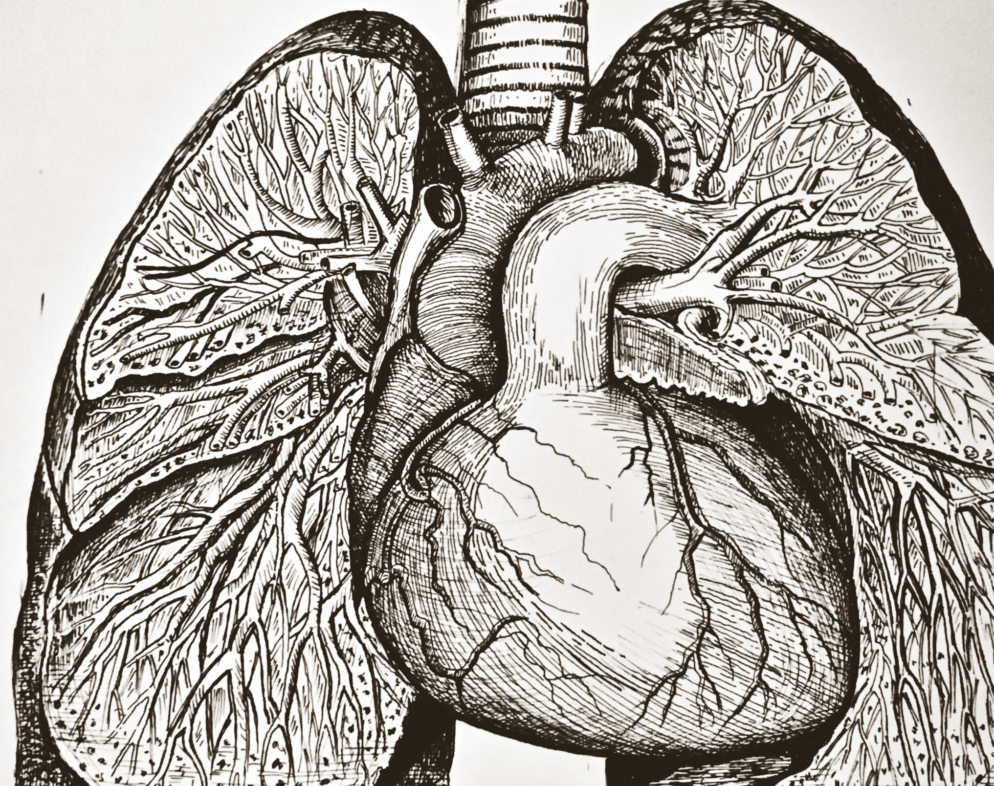
Thank you!!!

