Slide 1


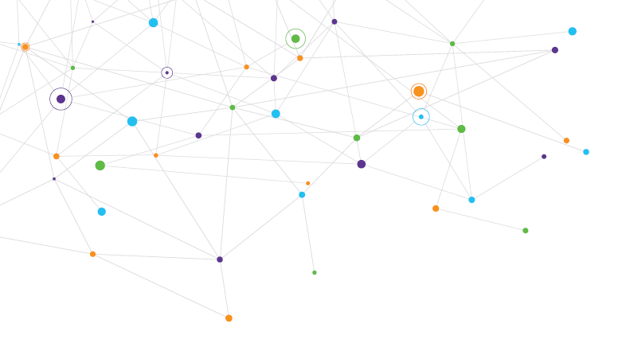
SWAG Cancer Alliance
Planning 2026-2027
Ruth Carr
Managing Director, SWAG Cancer Alliance

Slide 2

SWAG Key Priorities 2026-27
Cancer Performance & Pathway Improvement
Earlier Diagnosis – lung cancer screening, liver surveillance, pancreatic case finding, timely presentation, primary care pathways, innovation, screening, FIT, prevention
Neighbourhood Cancer Care – PSFU, prevention and management of impact of cancer, & treatment, experience of care & engagement
All underpinned by workforce, health inequalities, digital & innovation, engagement and collaboration
Treatment Variation – Implement national priority recommendations from clinical audit/GIRFT reports

Slide 3
2026/27 Cancer Performance & Pathway Improvement
Cancer performance
Develop and deliver plans for operational improvement in all providers currently in the bottom quartile nationally for the 28d FDS, 31d Treatment or 62d Standards, with the goal of delivering a 10%pts improvement in performance, capped at the planning ambitions:
  FDS - 80%
  31 days – 94%
  62 days – 80%
Treatment Focus- Lung cancer (62 day performance) -
  Review expected ongoing increase in demand for curative treatment, particularly considering increases in demand that might be expected as a result of the roll-out of the Lung Cancer Screening Programme.
  Plans should include actions across the staging and treatment phases of the pathway and include all patients, curative and palliative.

Slide 4
2026/27 Treatment Variation: Lung
Deliverables:
Implement national priority recommendations from clinical audit/GIRFT reports to reduce variation in treatment in trusts not meeting the NHS-wide target:
  Lung: 70% of patients with NSCLC stage IIIB-IVB and PS 0-1 receiving systemic anti-cancer therapy (SACT)
  Success measure: (TBC when NLCA State of the Nation report is released - due for publication 12/02/2026)
Actions
Identify a named clinical lead for each core recommendation (if not already done so in 2025/26) and seek to include the implementation of the recommendations and delivery of any QI activities on local
CAG workplans, where an overarching quality improvement collaborative does not yet exist or reporting progress to the overarching quality improvement collaborative.

Slide 5
Neighbourhood priorities for Early Diagnosis 26/27
Improving early diagnosis of cancer / Reducing late-stage diagnosis of cancer
Primary Care
Innovation
Screening
Timely presentation
Prevention
Neighbourhood Empowerment
Workforce support and education
Community outreach and engagement
Partnerships with the VCFSE
Awareness raising and campaigns
Data driven Targeted Interventions
PPVs/Cancer Champions
Reducing Health Inequalities including rare and less common cancers
Notes:
CXR Lung
Self referral pilots
EOI: 111 Online self-referral - (opt-in only): Support the development and local delivery of 111
online case-finding pilots to improve access for people at high risk of a cancer diagnosis,
initially focusing on breast and expanding to lung.
Prevention new

