Slide 1
A very brief update on tenosynovial giant cell tumour (T-GCT)
Sarcoma Clinical Advisory Group
Friday 10th October 2026
Consultant Oncologist Tim Spencer

Slide 2
T-GCT and challenges
Rare benign but locally aggressive tumour of synovium
Localised (single nodule/nodular tenosynovitis)
Diffuse (previously PVNS)
Surgery not always feasible (diffuse T-GCT, excessive morbidity)
High risk of local recurrence after surgery
Systemic treatments limited
Radiotherapy not standard

Slide 3
Drug | Mechanism | Trial | Approval status | Toxicity
Vimseltinib (Romvimza) | Selective inhibitor of CSF1R | Phase 3 MOTION trial: Ph3 db RCT for inoperable TGCT ORR 40% at 25 weeks (vs 0%) Clinically meaningful functional/symptomatic improvement | Approved in US & EU (surgery unsuitable) NICE STA suspended (?company not seeking approval) | Well tolerated Mostly G1/2 adverse events (liver, skin)
Pexidartinib (Turalio) | CSF1R tyrosine kinase inhibitor | ENLIVEN trial: Ph3 db RCT ORR ~38% at 25 weeks | Approved in US | Risk of severe liver toxicity
Emactuzumab | Monoclonal antibody against CSF1R | TANGENT trial: Ph3 db RCT Actively recruiting (Oxford, UCLH, Leeds) | Not yet approved | No data
Imatinib | CSF1R tyrosine kinase inhibitor | No RCT Cassier et al 2012 – multicentre retrospective study: 5/27 pts responded; 16/27 stable | Has been approved locally for off-label treatment | Mostly G1/2 adverse events (GI, skin, oedema)
Notes:
CSF1 = Colony-stimulating factor 1 receptor

Slide 4
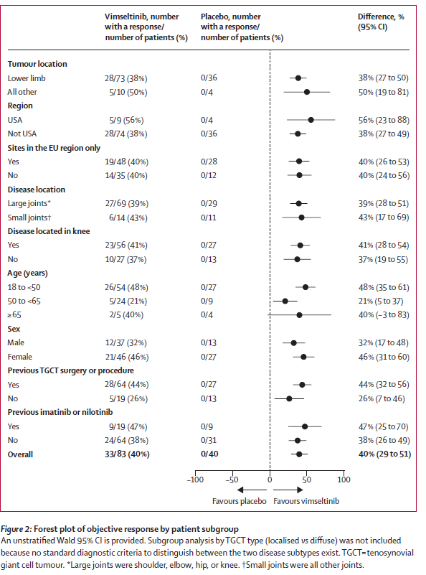
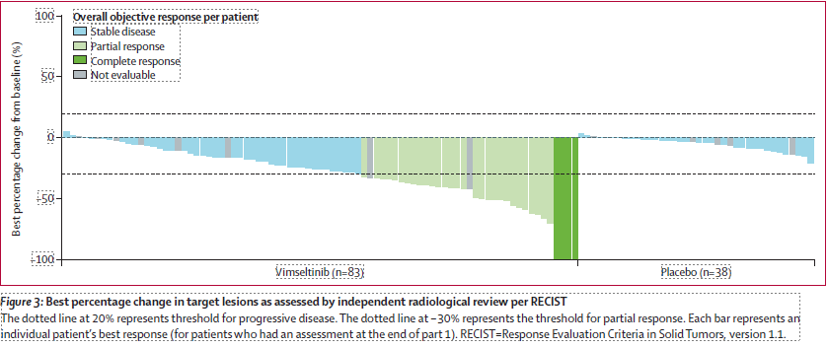

Slide 5
Drug | Mechanism | Trial | Approval status | Toxicity
Vimseltinib (Romvimza) | Selective inhibitor of CSF1R | Phase 3 MOTION trial: Ph3 db RCT for inoperable TGCT ORR 40% at 25 weeks (vs 0%) Clinically meaningful functional/symptomatic improvement | Approved in US & EU (surgery unsuitable) NICE STA suspended (?company not seeking approval) | Well tolerated Mostly G1/2 adverse events (liver, skin)
Pexidartinib (Turalio) | CSF1R tyrosine kinase inhibitor | ENLIVEN trial: Ph3 db RCT ORR ~38% at 25 weeks | Approved in US | Risk of severe liver toxicity
Emactuzumab | Monoclonal antibody against CSF1R | TANGENT trial: Ph3 db RCT Actively recruiting (Oxford, UCLH, Leeds) | Not yet approved | No data
Imatinib | CSF1R tyrosine kinase inhibitor | No RCT Cassier et al 2012 – multicentre retrospective study: 5/27 pts responded; 16/27 stable | Has been approved locally for off-label treatment | Mostly G1/2 adverse events (GI, skin, oedema)
Notes:
CSF1 = Colony-stimulating factor 1 receptor

Slide 6
Treatment options
Localised
Diffuse
Surgery (total synovectomy)
Surgical excision
Systemic therapy
Imatinib
TANGENT trial (Emactuzumab)
Compassionate access
(Vimseltinib/Pexidartinib)

