Slide 1

Sarcoma Pathology update autumn 2025

Slide 2
Tenosynovial giant cell tumour - clarification
Tenosynovial giant cell tumour can be diffuse or localised.
Historically the diffuse type was also called pigmented villonodular synovitis.
These are the same tumour, but with different growth patterns.

Slide 3
The difference is radiological, not on the pathology
LOCALISED = CIRCUMSCRIBED
DIFFUSE= INFILTRATIVE

Slide 4
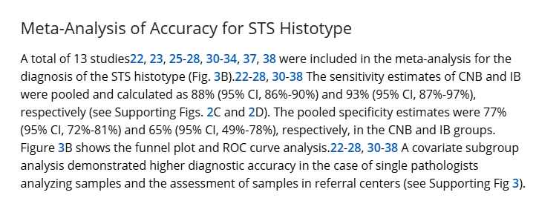
A refresher on the limitations and benefits of core biopsy – for tumour subtyping

Slide 5
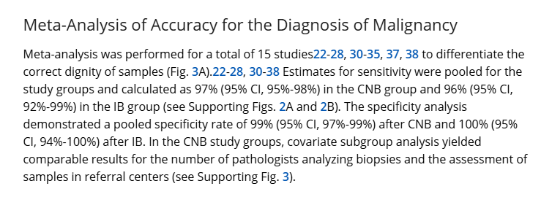
How about for basic benign vs malignant?
Birgin E, Yang C, Hetjens S, Reissfelder C, Hohenberger P, Rahbari NN. Core needle biopsy versus incisional biopsy for differentiation of soft-tissue sarcomas: A systematic review and meta-analysis. Cancer. 2020 Jan 1;126(9):1917-1928. doi: 10.1002/cncr.32735. Epub 2020 Feb 5. PMID: 32022262

Slide 6
Why we want to be specific
Accurate diagnosis is integral to our professional role and credibility as a specialist soft tissue pathology unit – the pathology team will aim to make the most accurate diagnosis they can from the tissue available. This will take more testing and time. Our aim if to limit those statistics.
There are few specific treatments for this patient group now, but it is only by being specific in diagnosis that there will be any in the future. The tumours are wildly different from each other biologically.
The prognosis of these tumours can be very specific and for personalised care, may be best managed with the specific tumour type in mind, rather than a low grade/high grade split.

Slide 7
Examples
Myxoinflammatory fibroblastic sarcoma = 1% metastasis rate, local recurrence +++
Pseudomyogenic haemangioendothelioma= 60% local recurrences (often multiple – lytic in bone, intramuscular and subcut) or develop additional nodules in the same anatomical region. Regional lymph node and distant metastases <5%, most often occurring years or decades after presentation.
Clear cell sarcoma = recurrence rates approaching 40% and pulmonary or lymph node metastasis in at least 30–50% of patients. Metastasis often occurs more than a decade after initial diagnosis. Survival rates at 5, 10, and 20 years are approximately 60%, 35%, and 10%, respectively

Slide 8
Uncertainty – why we can’t always be sure what it is
Tumour heterogeneity and lack of specific markers.
Unknown unknowns – in 2010, 20% of the papers in modern pathology were on soft tissue tumours.
They are not all described yet and if we confidently categorise them all, some of those will be wrong.

Slide 9
Belts and braces – genetic testing
Many tumours can be diagnosed without genetic testing but given the imitations of core biopsy our team has a low threshold for genetic testing.
Genetic testing adds in time, but increases accuracy.

Slide 10
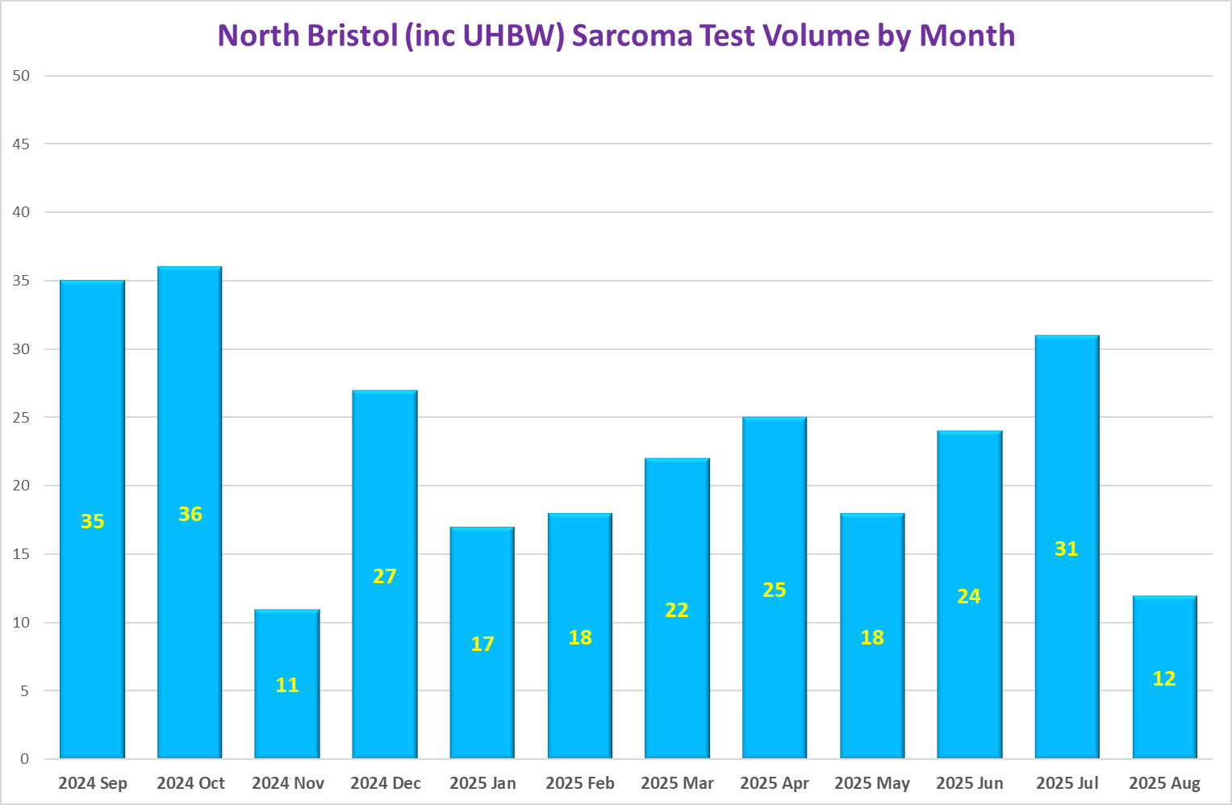

Slide 11
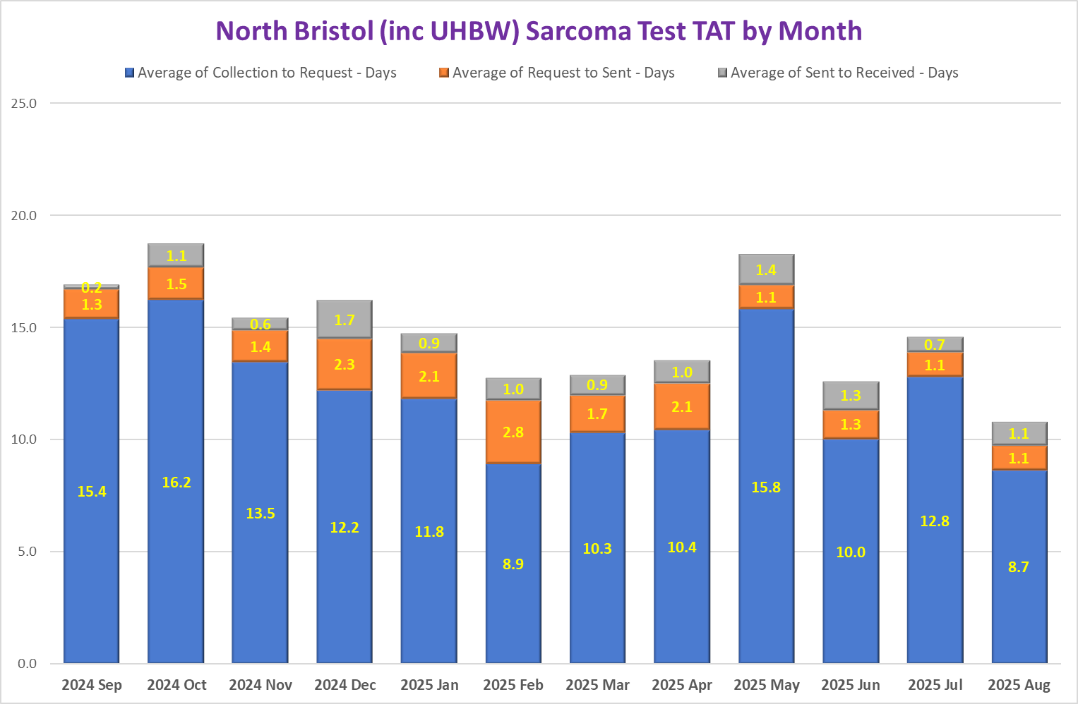
N.B. Average of sample collection to request calculation excludes requests >28 days after sample collection
N.B. The 12 months Average Sample Collection to Sample Received time is 15.9 days.

Slide 12
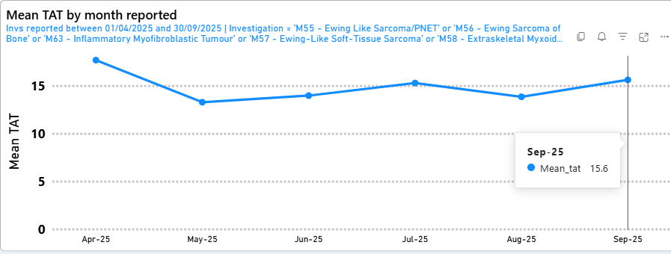
Average genomics sarcoma panel turnaround time
Average (days) from receipt by genomic lab to genomic report being issued
Turnaround time target 14 days. Compliance ~75%

