Slide 1


Retroperitoneal Sarcoma Service North Bristol NHS Trust
SWAG Sarcoma Clinical Advisory Group Ahmed Mahrous Consultant urological Surgeon

Slide 2
Sarcomas are rare - they represent only about 1% of all cancers
Retroperitoneal sarcomas 10% - 15% of all soft-tissue sarcomas.
The most common two types of retroperitoneal sarcomas are:
Liposarcoma Leiomyosarcoma other less common types solitary fibrous tumours, synovial sarcoma and PEComa.

Slide 3
The Bristol Sarcoma Service (BSS) manages sarcomas for Bristol and the surrounding region including:
Bath
Weston
Yeovil
Taunton
Other south west regional services are currently located in Plymouth

Slide 4

Our Sarcoma MDT Team
Consultant Oncologists Dr Gareth Ayre Dr Adam Dangoor Dr Timothy Spencer
Consultant Radiologists Dr Brathanban (Ben) Rajayogeswaran Dr Edward Walton
Reteropertoienal Surgeons Mr Salah Albuhessi Urological Surgeon Mr Ahmed Mahrous Urological Surgeon
Consultants Histopathologists Dr Naomi Carson Dr Demetris Poyiatzis Dr Francesca Maggiani
Clinical Nurse Specialists Christine Millman Rebecca Peach Sally Lovell Sarcoma Cancer Support Worker Hannah Hilton
Extended Members Miss Ann Lyons Colorectal Surgeon Prof Angus McNair Colorectal Surgeon Mr Reyad Abbadi HPB Surgeon Mr Marcus Brooks Vascular Surgeon Mr Ian Harding Orthopaedic Spinal Surgeon
MDT Coordinator Rosemary Rose

Slide 5
Referral & Triage
- 2WW / incidental / secondary care
- Discussed at Sarcoma MDT
Diagnosis
- CT CAP baseline
-+/-MRI
+/-PET-CT selected - Image-guided biopsy* (CT- IR or US -OP one stop clinic)
Pre-treatment Workup
- MDT review
- Surgical planning
- Patient counselling Prehab + Anaesthetic review
*biopsy is strongly recommended, unless the imaging reviewed in sarcoma MDT is pathognomonic of liposarcoma UK guidelines for the management of soft tissue sarcomas British Journal of Cancer, May 2024
Treatment
- Neoadjuvant RT in selected cases
- Surgery: aim is En-bloc R0
- Multivisceral resections
Post-treatment Care
- ITU/HDU support
- Rehab + physio
- CNS
- Post op Histology review in MDT, - Follow up Clinic

Slide 6
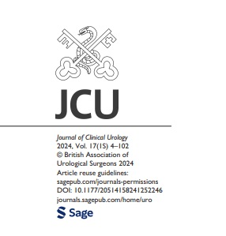
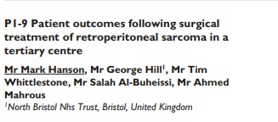
Latest audit on retroperitoneal sarcoma
103 patients underwent surgery for RP sarcoma 2016–2023
78/103 patients had Confirmed retroperitoneal sarcoma on final histology
R0 64.9%
R1 31.1%
5 years overall survival 69.1%

Slide 7
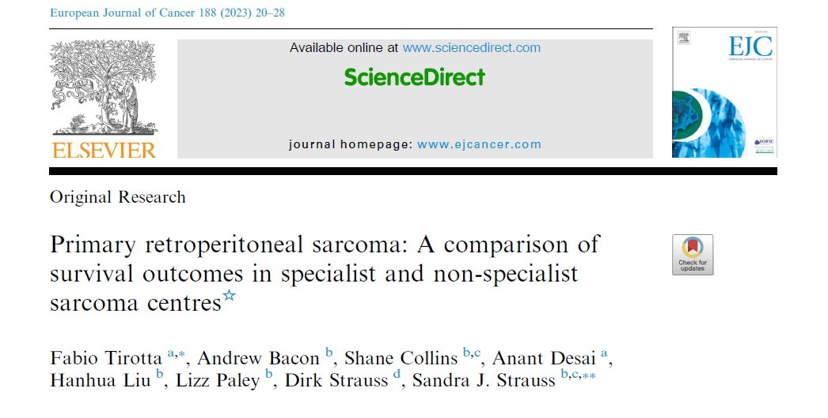
Benchmark 5 years Survival 62.8%
Our 5 years overall survival 69.1%

Slide 8
Strengthen regional collaboration Ongoing audit to benchmark outcomes

