Slide 1
A little on Mohs…
Mohs for squamous cell carcinoma
Management of MIS with regression
Will Hunt

Slide 2




Slide 3
Mohs surgery

Slide 4
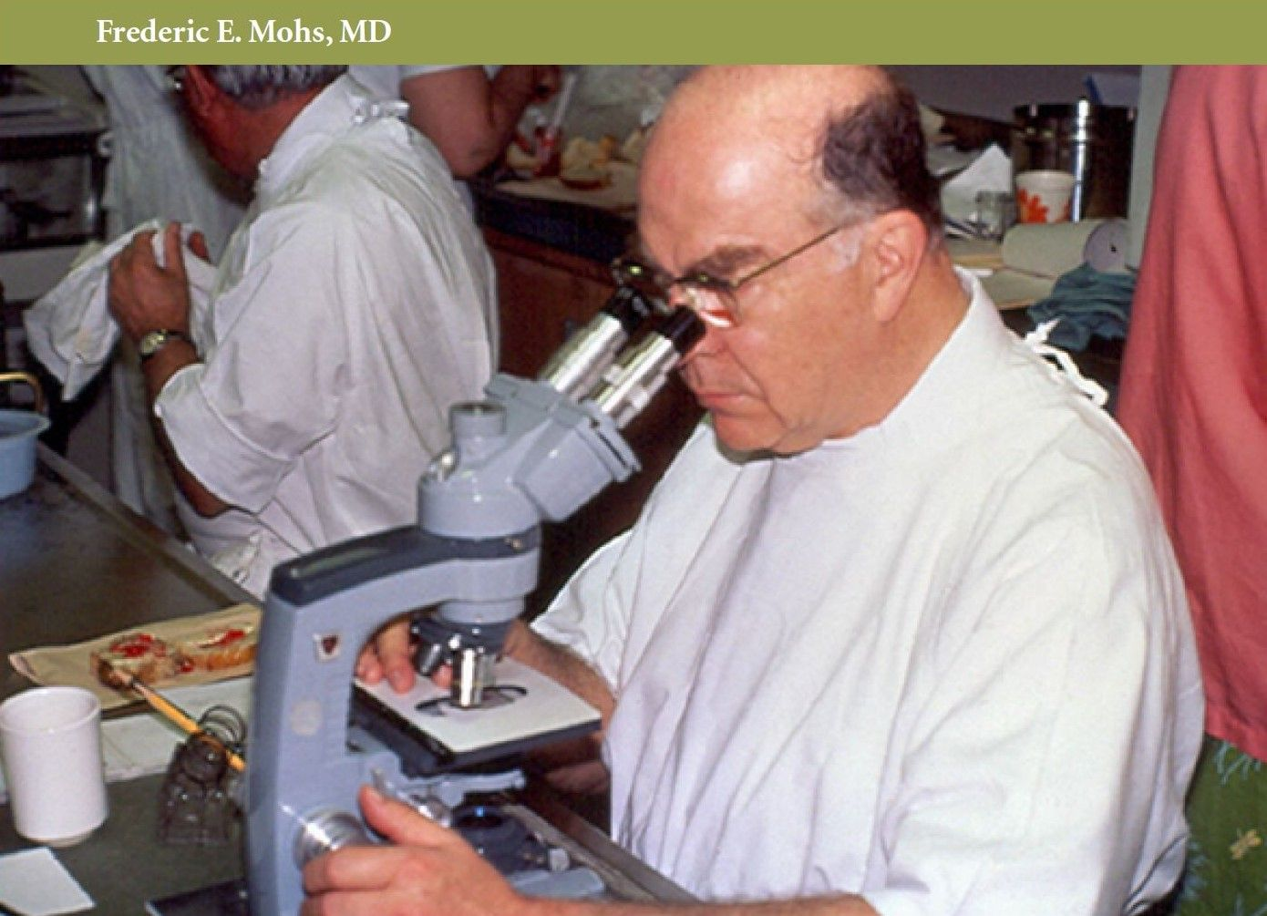
Notes:
1930 American general surgeon called Fred Mohs starting developed the origin of what we call today Mohs.
He fixed cancers in situ with Zinc paste under local hence it was originally called chemosurgery and mapped the tumour excisions out.

Slide 5
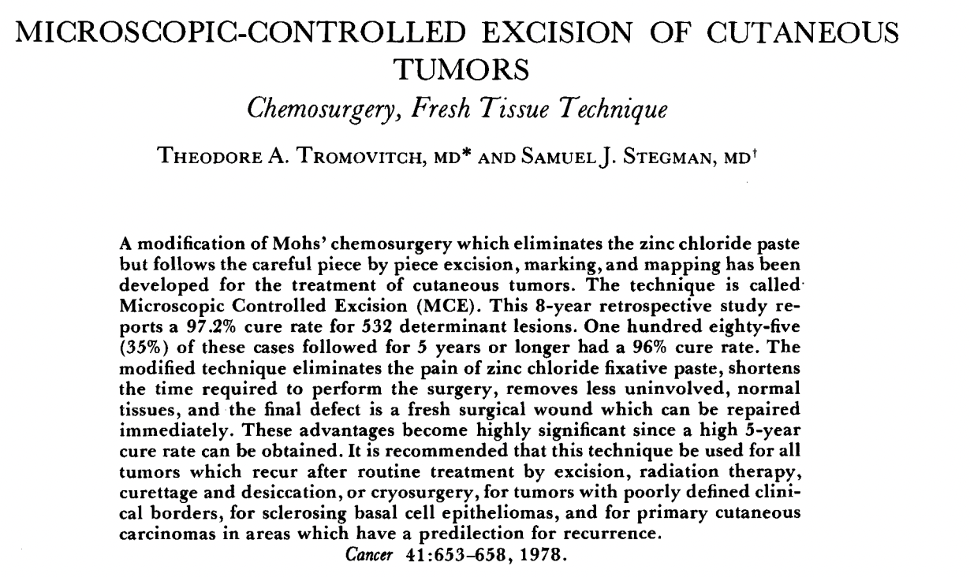
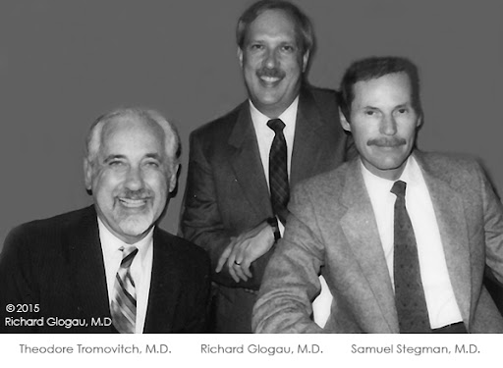
Notes:
Dermatologists were the most interested in the technique, and the number grew.
In the 70s American dermatologists Tromovitch and Stegman developed the technique further with the introduction of fresh frozen tissue removals.

Slide 6
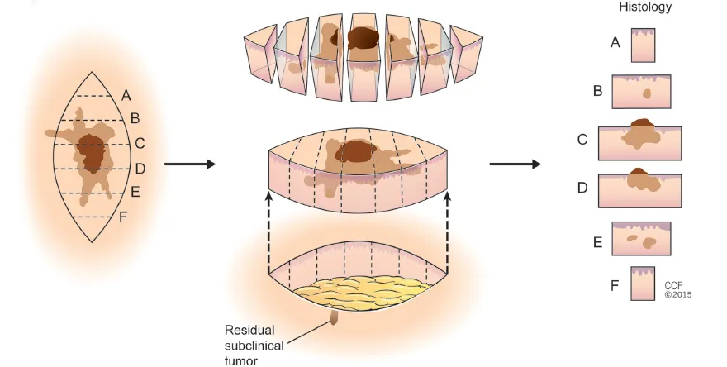
Breadloafing vs Mohs Sectioning
Notes:
So what is so great about Mohs. Well to understand, we need to understand how tissue specimens are processed: breadloafing of the histological specimen has been the conventional way of assessing specimens: slicing it up like a loaf of bread and looking end on between those slices. If tumour does not go to marginal surface then called clear,
but can miss tumour projections going to the margin: assessment is typically a few percent of marginal surface. That is why tumours recur when declared clear.

Slide 7
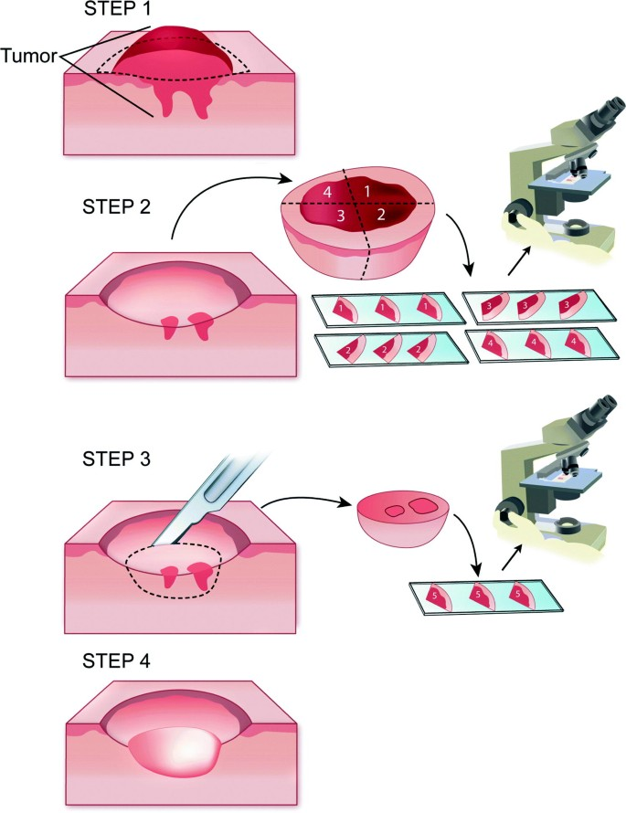
Mohs Sectioning
Notes:
Mohs looks at 100% margin, since Mohs layers flattened on and sectioned to show deep and peripheral margin in one plane.
With the map, can trace any residual tumour back to surgical defect and resect it in stages.
Mohs tho, does have disadvantages, frozen IHC has not yet hit the UK and that means assessment is reliant on H&E and conventional stains only and is time consuming.
We have a strong collaboration with the pathology team for this service.

Slide 8
Mohs surgery for SCC

Slide 9
Mohs on Mohs for SCC
Mohs described his cohort of cSCC patients in 1978:
In total 10/822 (1.2%) cSCCs recurred following MMS using frozen tissue process. FU 1-22 years.
Single surgeon
Large loss to FU
Historic data
Mohs FE. Chemosurgery: Microscopically Controlled Surgery for Skin Cancer. Springfield: Charles C. Thomas Publisher, 1978.
Notes:
Concept of Mohs for SCC is nothing new. Mohs surgery has been used on SCCs and BCC since is its inception. In fact the first Mohs case was completed on an SCC.

Slide 10
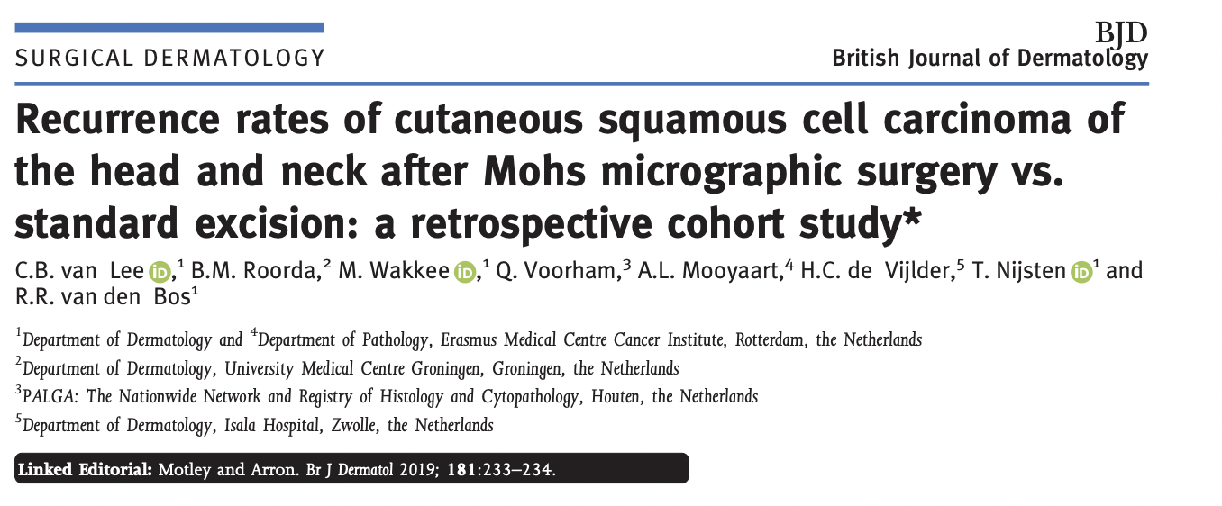
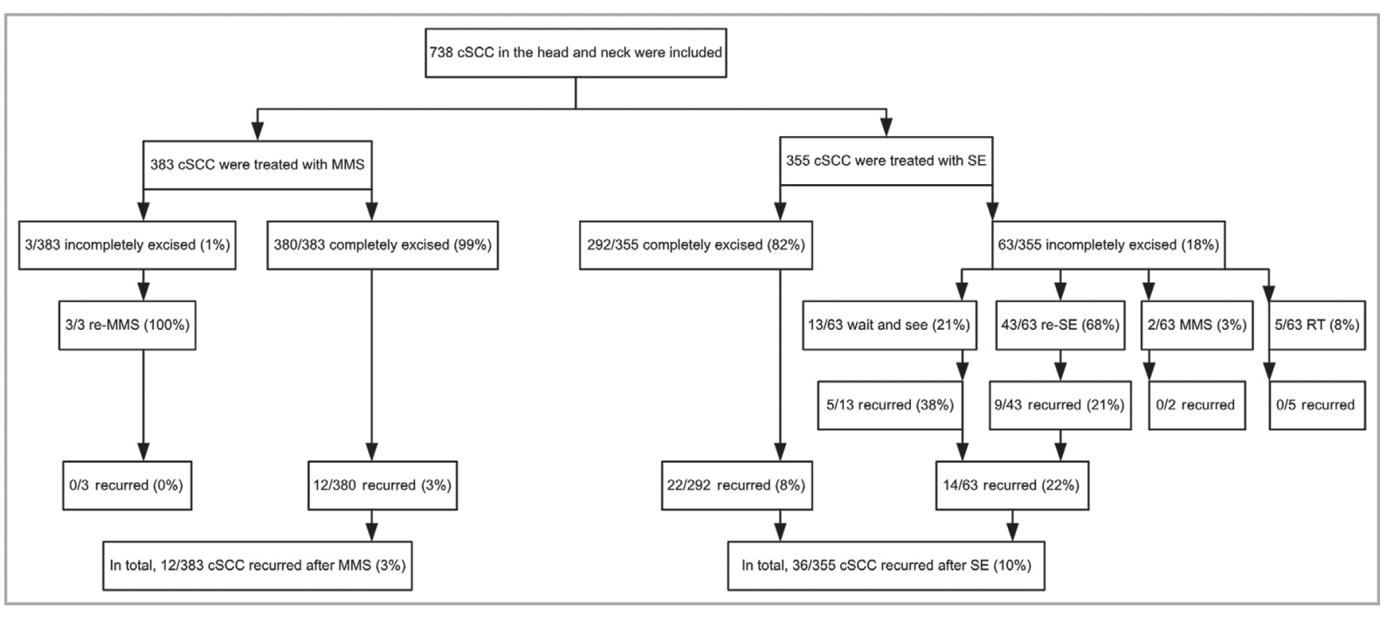
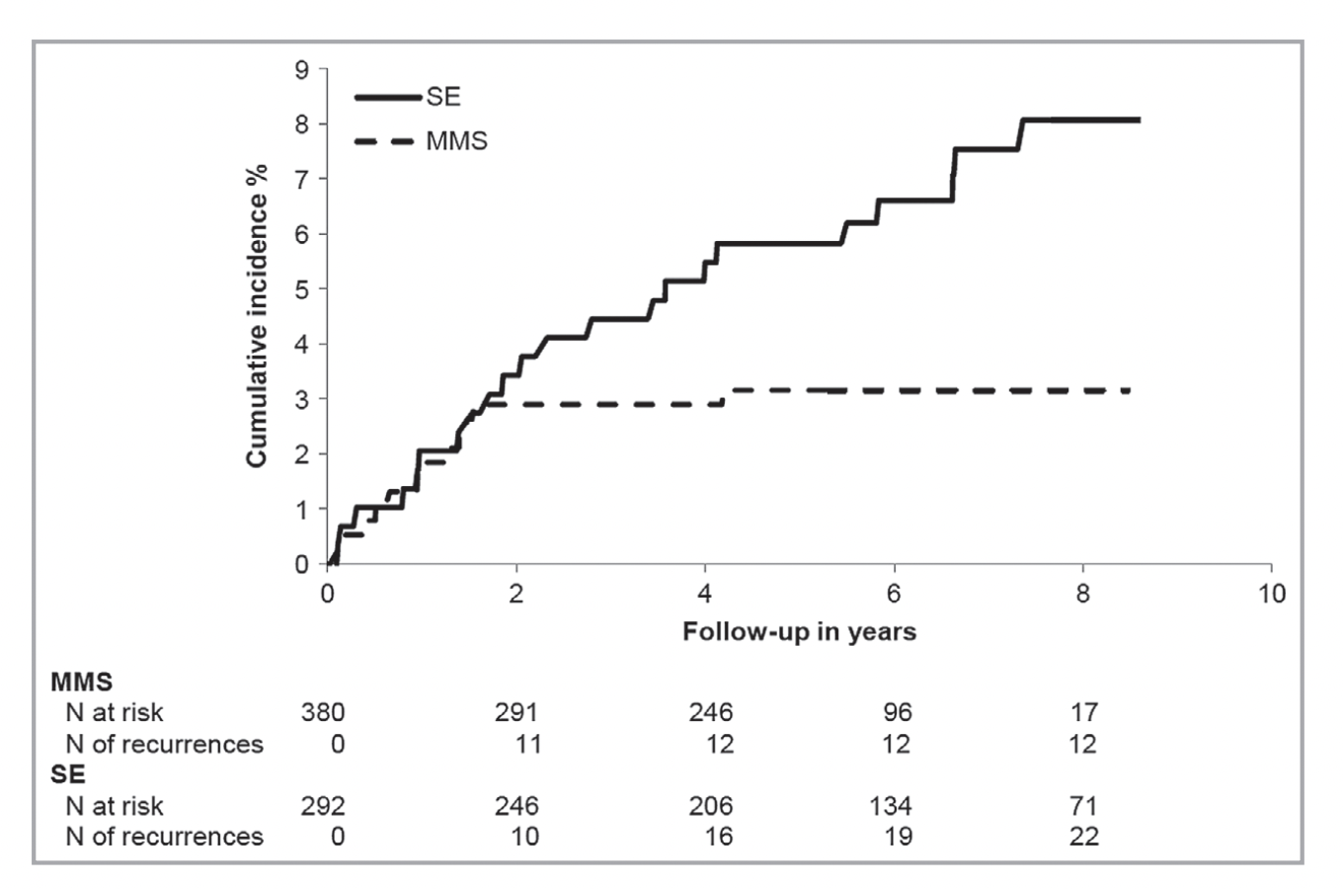
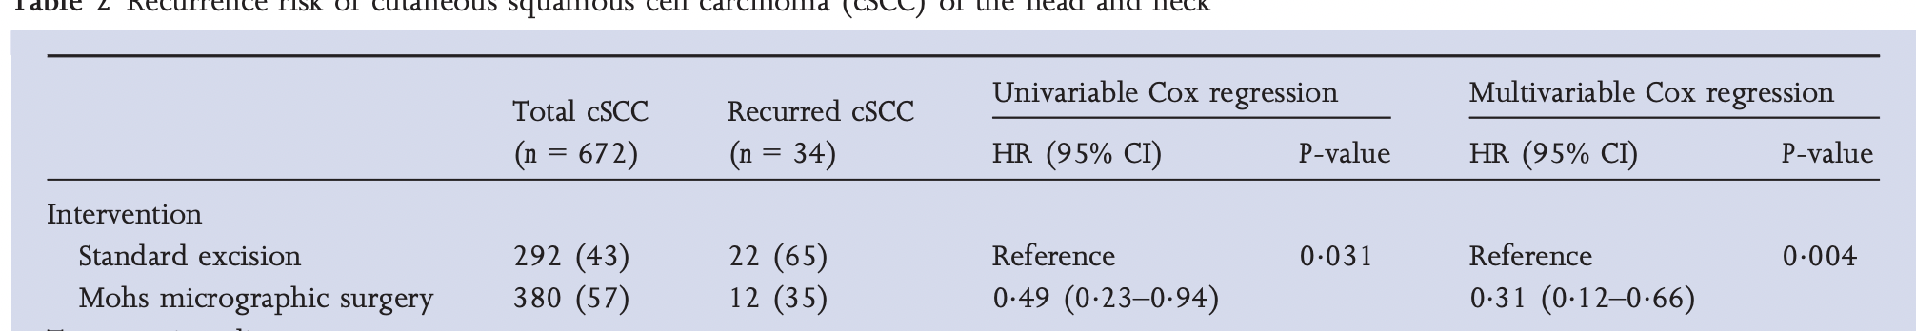
Notes:
Moving to more contemporary data this cohort study was published in the BJD in 2019: This was in the Netherlands in two centres. 5 year median FU. SCCs either were operated on by MMS or by Excisions with a 5-10mm margin. For the study 4 dermatopathologists subsequently second reported all specimens .
Mohs surgery (383 SCCs) noted to have a complete excision rate of 99%. SE complete excision rate of 82% (355 SCCs)
Of the 99% completed excised Mohs surgery tumours 3% locally recurred. Of the 82% completely excised SCCs with SE. 8% locally recurred which was statistically significant. Patients were linked to the the national dutch cancer database to ensure all recurrences identified.
Size and depth 3x less likely to recurr.

Slide 11
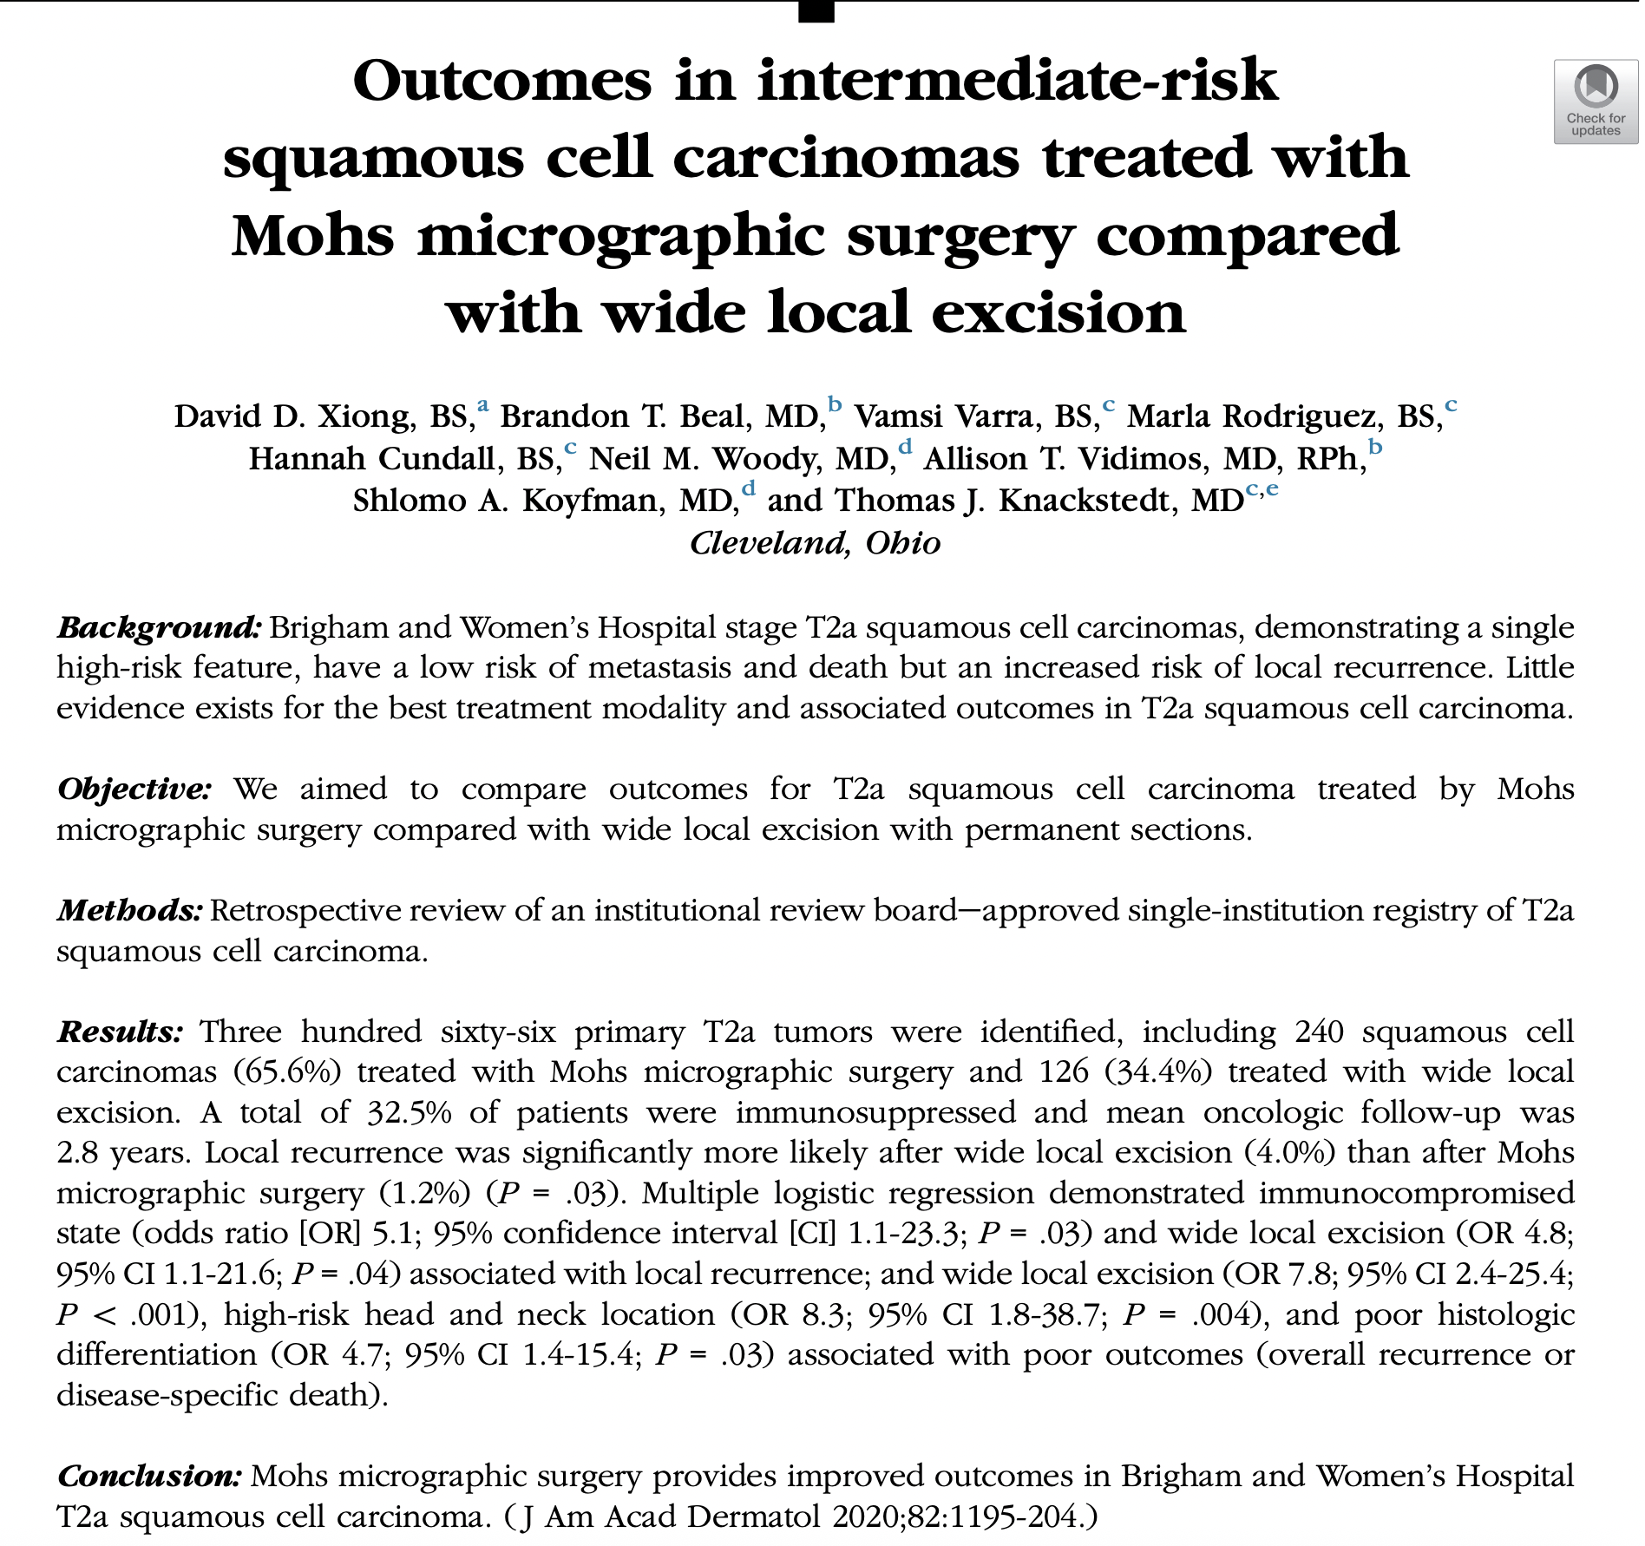
A BWH T2a tumor has one of the following four major risk factors:
Primary tumor diameter of 2 cm or greater
Tumor invasion beyond subcutaneous fat
Large-caliber PNI ( ≥0.1 mm in diameter)
Poor differentiation
Notes:
2020, single institution study in what we would call high-risk SCC: similar findings. Mohs significantly less likely to recur than standard excisions
5.6mm margin.

Slide 12
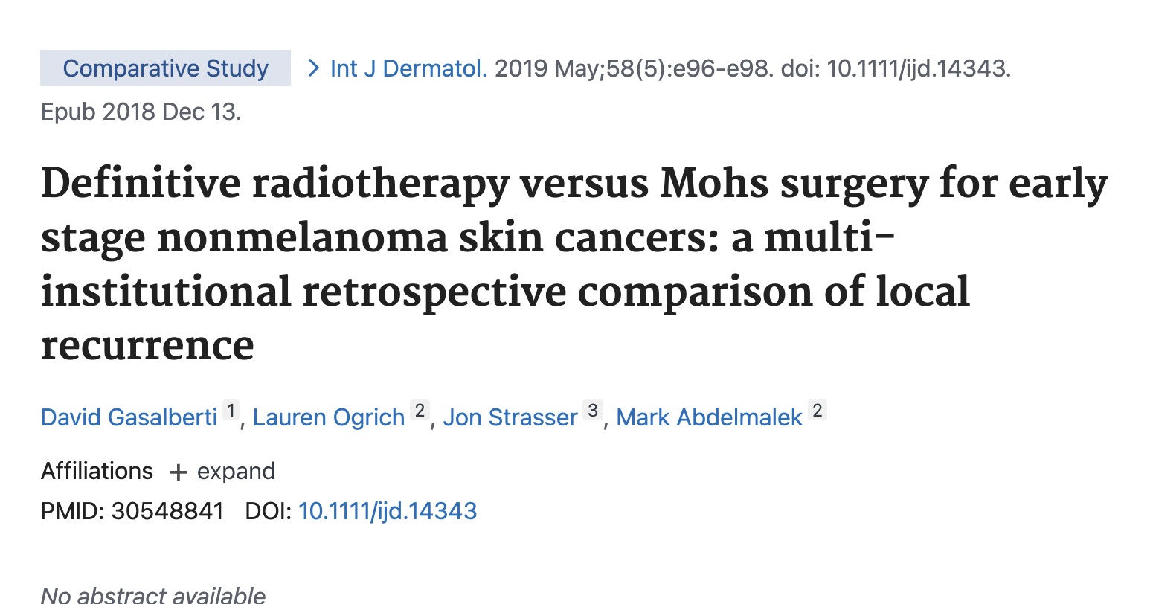
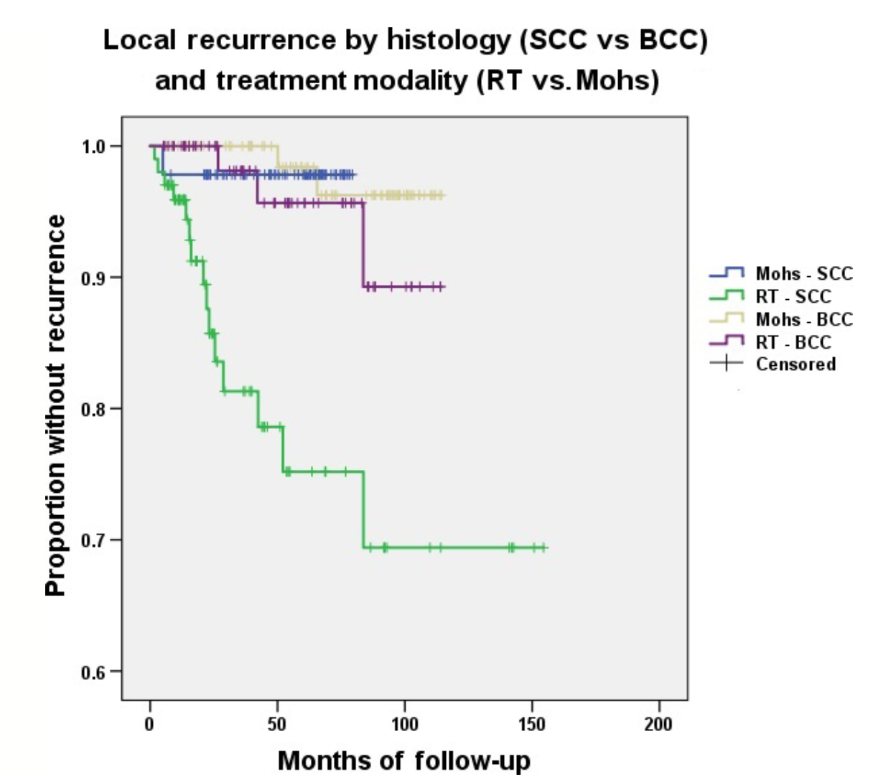
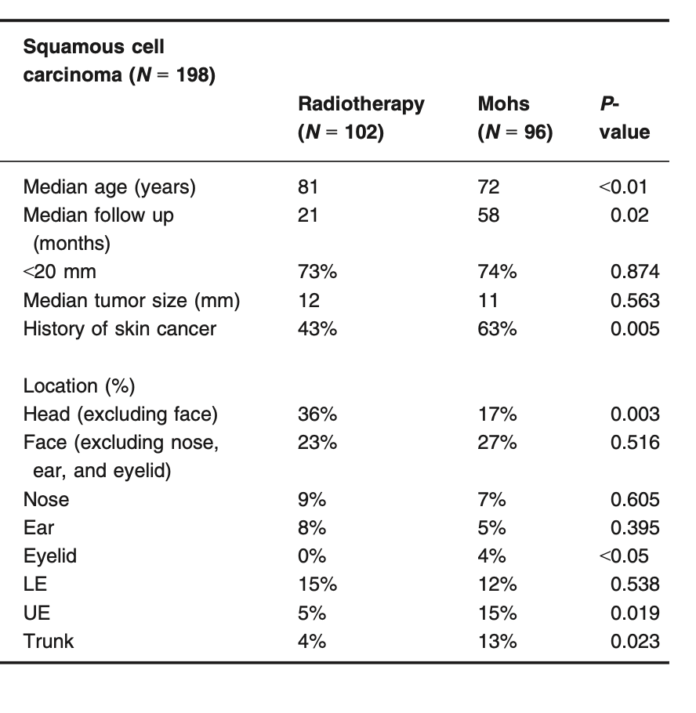
Notes:
Oncologists!!
MMS for T1-T2 cSCC had a superior rate of local control at 5 years when compared to RT alone (98 vs. 75% P < 0.01).
Median follow-up 21 months RT, median follow-up 58 months MMS
RTX being heterogenous approaches but mostly commonly electrons. 6MeV (megaelectronvolt)

Slide 13
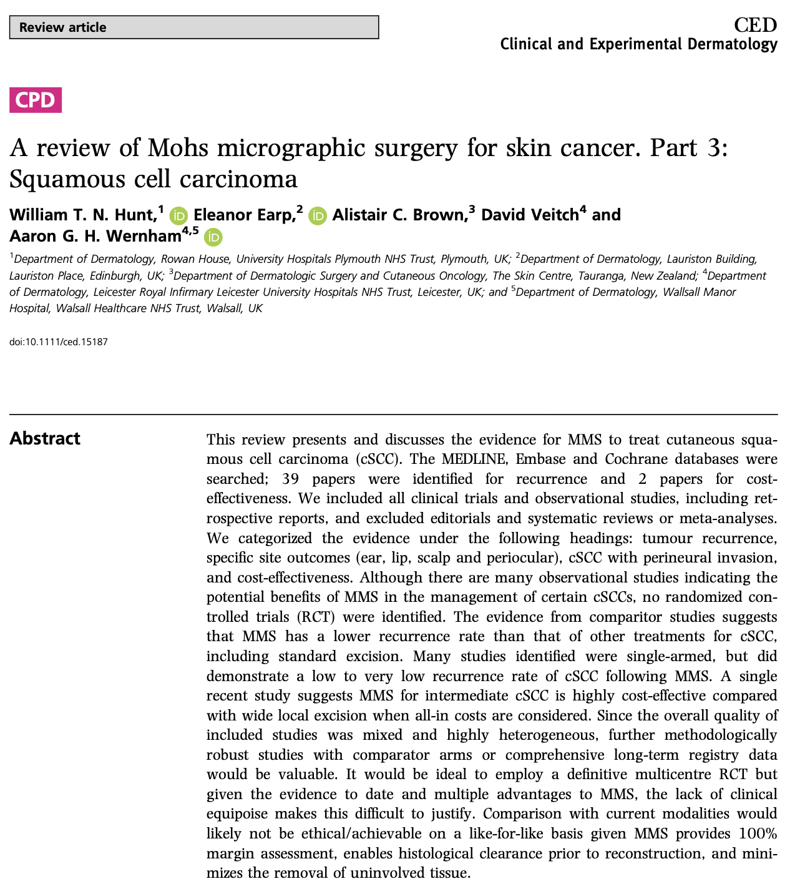
Notes:
I undertook this systematic review in 2021. Evidencing the use of Mohs in SCC. Consistently extremely low recurrence rates. Many studies were non-comparitor studies, but of those that were: Mohs trended or was significantly less likely to recur with Mohs compared to: excisions, radiation, and cryosurgery.

Slide 14
Guidelines

Slide 15
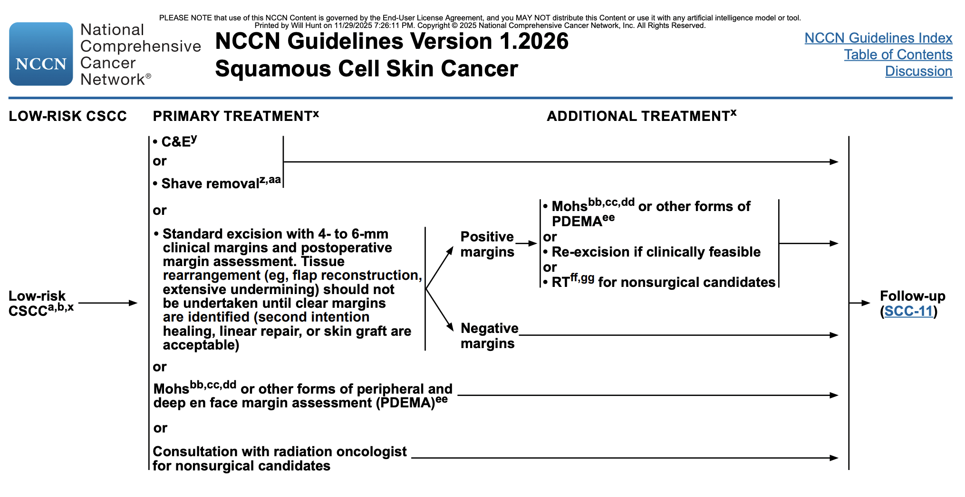
Focal SCCIS
Notes:
NCCN guidelines. This is the American guidance, it is a living guideline.

Slide 16
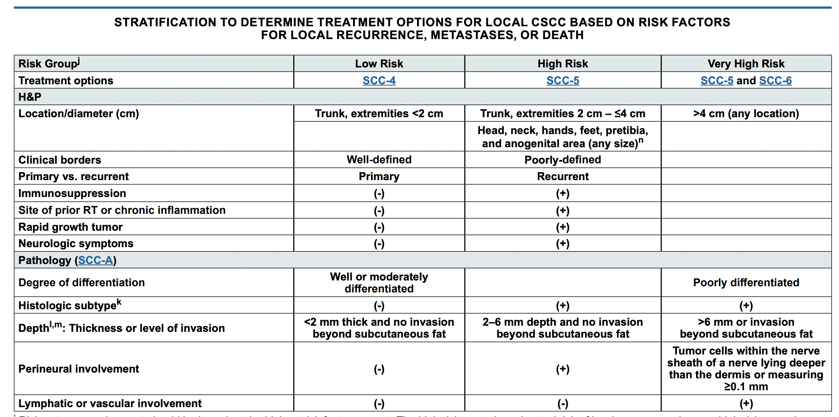
Notes:
Surprise is that all head and neck tumours and digits all qualify has high risk. Very High risk would be TNM pT3, but also poorly differentiated.

Slide 17
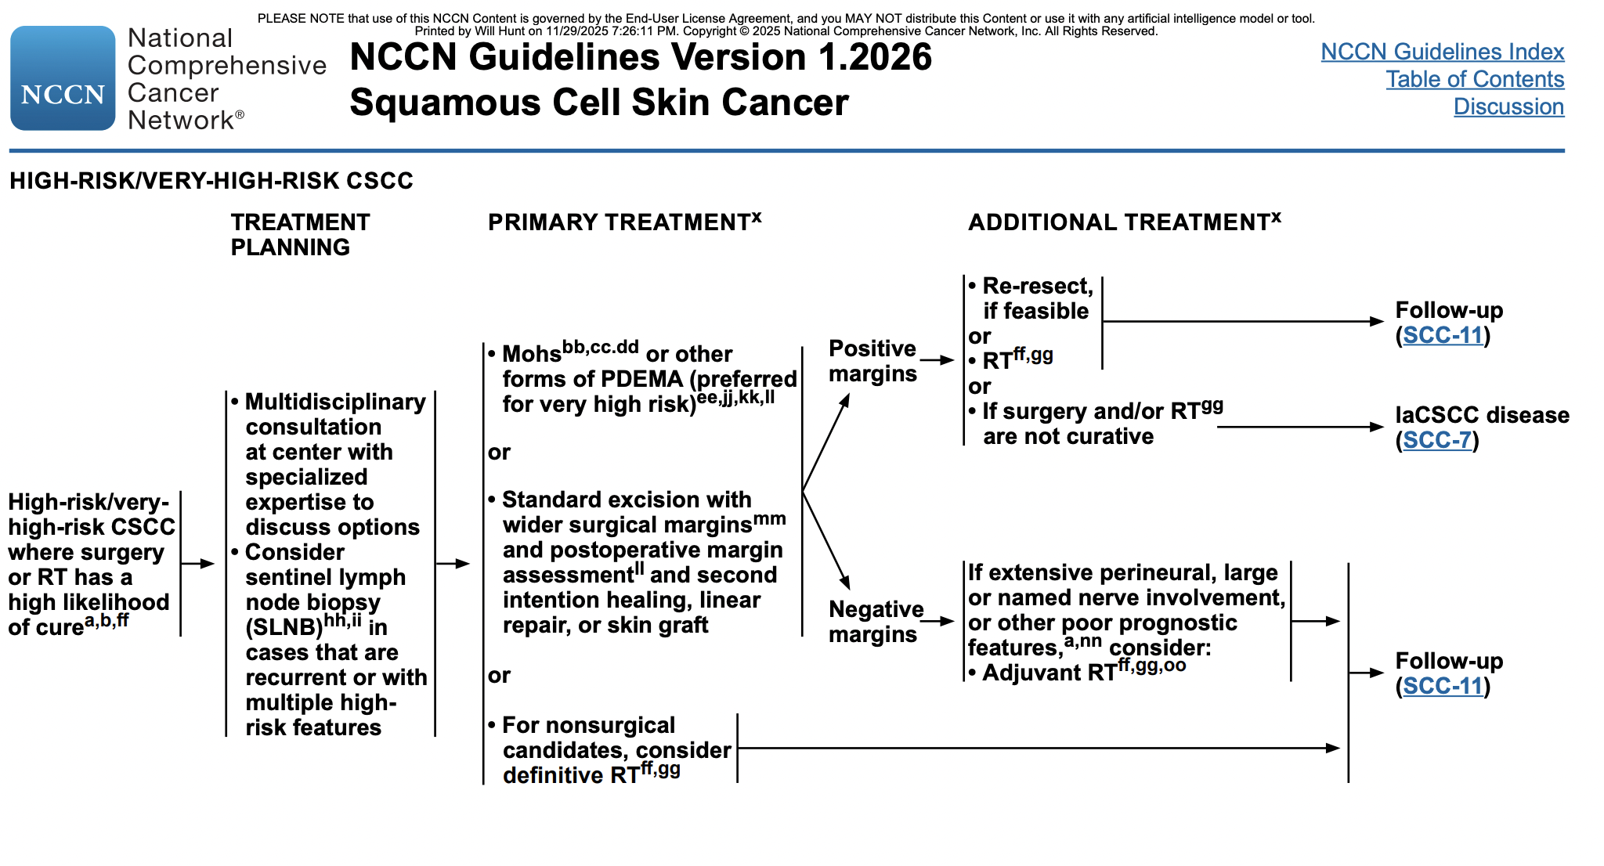
Notes:
NCCN guidance for high / very high risk.
Mohs first line, partic if very high risk.
SE also an option but with non-tissue rearrangement reconstructions
So Mohs is positioned quite favourably for patients

Slide 18
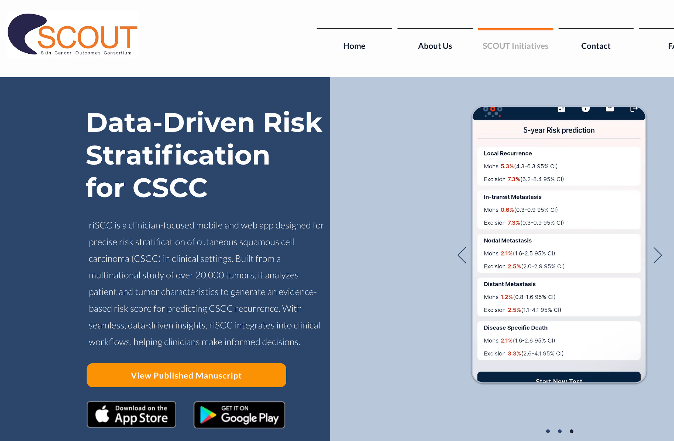

Notes:
To also aid decision making:
Scout App. At this years’ ACMS meeting presented Risk stratification tool for SCC. Useful to help shape decision making re tumours and recurrence risk. 20,000 tumours, managed with Mohs and SE in large cohort study from several counties.
Plug in patient details and see risks of LR, nodal, and distant mets for that patient and their cancer.
Helps inform decision making

Slide 19
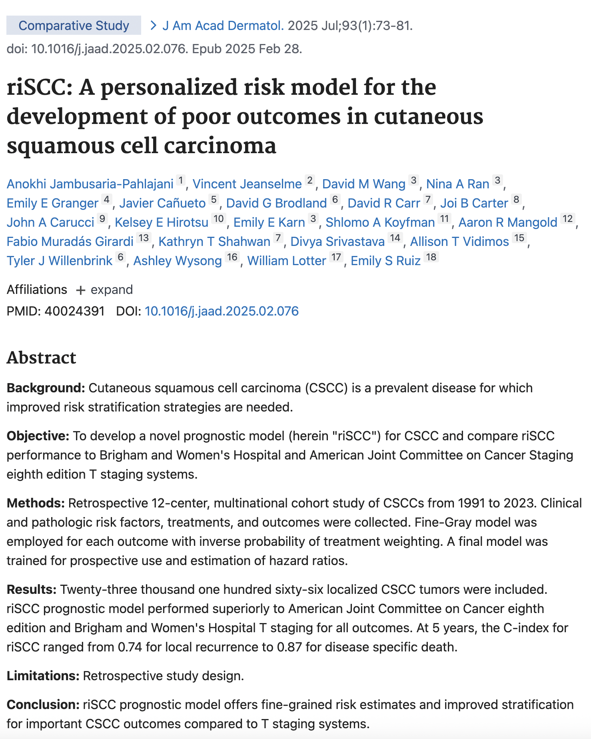
Notes:
The following variables were collected from the patient's medical record: age, sex, immune status (reasons for immunosuppression, including hematologic malignancy, solid organ transplant, autoimmune disease, and/or iatrogenic immunosuppression), recurrent tumor status, anatomic location, histologic differentiation (well, moderate, or poor), perineural invasion (PNI), lymphovascular invasion (LVI), preoperative tumor diameter (in millimeters (mm), as a continuous variable), depth of invasion (tissue level depth or depth in mm), surgical treatment (wide local excision (WLE) or Mohs micrographic surgery (MMS)), margin status, and use of adjuvant therapy (including type, dose, and number of fractions for radiotherapy or chemotherapy utilized).
The date of diagnosis was defined as the date of biopsy or, if unavailable, the date of treatment (eg, surgery). Follow-up began on the date of primary treatment initiation or on the biopsy date if no treatment was performed. Clinical outcomes of interest included LR, ITM, NM, DM, and DSD, which were assigned to the primary tumor according to guidelines outlined by an expert panel on standardizing CSCC outcome reporting7: LR, tumor with comparable histology arising within the surgical scar; ITM, satellite tumors or dermal/subcutaneous metastatic deposits clinically distinct from the primary tumor and occur before the first echelon draining regional lymph nodes; NM, tumor present in the regional lymph nodes, including parotid metastases; DM, tumor involvement beyond the regional lymph nodes; and DSD, death due to CSCC or its treatment. Date of recurrence was defined as the date of histologic confirmation of CSCC outcome during follow-up. End of follow-up was the date of the last office visit by dermatology, oncology, or radiation oncology, or date of death.

Slide 20
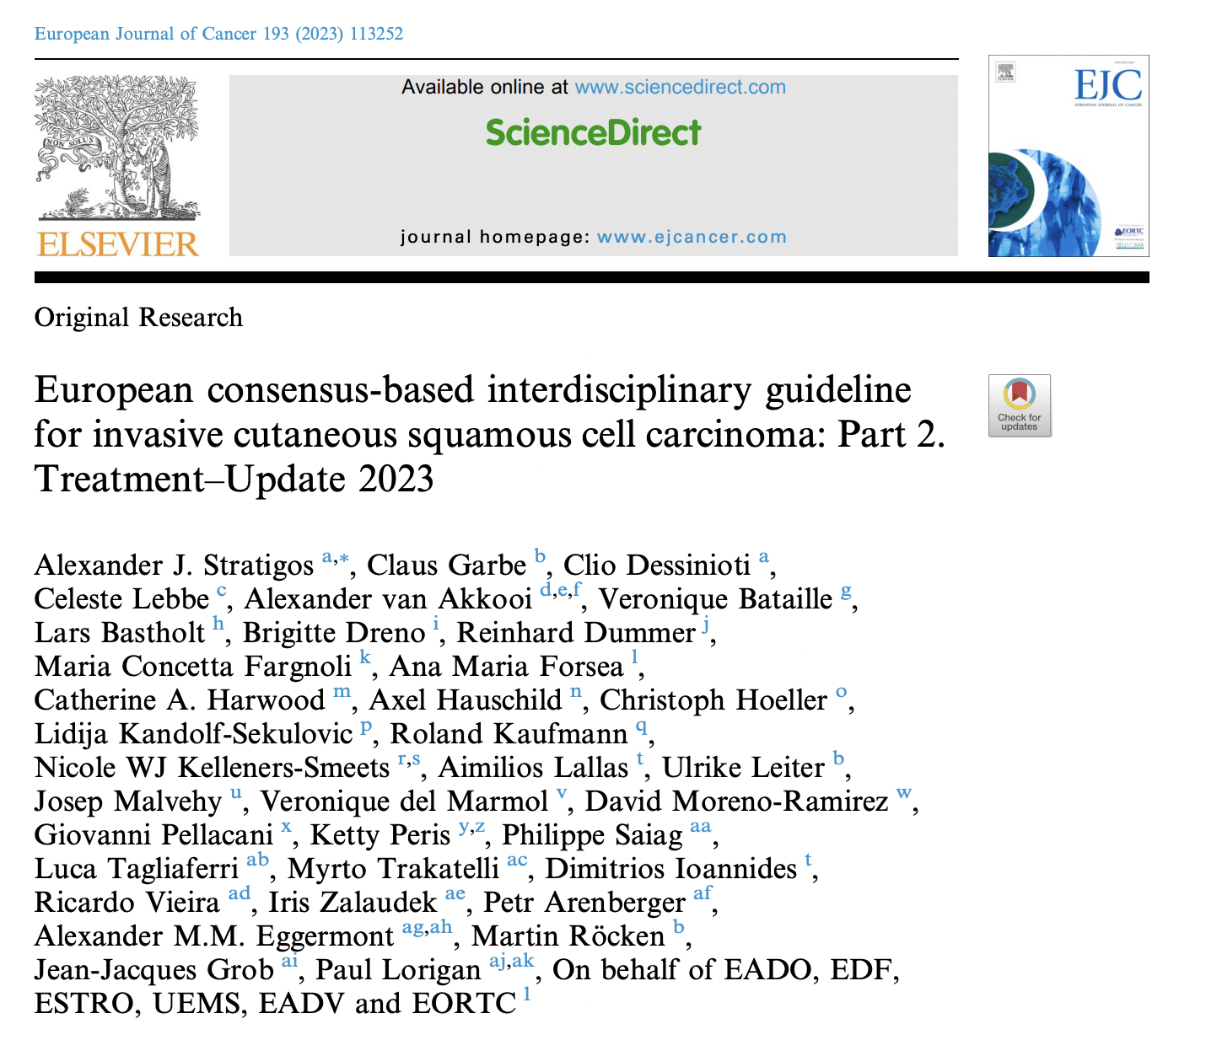
Notes:
So we have done US. What is europe recommending? Mohs surgery very variable provision,

Slide 21
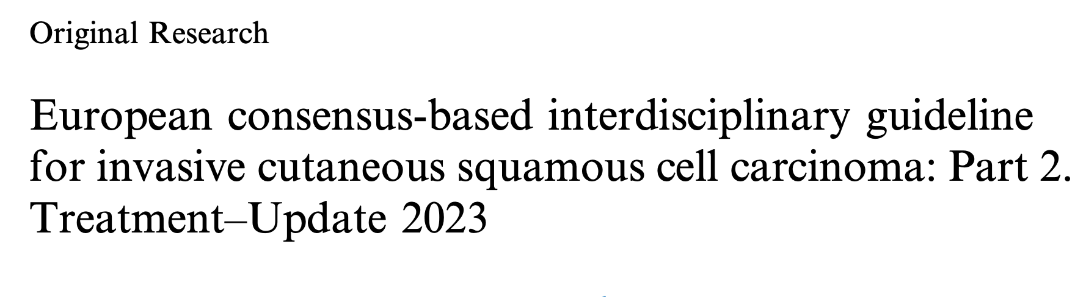
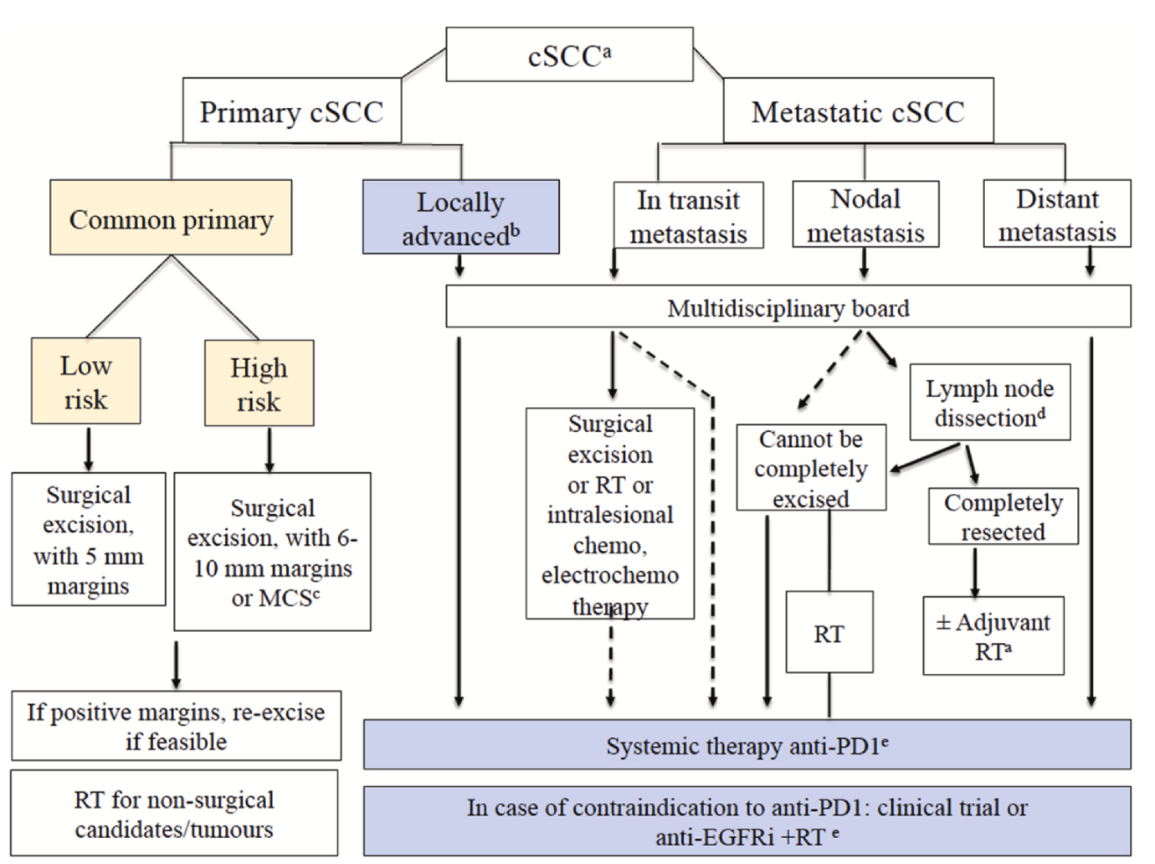
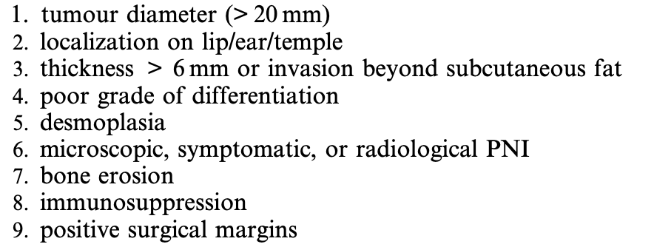
Notes:
EUropean guidance. First line high risk SCC.
High risk factors presented adjacent.

Slide 22
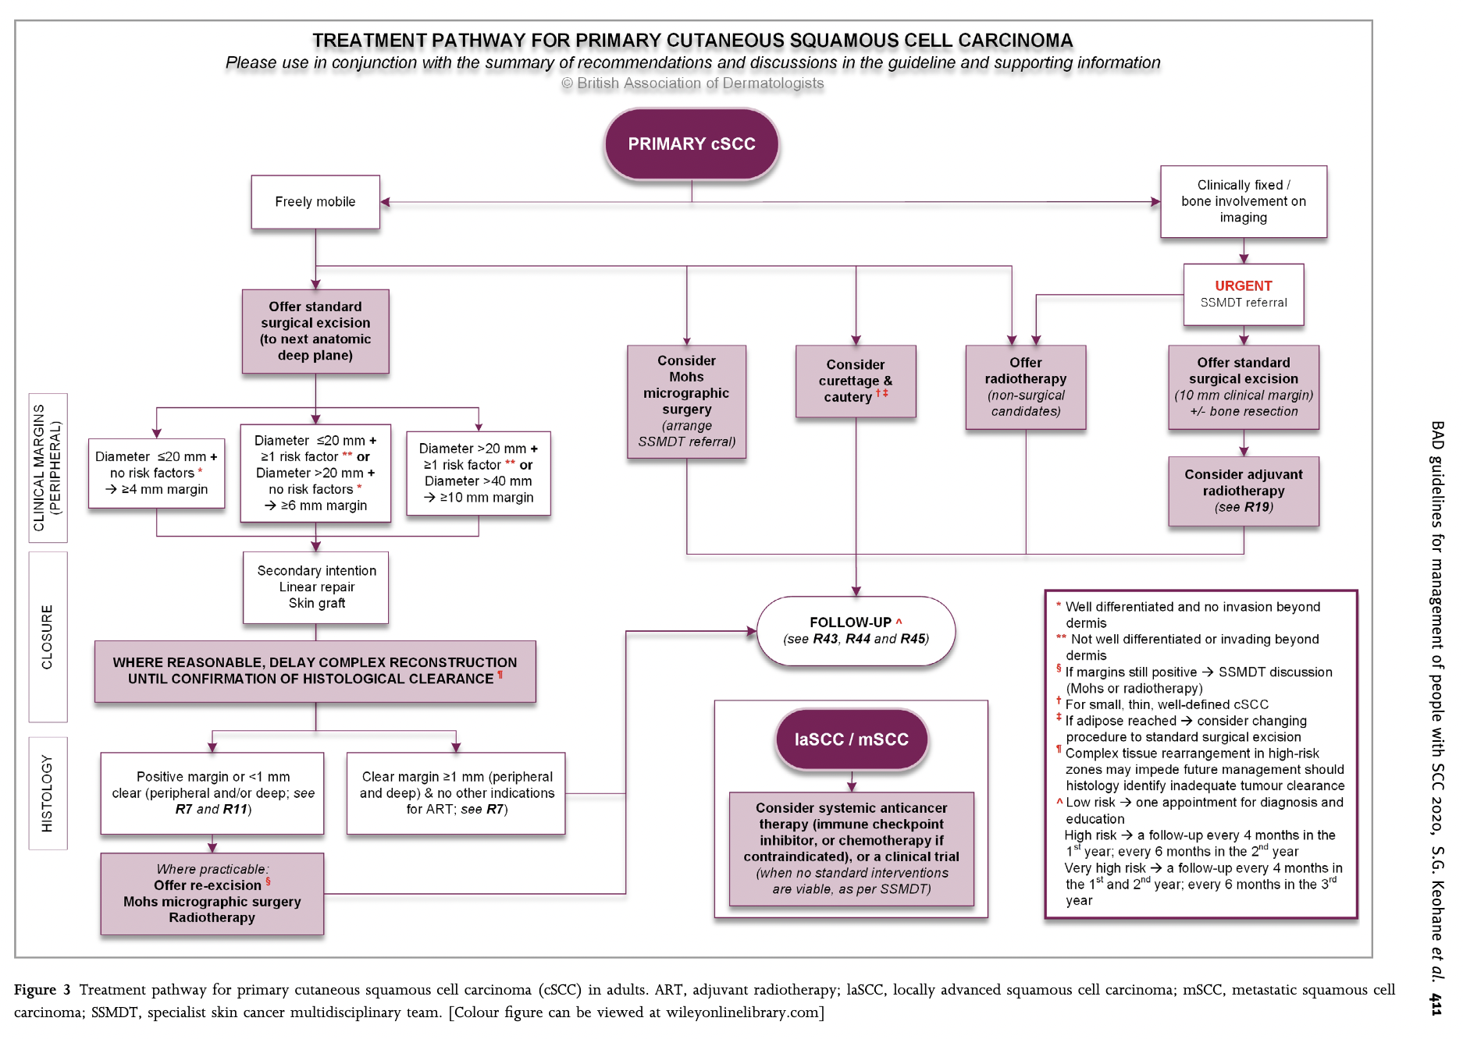
Mohs micrographic surgery: Consider Mohs micrographic surgery in selected people with cSCC following SSMDT discussion, particularly where tumour margins are difﬁcult to delineate or in sites where tissue conservation is important for function.
S.G. Keohane, J. Botting, P.G. Budny, O.M. Dolan, K. Fife, C.A. Harwood, R. Mallipeddi, J.R. Marsden, R.J. Motley, C. Newlands, C. Proby, A. Rembielak, D.N. Slater, J.A. Smithson, P. Buckley, P. Fairbrother, M. Hashme, M.F. Mohd Mustapa, L.S. Exton, the British Association of Dermatologists’ Clinical Standards Unit, British Association of Dermatologists guidelines for the management of people with cutaneous squamous cell carcinoma 2020, British Journal of Dermatology,
Notes:
Mohs in BAD guideline positioned as consider MMS as primary treatment, and an option for incomplete excisions.
Guideline approaching 6 years old.

Slide 23
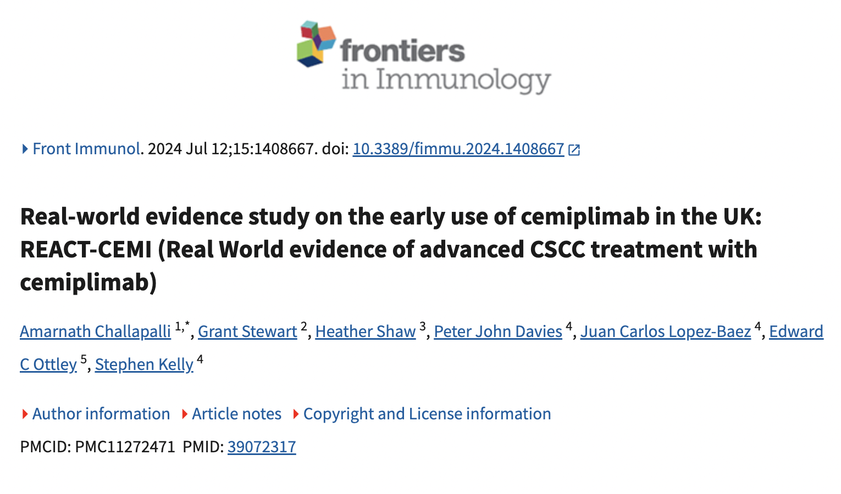
Notes:
In that time lots of things of changed. Cemiplimab for example on the scene, which the guidance does not even mention!
Big shout out to very own Amar here! Kudos!!

Slide 24
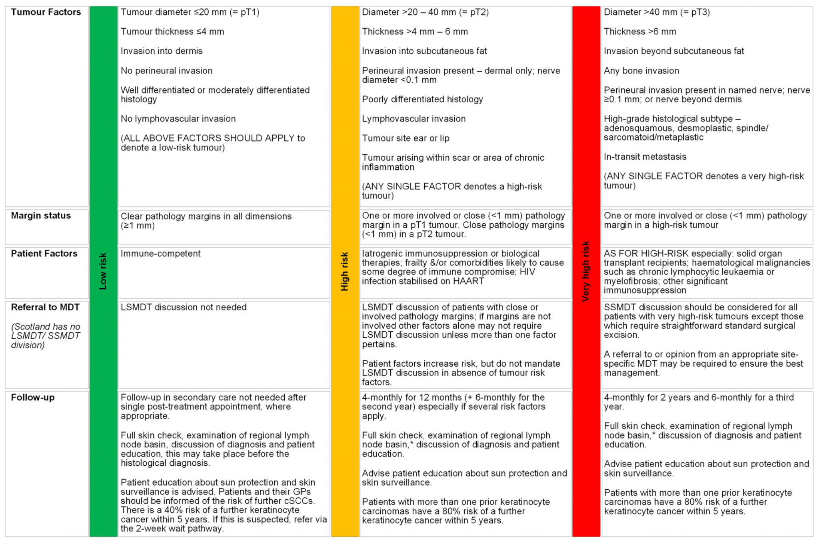
Notes:
Just to show UK guidance, not the PD is in high risk in US, that is very high risk.
Also immune suppressed patient all tumours either high or very high risk.

Slide 25
Cases

Slide 26
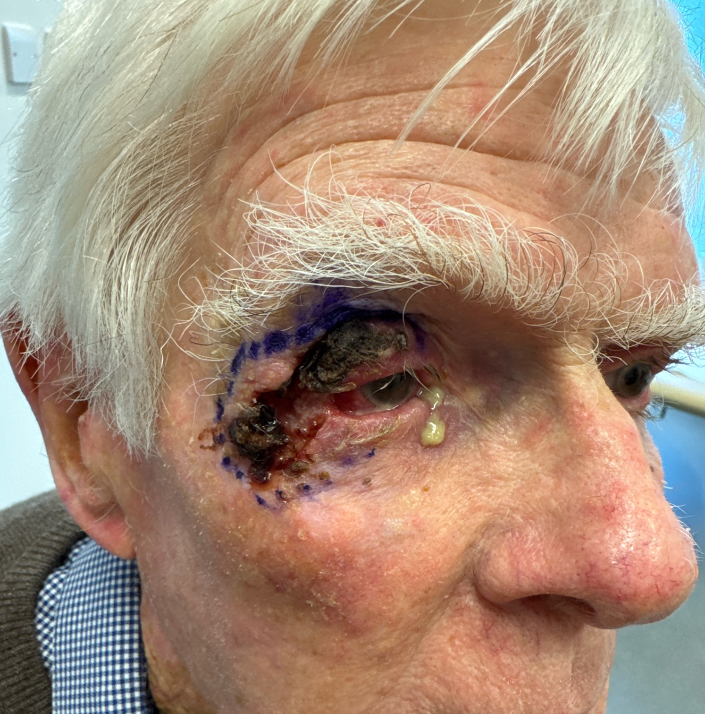
Notes:
Bx proven 40mm Mod diff SCC in immunocomptent 83 year old gent, involving full thickness upper and lower lids, lateral canthus and temple. Mohs extirpated in 2 stages and reconstructed with Paolo Scollo who referred in with Mustarde, Free tarsal Graft, + Cutler-Beard flap.

Slide 27
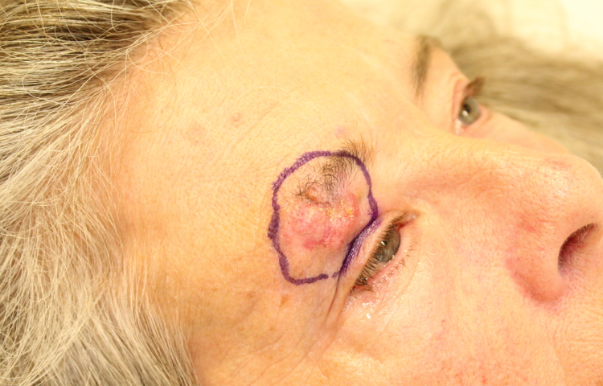
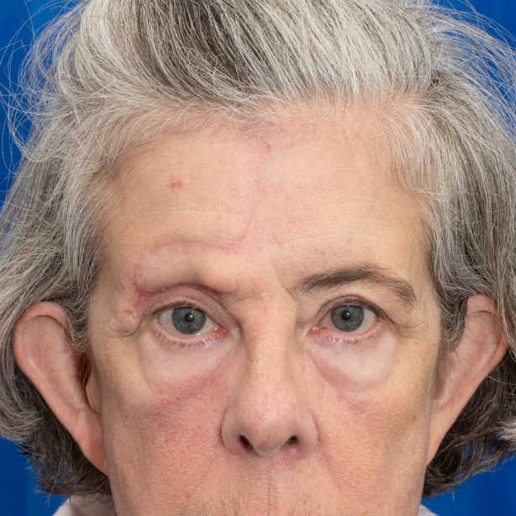
Notes:
This lady is a 60 year old renal transplant recipient with a 42mm multiply recurrent moderately differentiated SCC with multifocal PNI on the right eyebrow and upper lid. Mohs Extirpated in one Mohs stage, and complex defect reconstructed by myself with a FTSG from contralateral lid for upper eyelid and banner transposition flap with paramedian approach.

Slide 28
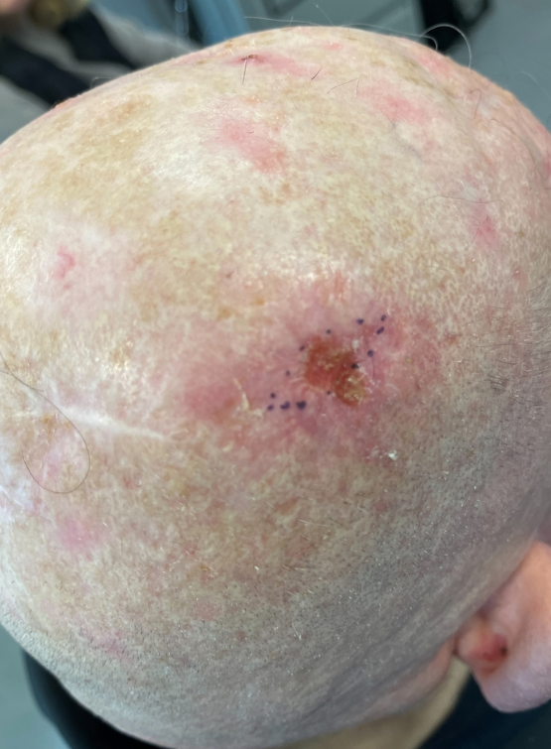
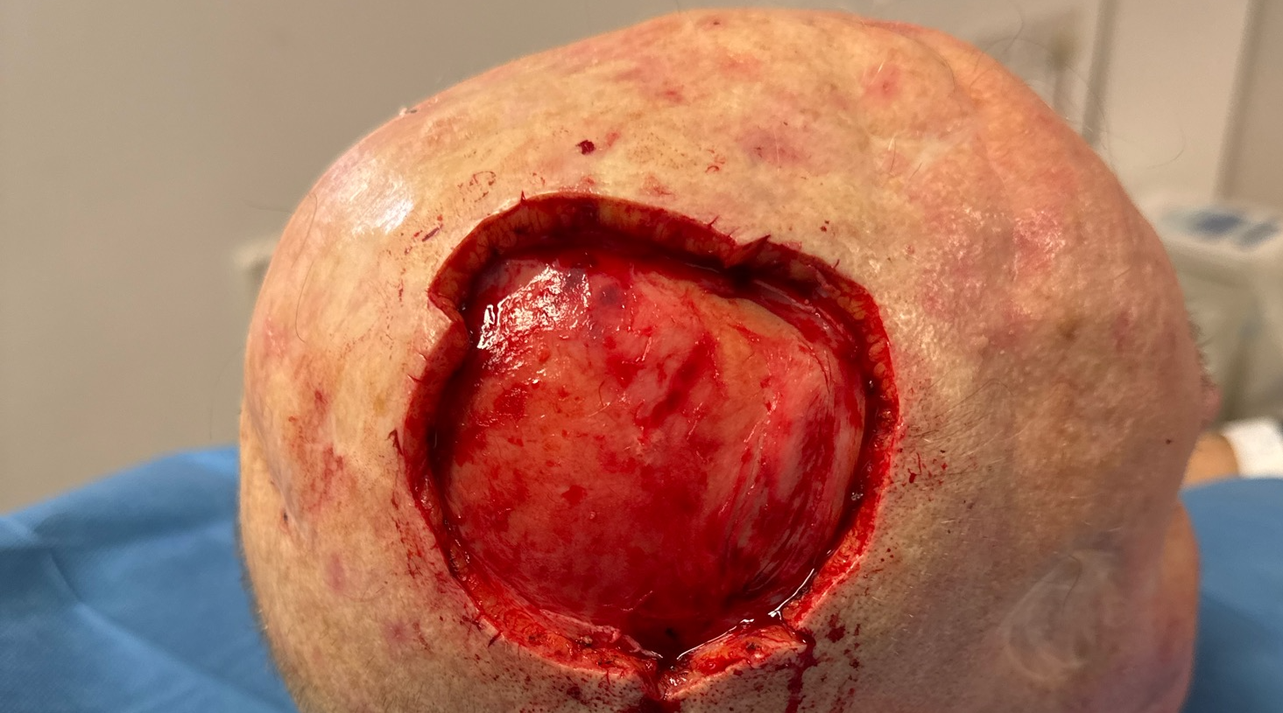
Notes:
Immune suppressed 81 year old. Very ill-defined 48mm, poorly differentiated endophytic infiltrative SCC with multifocal large calibre PNI. Cleared in 3 stages, tracking out 3cm from visible margin due to PNI. Delayed graft planned

Slide 29
Take homes
Mohs offers complete excision in one day, and significantly less likely to recur than SE
Consider referring your high risk SCCs (high risk tumours, patients, or tricky sites)
Better to do early than late
If wish to reconstruct that’s fine
Notes:
Standard excision will do well for most SCCs, but Mohs will add value for certain patients and tumours.
Sites around vital structures such as eyelid, nose, lips and ears, digits.

Slide 30
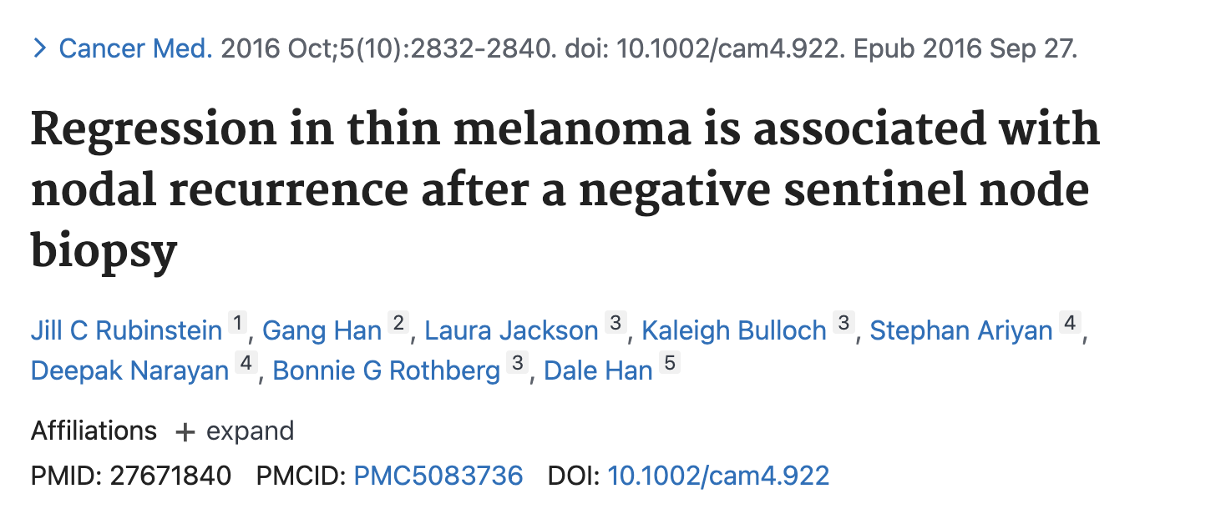
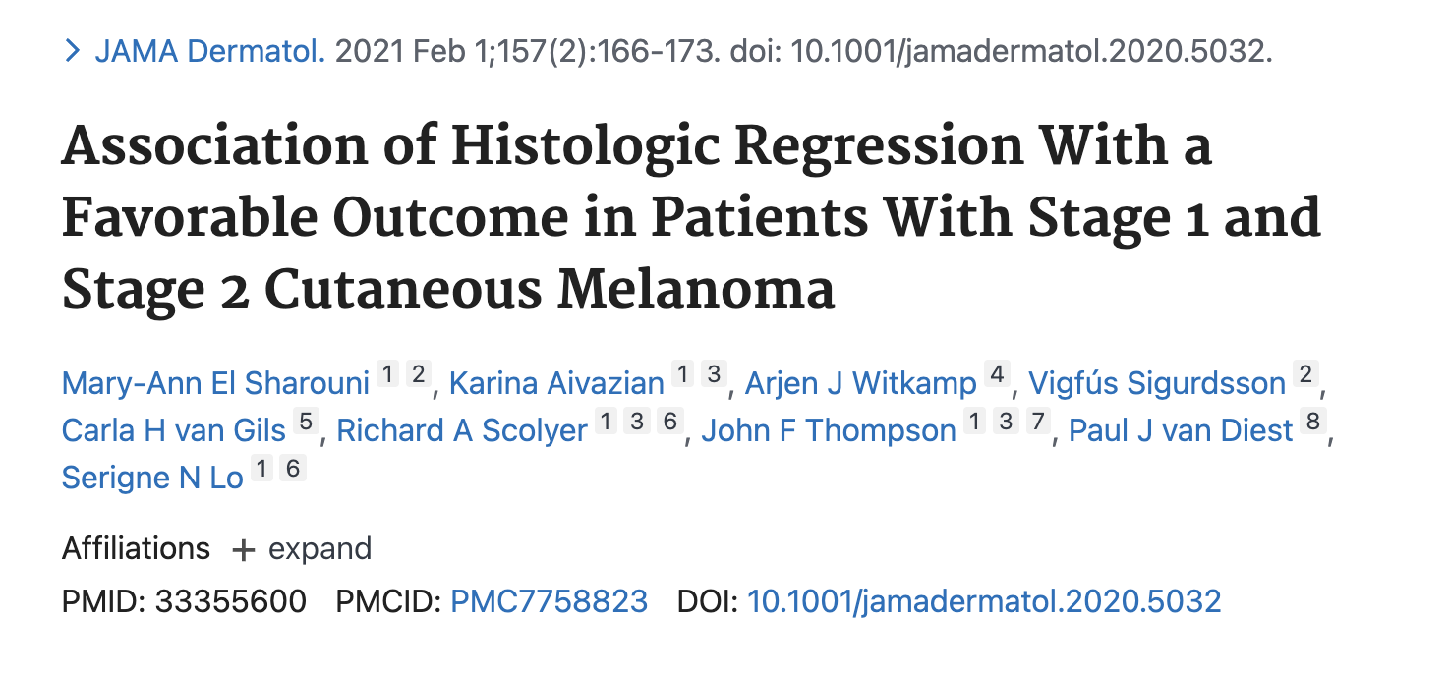
Finally: MIS and regression what we doing?
“If dermal regression is present in a severely dysplastic naevus, in situ melanoma or invasive melanoma, there is some peer support, with appropriate skin cancer MDT discussion, for treating the lesion clinically as a potentially upstaged melanocytic lesion, taking the depth of dermal regression into account as potentially regressed invasive malignancy.”
“The RCPath suggest that severely dysplastic nevi and in situ melanoma which show convincing features of established regression should be discussed by the MDT to determine whether the melanoma should be treated clinically as an upstaged lesion”
Slater, David, and Martin Cook. "Standards and datasets for reporting cancers Dataset for histopathological reporting of primary cutaneous malignant melanoma and regional lymph nodes RCPath. February 2019." (2019). Scottish Intercollegiate Guidelines Network (SIGN). Cutaneous melanoma. Edinburgh: SIGN; 2023. (SIGN publication no. 146
Notes:
Is regression favourable since it has suggested solid immune response and destruction of invasive tumour.
Subjectivity around regression.
Is it not favourable since it masks invasive melanoma not seen on conventional sectioning
‘melanoma with extensive regression phenomena and residual melanoma in situ component’
histological regression as replacement of tumour cells by lymphocytic inflammation with attenuation of the epidermis and nonlaminated dermal fibrosis with inflammatory cells, melanophagocytosis and telangiectasia

Slide 31
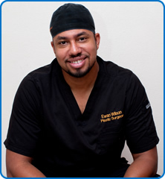

Slide 32


Slide 33
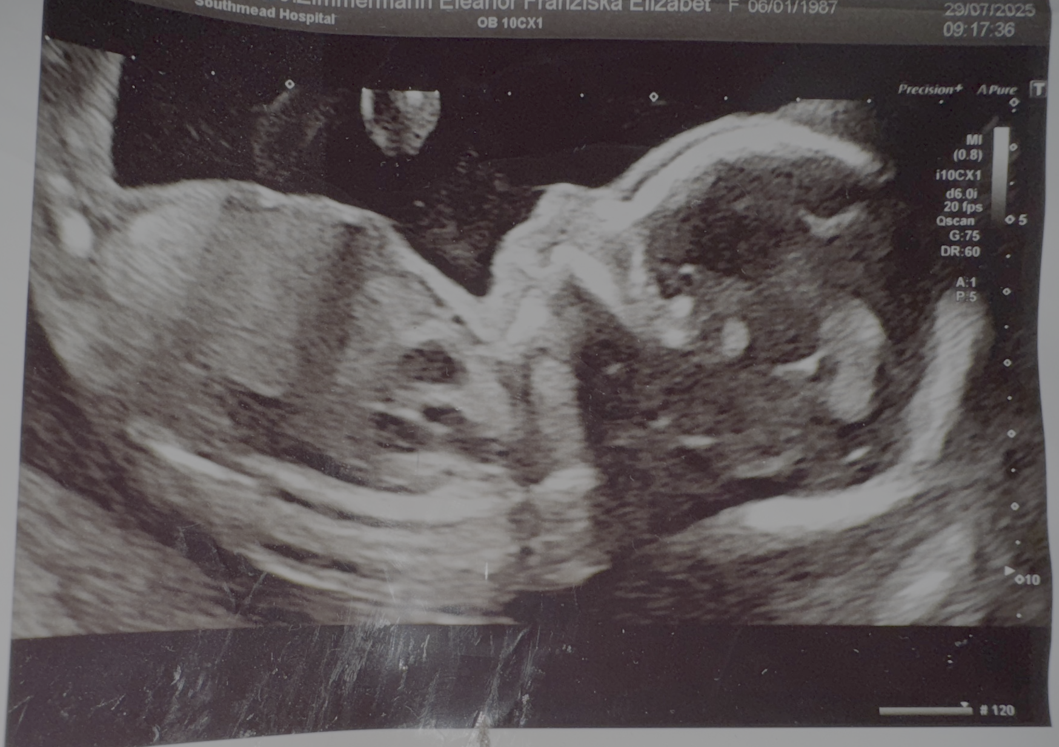

Slide 34
will.hunt@nbt.nhs.uk

