Slide 1

Dr Sophie Evans
Haematology ST4
26/11/2025
Haematology trial finder on the fly

Slide 2

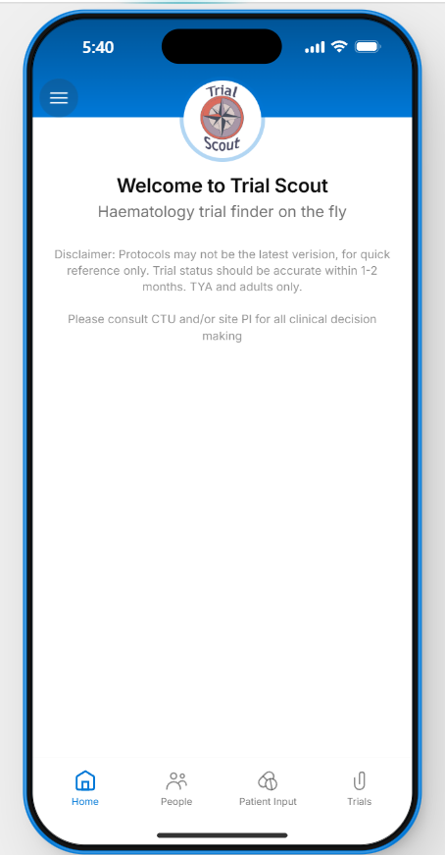
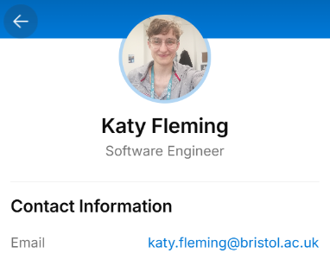
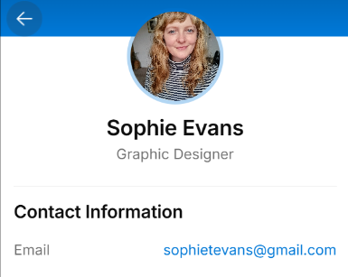

Slide 3
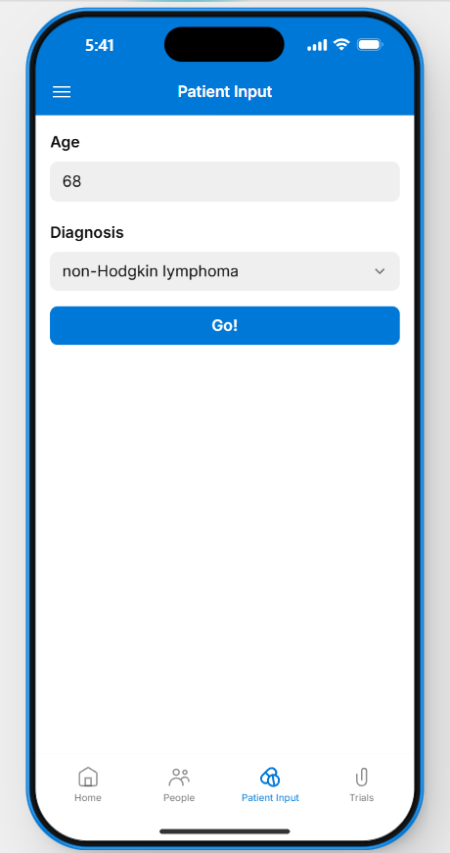
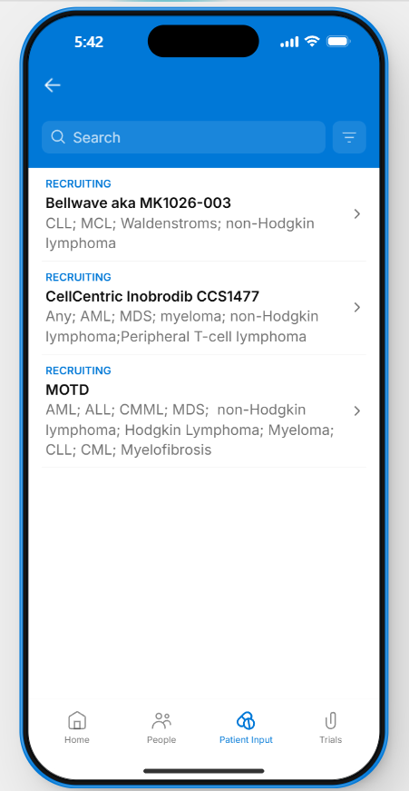
By patient details

Slide 4
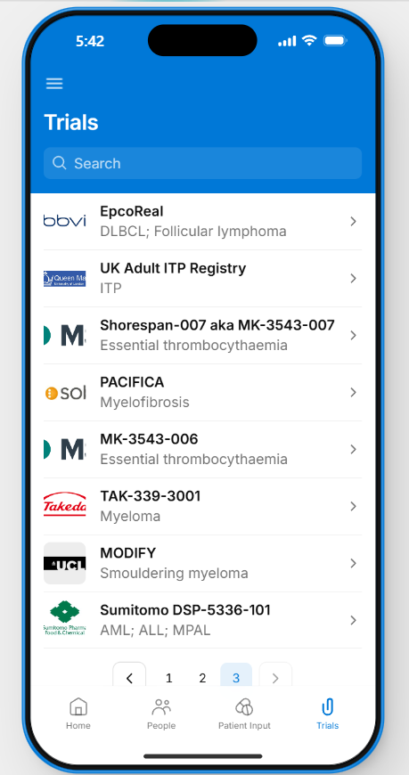
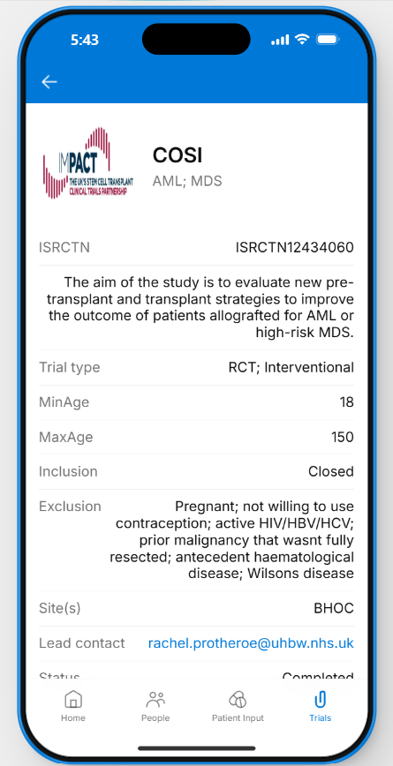
By trial list

Slide 5
Contact site trial coordinator
1
Receive list of trials, recruitment status, and main contact for each study
2
Find inclusion/exclusion data from public protocol or NIHR profile
3
Manually add details to app
4
Initial site set up process

Slide 6
Included in updates from site trials coordinator
Manually add, edit, or remove trials as appropriate
Receive important amendments on delegated trials from PI
Ongoing updates

Slide 7
Current uses | Next aims
Consolidated list of trials and recruitment status Quick and easy access to trial information Easier to see trials at other sites and find relevant PI or contact | Add data for all Trusts in Severn Deanery/South West region Collect feedback on usage and additional features Assess engagement with app and impact on trial queries and recruitment Explore interest from Oncology in using Trial Scout

Slide 8
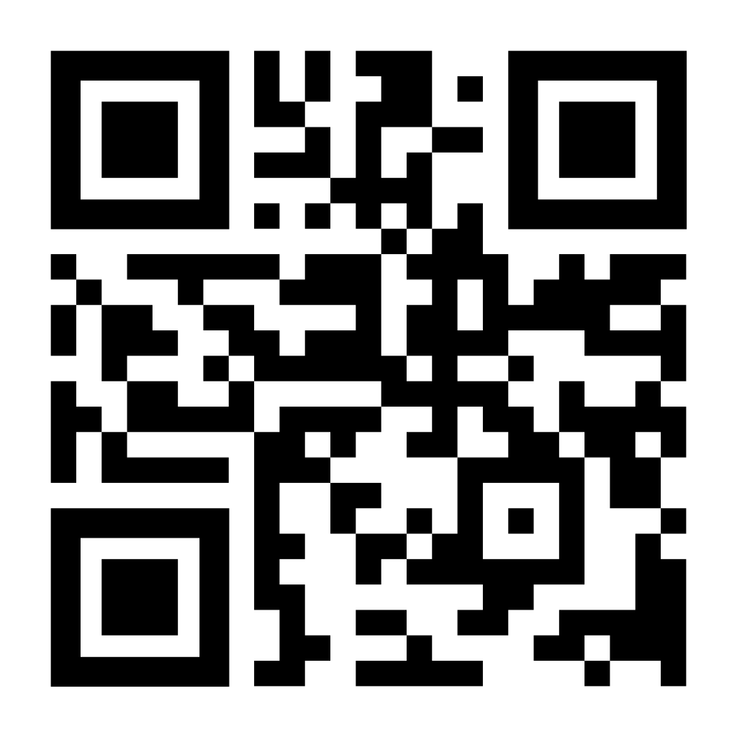
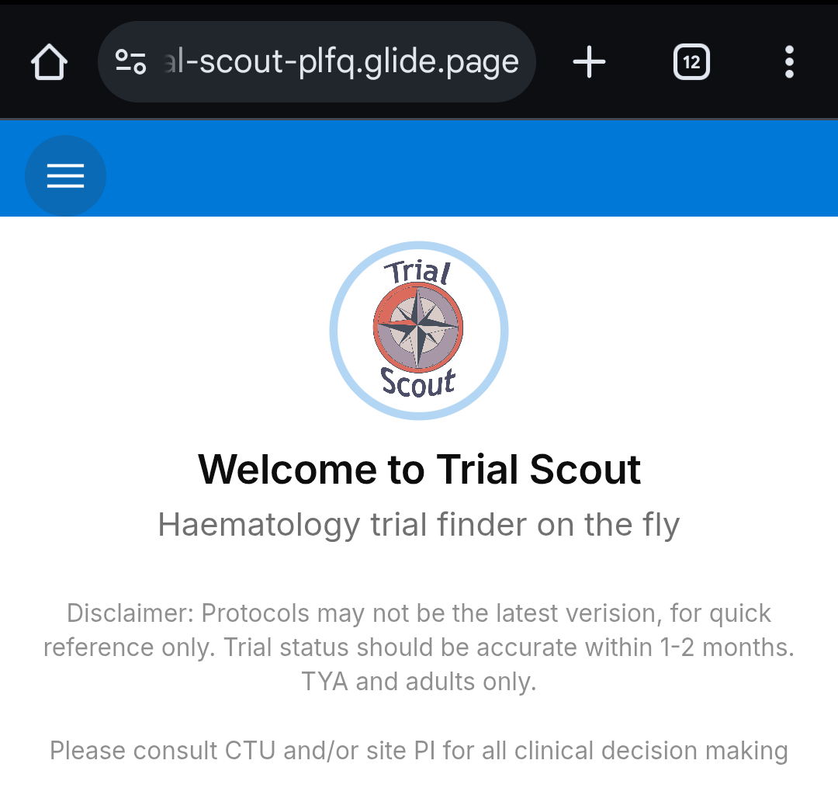
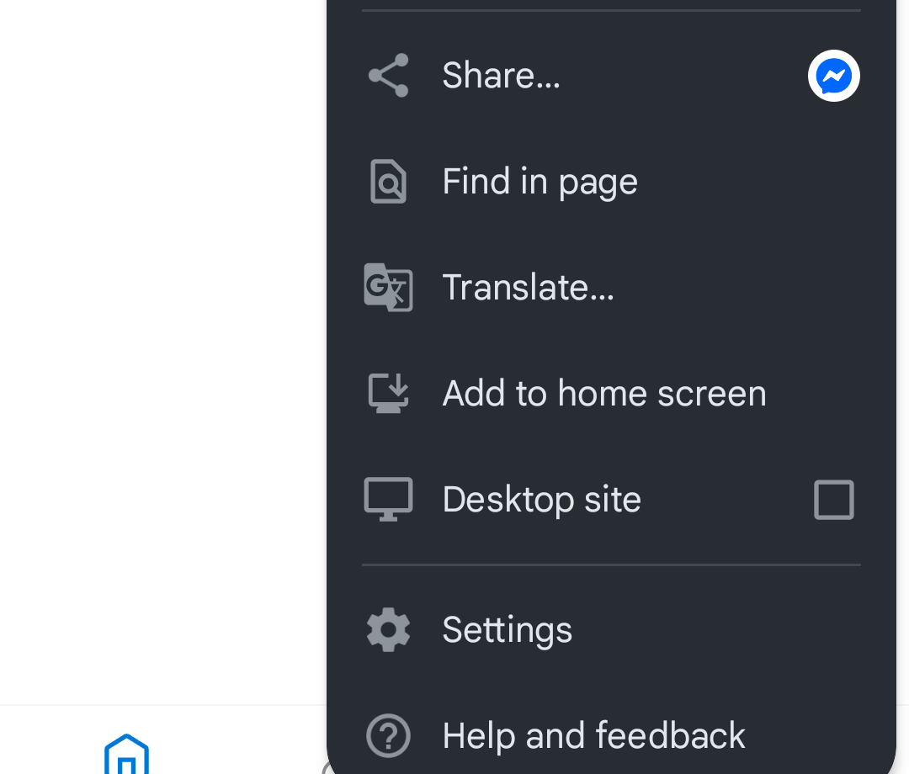
How to sign up
Use QR or link to access web site
Request access using a personal e-mail address (we do not have a business account to facilitate multiple NHS e-mails)
To add to your phone homepage as an app link, click the 3 dots in the top right corner of your browser page and select ‘add to home page’
https://sw-trial-scout-plfq.glide.page/

