Slide 1
SWAG Network Haematological Cancer Clinical Advisory Group
Research Update
Claire Matthews
26/11/2025

Slide 2
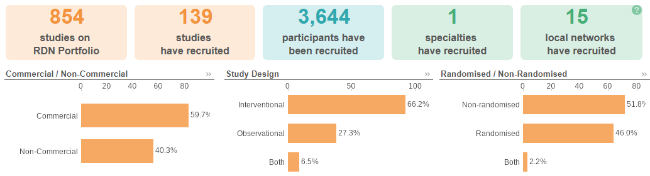
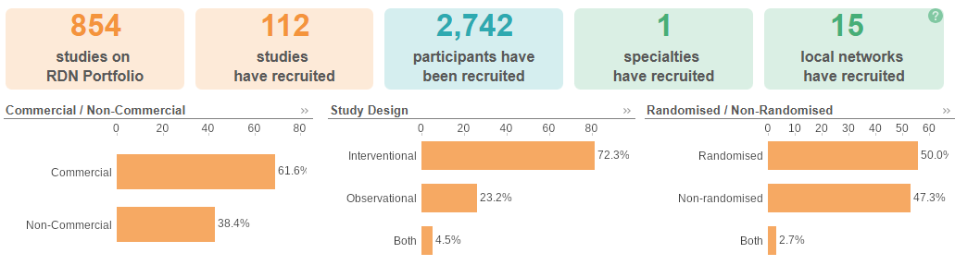
National Haem Cancer Research Recruitment
Apr 25 - Nov 25
Apr 24 - Mar 25
Source: ODP All Portfolio

Slide 3
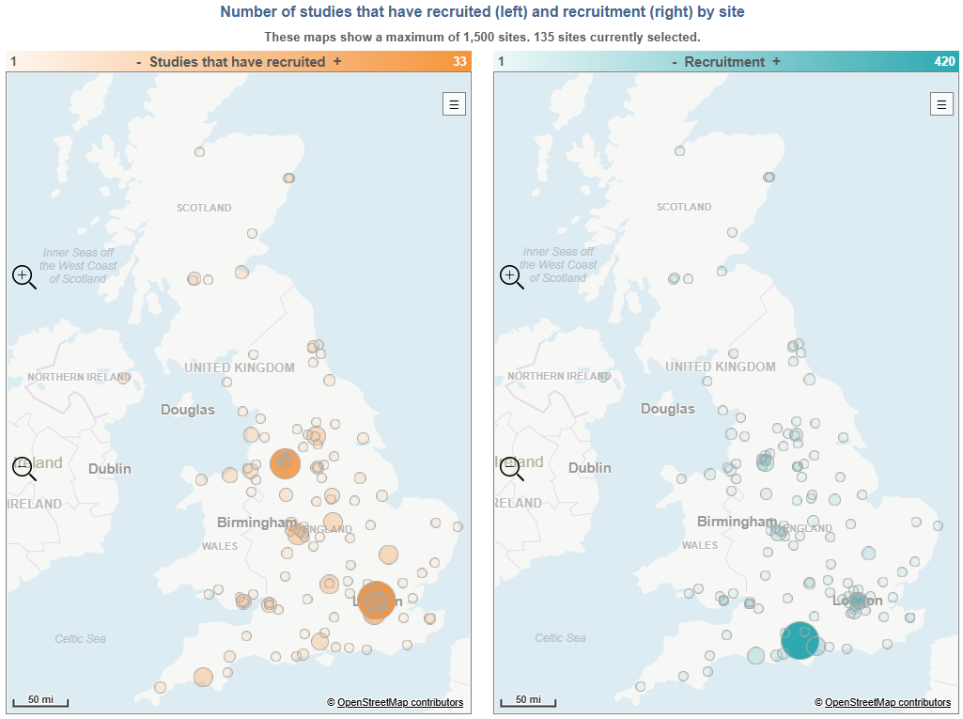
Research Activity by Site 2025/2026

Slide 4
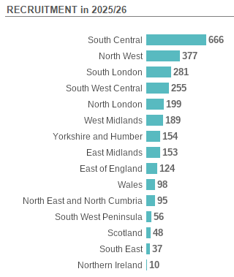
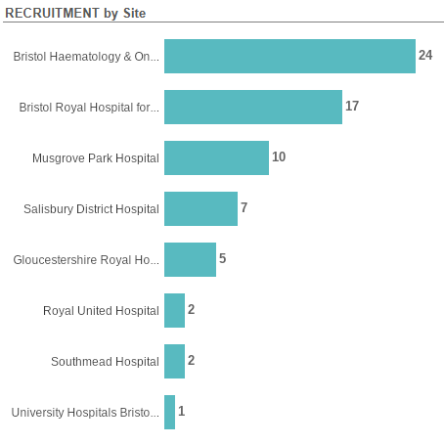

Slide 5
Gloucestershire Hospitals NHS Foundation Trust | 40
A Phase 3 Study in Myelofibrosis of Navtemadlin vs Placebo as Add-on Therapy to Ruxolitinib | 1
Bomedemstat vs Hydroxyurea for Essential Thrombocythemia | 3
MITHRIDATE Trial Version 2.0 10-June-2019 | 7
MK3543-006 | 1
PACIFICA: Pacritinib vs Physician’s Choice in Myelofibrosis | 2
RADAR (UK-MRA Myeloma XV) | 26
Royal United Hospitals Bath NHS Foundation Trust | 23
EPIC - NIS in CLL patients treated with acalabrutinib through the EAP | 6
MITHRIDATE Trial Version 2.0 10-June-2019 | 1
RADAR (UK-MRA Myeloma XV) | 16
Salisbury NHS Foundation Trust | 17
LCH­-IV | 1
P22-905 | 10
PROPEL | 1
STATIC | 5
VICTOR | 0
North Bristol NHS Trust | 11
ALMANAC | 0
Biology and genetics of smouldering myeloma | 1
MITHRIDATE Trial Version 2.0 10-June-2019 | 3
STATIC | 7

Slide 6
University Hospitals Bristol And Weston NHS Foundation Trust | 154
ALLTogether1 | 79
DETERMINE | 8
iMMagine-3 | 4
INCA 34176-357 | 0
LCH­-IV | 27
MajesTEC-7 | 5
MK1026-003 | 4
PROPEL | 3
RADAR (UK-MRA Myeloma XV) | 9
Understanding how to use immune cells to TARGET blood cancer cells | 9
VICTOR | 6
Somerset NHS Foundation Trust | 45
Biology and genetics of smouldering myeloma | 13
Biomarker Driven Antifungal Stewardship: The BioDriveAFS Trial. V1.0 | 14
PROPEL | 5
RADAR (UK-MRA Myeloma XV) | 11
STATIC | 2

Slide 7
Studies In set-up/under consideration in SWAG Region
CPMS | Short Name | Title | Planned Opening | Planned Closure | Sample Size UK | Sponsor
68990 | ACT-AML-901 | A Phase I/II Open-Label Cohort Evaluating the Safety and Efficacy of a Tagraxofusp, Venetoclax, Cladribine, Cytarabine Induction Regimen, leading into a Randomised Open-label Cohort Evaluating Safety and Efficacy of a Tagraxofusp, Venetoclax, Cladribine, Cytarabine Induction Regimen Compared with Intensive Chemotherapy in Fit Adults with Newly Diagnosed Acute Myeloid Leukaemia | 15/12/2025 | 28/12/2028 | 200 | DIDACT FOUNDATION
Data cut: 20/03/2025
Source: ODP All Portfolio

Slide 8


Be Part of Research is a UK-wide service that helps people find and take part in health and care research across nearly every health condition.
A resource for:
patients or their families keen to get involved in research
Researchers looking for target population for research
https://bepartofresearch.nihr.ac.uk/

Slide 9
Key messages for patients
Be Part of Research makes it easier than ever to find and take part in health and care research.
Simply sign up online and choose the areas of research you’re interested in.
You’ll then be matched to suitable studies and sent clear information about what’s involved and how you can take part.
The decision on whether to take part is always yours.

Slide 10

Associate Principal Investigator
Scheme
Six month in-work training opportunity, providing practical experience for healthcare professionals starting their research career.
People who would not normally have the opportunity to take part in clinical research in their day to day role have the chance to experience what it means to work on and deliver a NIHR portfolio trial under the mentorship of an enthusiastic Local PI.
CIs working with a CTU can register their study on the scheme
https://www.nihr.ac.uk/health-and-care-professionals/career-development/associate-principal-investigator-scheme.htm

Slide 11

Principal Investigator Pipeline Programme
(PIPP)
Overview
Research delivery nurses, midwives and AHPs
12 to 18 months
Free if you’re eligible
Live virtual lessons, online learning and hands-on experience
Cohort 4 applications open in April 2026, approx 60 places
Please email nursingandmidwifery@nihr.ac.uk for more information
https://www.nihr.ac.uk/career-development/clinical-research-courses-and-support/principal-investigator-pipeline-programme

Slide 12
NIHR ODP https://odp.nihr.ac.uk/
Open data platform. Data on performance across whole RDN, including all specialty areas
NIHR Be Part of Research https://bepartofresearch.nihr.ac.uk/
See which studies are open across the country
Find a Clinical Research Study (ODP) http://csg.ncri.org.uk/portfolio/portfolio-maps/
Search for a study to fit criteria. Good for horizon scanning, eligibility criteria

Slide 13
RRDN Contacts
swc.rrdn@nihr.ac.uk
Study Support Service Manager: claire.matthews@nihr.ac.uk
CAG Research Lead: sally.moore@uhbw.nhs.uk

