Slide 1

South West Cervical Cancer Elimination
SWAGGER Engagement
Ensuring timely & effect cervical cancer care
28st November 2025

Slide 2
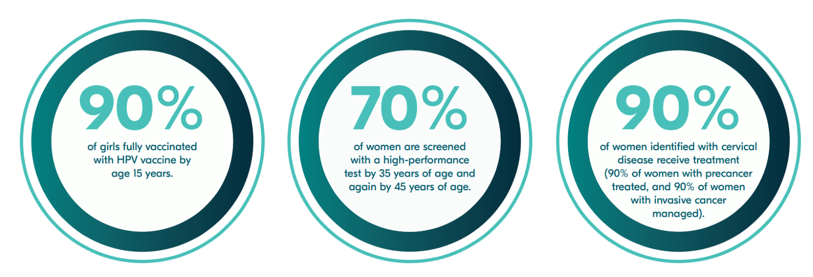
The call to eliminate cervical cancer
2020 WHO launched a Global Strategy to Accelerate the Elimination of Cervical Cancer
2023 NHS England pledged to eliminate cervical cancer by 2040 through the adoption of the WHO Strategy
2024 SW Cervical Cancer Elimination Strategy started
Notes:
Notes:
The World Health Organisation launched the Global Strategy to Accelerate the Elimination of Cervical Cancer. As over 99% of cervical cancer is caused by HPV and therefore preventable, this is an achievable ambition.
The % noted in each of the 3 pillars is the minimum we need to reach and sustain in order to eliminate cervical cancer.
In November 2023 Amanda Pritchard announced NHS England’s pledge to eliminate cervical cancer in England by 2040.
In the South West, the SW Vaccination and Screening Team (SW VaST) began the process of pulling the data together to obtain a baseline of what the current situation is for these 3 pillars
We undertook a review of the literature of research and evidence and modelled what increases we needed in order to achieve and sustain the 3 pillars
And most importantly, we brought this to our stakeholders and partners to bring awareness and begin discussions with them

Slide 3
More than 2 women die every day from cervical cancer in the UK (4 in some areas of deprivation the SW), but 99.8% of cases are preventable,
The South West has a higher cervical cancer incidence rate than England (9.8 vs 9.4 per 100,000).​
To eliminate cervical cancer, we need to lower the incidence to < 4 per 100,000.
Over the next 5 years, the South West will:
  increase HPV vaccination rates to at least 90% for boys and girls
  halt the decline in cervical screening rates and increase the screening rate to at least 70% in the 25-49 cohort
  ensure at least 90% of women diagnosed with cervical disease receive treatment.
This will enable us to meet the screening and vaccination targets by 2030 and eliminate cervical cancer in the South West by 2040.
Eliminating cervical cancer in the South West by 2040
Case for change
Acknowledgement to London for sharing their strategy
Notes:
This slide highlights the case for change in the South West
The 5 year data. (2016-2020) used in this slide shows that 2 women die of cerical cancer in the UK every day, but in some most deprived areas in SW this is as high as 4. This is one reason why the South West has a higher cervical cancer incident rate than the England average. We need to have less than 4 per 100,000 in order to be considered as eliminating cervical cancer. As a small % of cervical cancers are not caused by HPV, there will still be some cervical cancers diagnosed after we meet the targets set out in the 3 pillars.
Over the next 5 years, we in the South West will increase HPV vaccine rates in both boys and girls. We know boys are protected against other HPV causing cancers so it is important they are vaccinated. We will increase coverage of cervical screening to achieve and exceed 70% coverage and ensure 90% of diagnosed cervical cancers are treated in a timely way. By achieving these by 2030, we will be able to eliminate cervical cancer by 2040.
This is an exciting time knowing that in the South West we have begun the journey to eliminate cervical cancer

Slide 4
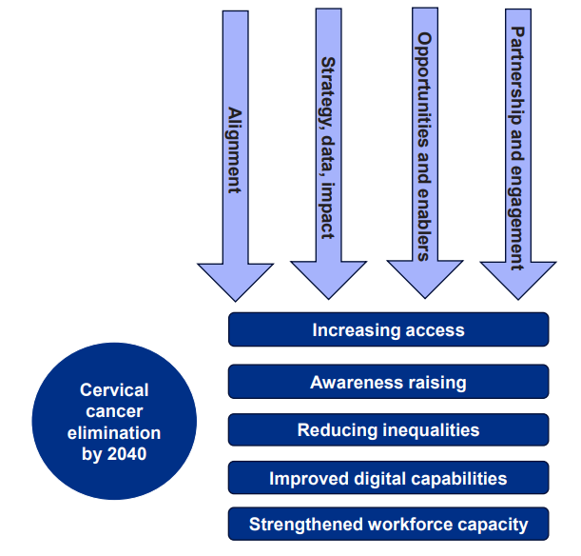
Making the plan a reality
Five Cross cutting themes
National Coordination
Regional Adaption
Shared Responsibility across NHS, public health, education and community sectors

Slide 5
Purpose of discussion
The WHO elimination framework targets 90% treatment coverage for diagnosed cervical cancer cases.
90% of women & people with a cervix identified with cervical disease receive treatment. (90% of women with precancer treated and 90% of women with invasive cancer managed)
We are scoping the treatment pillar for cervical cancer elimination in the South West.
Objectives:
Identify key treatment metrics relevant to cervical cancer care
Gather clinician insights on treatment variation and barriers
Collate available data across trusts to assess performance
Support development of regional best practice guidance
Inform future Health Equity audits and strategic proposals

Slide 6
Current Challenges
Data & metrics
Lack of nationally mandated treatment metrics.
Inconsistent data availability across trusts (KC65 limits; no reliable subsite/stage breakdowns).
Resource constraints for data extraction and limited automation.
Workforce & capacity
Staffing shortages, rota gaps, and limited nurse colposcopist capacity.
Theatre/RT scheduling pressures limiting timely procedures.
Clinical governance & practice variation
Variation in clinical practice and equipment across gynae units.
Non‑compliance concerns with conservative management pathways.
Inconsistent MDT engagement and decision‑to‑treat tracking.
Operational risks
Referral triage queues, unfilled short‑notice slots and booking friction.
Infrequent QA visits and equipment deficits impacting treatment accuracy and timeliness.
Equity and access
Transport, childcare, language and deprivation barriers reducing attendance and completion for some groups.
Notes:
While screening and vaccination metrics are well-established, treatment metrics remain undefined nationally.
These are the barriers repeatedly reported across SW trusts. They cluster into four actionable problem areas: unreliable data that prevents timely oversight; constrained workforce and capacity; variation in clinical governance and MDT processes; and operational/infrastructure gaps that create avoidable delays and inequity. Today we’ll focus on minimal, high‑impact fixes that address each cluster (data minimums, pooled triage, MDT micro‑standards, and targeted equity supports).

Slide 7
Questions?
What constitutes high-quality, equitable treatment for cervical cancer across surgical and oncological pathways?
What are the barriers to timely treatment in colposcopy?
What are the barriers once a cancer diagnosis has been made?
How we might define and measure access, timeliness, and outcomes particularly for underserved populations?
Any existing datasets, trials, or national benchmarks that could inform our regional approach?

Slide 8
Suggested next steps?
Identify key treatment metrics relevant to cervical cancer care (Consider National input, timeliness, coverage, stage, completion, equity)
Complete a call for evidence: Gather clinician insights on treatment variation and barriers
Regional Colposcopy network proposal
Support development of regional best practice guidance
Inform future Health Equity audits and strategic proposals
Notes:
Today we are asking the group to consider what deliverables could convert your expert insight into measurable actions. Presented above are some suggestions however please feel free to discuss and get back to us regarding your comments.

Slide 9
Thank-you
Lucybond@nhs.net
rajvinder.dhillon@nhs.net

