Slide 1
Postmenopausal Bleeding
Is a pipelle enough to diagnose endometrial cancer?
Laura Atherton
Aileen Mohan
Ellie Stokes
Fenella Rice

Slide 2
Objectives
To review the problem of endometrial cancer including risk factors and pathophysiology
To understand the current guidelines in our Trust with respect to PMB
To review the efficacy of pipelle biopsy in diagnosis of endometrial cancer, both theoretically and in our unit
To use data collected from audit to determine whether our guidelines can be altered to improve patient flow, service efficiency and service costing

Slide 3
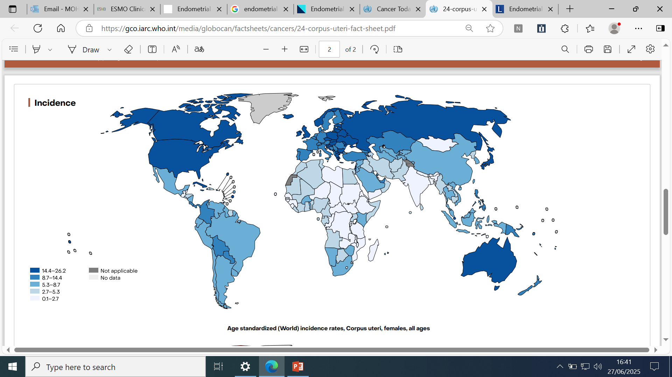
Background-The Scope of the Problem
7th most common female cancer worldwide, most common gynaecological cancer in high income countries.
Risk factors include increasing age, obesity, hypertension, prolonged exposure to unopposed oestrogens.
Mortality increasing by 1.9% per year on average
T1- endometrioid adenocarcinoma. Oestrogen dependent. Often preceded by atypical hyperplasia
T2-serous/clear cell/carcinosarcoma/undifferentiated. Non oestrogen dependent, poorer prognosis.
Notes:
24-corpus-uteri-fact-sheet.pdf
Mortality increasing due to increasing incidence of obesity
Endometrial cancer - The Lancet
Endometrial cancer: ESMO Clinical Practice Guideline for diagnosis, treatment and follow-up&#x2606;

Slide 4
Current Guidelines
Post menopausal bleeding = any bleeding that occurs > 12 months after cessation of menstruation
90% of endometrial cancer presents with PMB
Pre-test probability of PMB being attributable to endometrial cancer is 10-15%
Smith-Bindman (1998) MA 5892 women and found TVUS with ET < 5mm reduced post-test probability of endometrial cancer to 1% (sensitivity 96%).
Pipelle sensitivity 99.7% in detection of endometrial cancer
Notes:
Complexities arise when lack of clarity about whether people are truly menopausal or not e.g. mirena coil, other progesterone contraceptives.
Smith-Bindman R, Kerlikowske K, Feldstein VA, Subak L, Scheidler J, Segal M, et al. Endovaginal ultrasound to exclude endometrial cancer and other endometrial abnormalities. JAMA 1998; 280: 1510–7.View
CASPubMedWeb of Science®Google Scholar
13Dijkhuizen FP, Mol BWJ, Brölmann HAM, Heintz AP. The accuracy of endometrial sampling in the diagnosis of patients with endometrial carcinoma and hyperplasia: a meta-analysis. Cancer 2000; 89: 1765–72.View
CASPubMedWeb of Science®Google Scholar

Slide 5
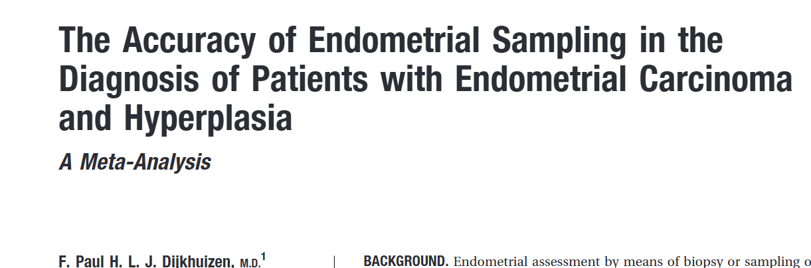
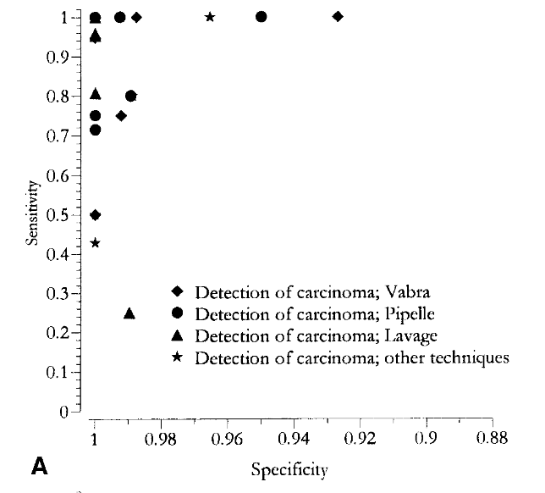
Pipelle – The Data
Dijkhuizen et al (2000)
MA 39 studies, 7914 women
1966-1999
Pipelle 99.6% sensitivity post menopausal women
( 91% pre-menopausal, 82.3% hyperplasia)
Notes:
Where do the stats come from?
The accuracy of pipelle mostly comes from this metaanalysis which was published in 2000, but actually contains women from as far back as 1966. It looks to be a large study, but actually looking at post menopausal patients alone, only 4 of these 39 studies were included, and this is what gives the 99.6% sensitivity for pipelle in this population.
Pipelle seems to be less accurate for pre-menopausal women, and also less accurate for endometrial hyperplasia
Further limitations are that up to 0-54% sampling failure and they were unable to relate this to the likelihood of diagnosis
The diagram on the side shows a ROC (receiver operating curve, showing relationship between true positive and false positive rate. In these graphs the top left aspect of the curve shows perfection ie 100% true positives, 0% false positives) showing sensitivity vs specificity for endometrial sampling in 31 of the 39 studies. Pipelle is the circle, other techniques such as vabra, lavage are also listed.

Slide 6

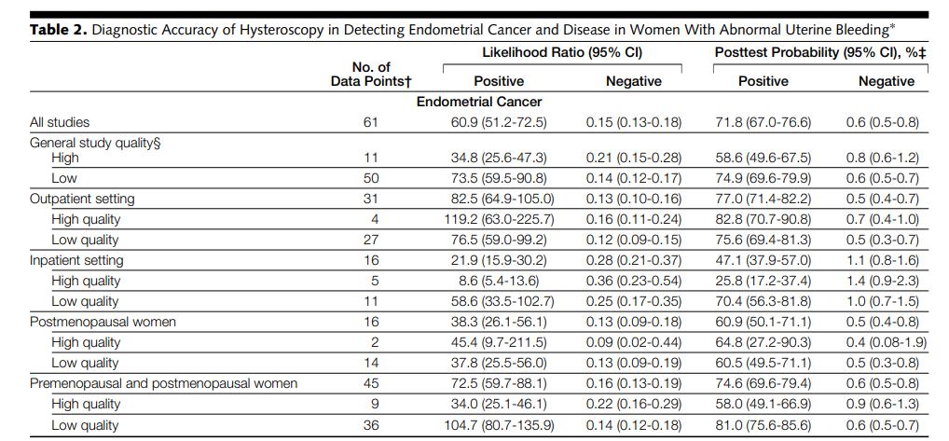
Hysteroscopy- The Data
Systematic review 2002
Pooled 65 studies, 26,346 women
Overall sensitivity 84.6% endometrial cancer
(sensitivity hyperplasia 78%)
Positive hysteroscopy increased the pre-test probability from 3.9% (11% in post menopausal) to 71.8%
Notes:
Abnormal uterine bleeding- pre and post menopausal
Post menopausal women only represented 29% of the women studied
Likelihood ratios – positive likelihood ratio how likely a positive result is accurate ie sensitivity/ 1-specificity. A higher LR shows a higher likelihood of disease being present in the instance of a positive result
Significant heterogenicity within results and variation in the sensitivity data between studied. This is not accounted for by menopausal status, but is thought to be accounted for by variations in inpatient vs outpatient, and general study quality. #

Slide 7
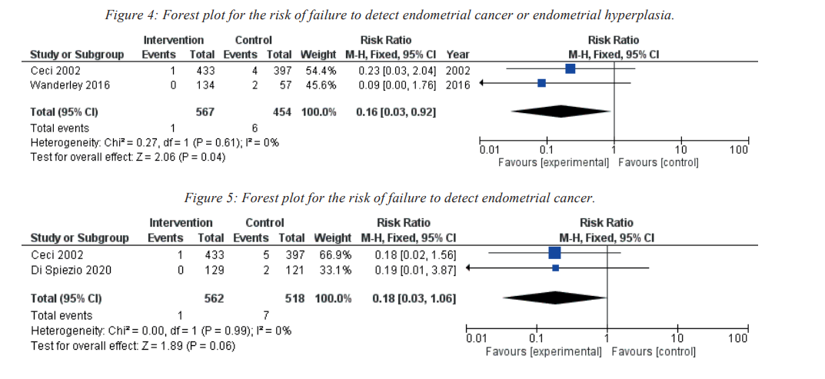
Pipelle vs Hysteroscopy
Sardo et al 2022
Meta-analysis comparing blind endometrial biopsy vs biopsy under direct guidance for diagnosis of endometrial cancer
4 studies suitable-1295 patients
Hysteroscopic guided biopsy higher chance of adequate sample (RR=1.13)
Hysteroscopy reduced chance of failure to diagnose cancer or hyperplasia (82% (RR=0.16)
However, no significant difference between hysteroscopy and blind biopsy in the diagnosis of endometrial cancer alone (p=0.06)
Notes:
Observational non randomised studies
Results heterogenous
Implication that hysteroscopy is helpful if discrete area of hyperplasia which we can then biopsy, if the pipelle does not show a concrete result and there is ongoing clinical suspicion

Slide 8
Biopsy alone vs Hysteroscopy
Bedner et al 2007
Hysteroscopy and directed biopsy vs blind D&C
734 patients with peri-menopausal bleeding or abnormal endometrium on USS
Hysteroscopy satisfactory to collect samples in all but 4 patients (insufficient sample)
Hysteroscopy failed to diagnose 3 simple and 1 atypical hyperplasia
Blind D&C unsatisfactory samples in 23 patients
D&C failed to diagnose 8 polyps, 9 hyperplasia and 4 cancers)
Conclusion hysteroscopy and directed biopsy more sensitive in diagnosing endometrial cancer.
Notes:
Abnormal endometrium including ET > 2.5mm, fluid in endometrium, abnormal endo/myometrium interface, focal lesions in endometrium.
Did not specifically use pipelle
Small numbers of patients who failed to have a diagnosis on blind D&C or Hysteroscopy

Slide 9

Cancer in Polyps
Post menopausal women:
Risk of hyperplasia or cancer in a polyp (no bleeding)?
1.9%
Risk of hyperplasia or endometrial cancer within a polyp (with bleeding)?
3.8%
Wethington SL, Herzog TJ, Burke WM, Sun X, Lerner JP, Lewin SN, Wright JD. Risk and predictors of malignancy in women with endometrial polyps. Ann Surg Oncol. 2011 Dec;18(13):3819-23. doi: 10.1245/s10434-011-1815-z. Epub 2011 Jun 24. PMID: 21701931.
Notes:
This study looked at > 1000 cases of endometrial polyps to determine whether any specific risk factors for hyperplasia or cancer could be identified. The only specific risk factor which was significantly associated with the presence of cancer was menopausal status
For premenopausal women the likelihood of cancer is significantly less-0.9-1% for those with no irregular and erratic bleeding respectively.

Slide 10
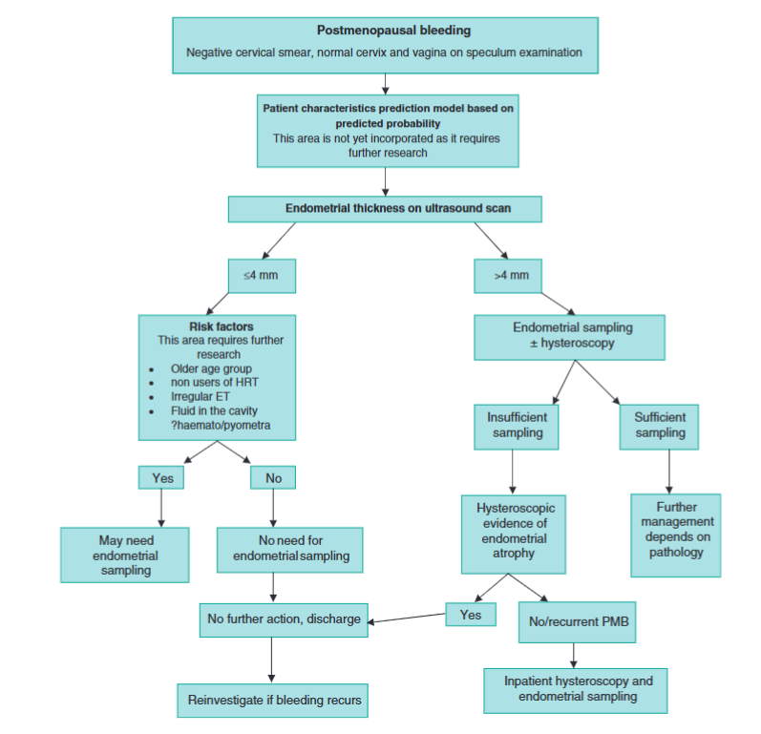

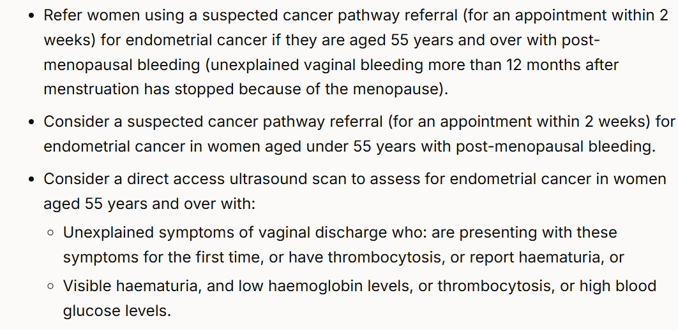
The National Guidance
Notes:
No clear naitonal guidelines on what we should be doing with women who present with PMB. The NICE guidelines recommend doing a biopsy +?_ hysteroscopy for anyone with an endometrium more than 4mm. They also recommend considering completing a biopsy for anyone who has bleeding and specific risk factors or specific scan findings.
Management of women with postmenopausal bleeding: evidence‐based review

Slide 11
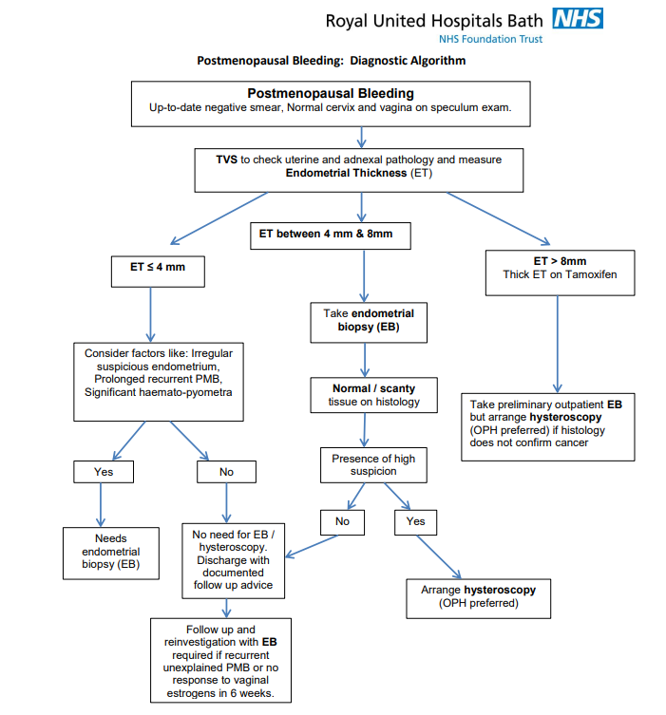
Our Current Guidelines
Notes:
Our current guidelines recommend taking a biopsy 4-8mm, and going straight to hysteroscopy for anyone with an endometrium >8mm. Those with a normal pipelle are still going on to have a hysteroscopy even in the presence of a normal result, and those who have a cancer diagnosed on pipelle are still being referred for hysteroscopy (although it will likely be cancelled if the histology returns before the appt). This means our current guidelines are not completely streamlined and there is room for clairty and potentially improvement

Slide 12
Our Audit
Gold standard:
All patients with PMB and ET > 4mm should have an endometrial biopsy (ideally in an outpatient setting at first attendance)
Additional fact finding:
1. Do the standard risk factors for endometrial cancer reflect those in our local population
2.What medium is used to diagnose the majority of our endometrial cancers?
3.How accurate is pipelle for the diagnosis of endometrial cancers?

Slide 13
The data
All patients diagnosed with endometrial cancer March 2017-March 2024
450 patients (77 excluded as diagnosed in alternative units)
Age average
68.4
Median parity
2
Median BMI
31.2

Slide 14
The Risk factors Quiz
18.9% diabetic
41.1.% hypertensive
4.4% on HRT
2.6% on tamoxifen
Median ET 15mm

Slide 15
How were our cancers diagnosed?

Slide 16


Award Ceremony

Slide 17
Who were our false negatives?
Our use of Pipelle
312 patients had a pipelle successfully completed in clinic (69.2%)
98.4% of those who had a pipelle in clinic had cancer diagnosed on this methodology
Sensitivity 95.3% for diagnosis of cancer with any successful pipelle
Sensitivity 98.7% for diagnosis of cancer (if exclude those with insufficient samples/ hyperplasia
25 patients
10- atypical hyperplasia on pipelle, upstaged on post op histology
11- insufficient sample
3- normal histology in context of polyp (then referred hysteroscopy)
1- normal finding
Notes:
Who had a pipelle in clinic, but their cancer diagnosed using another method
The normal finding patient was an outlier. 1 normal pipelle- review of this case referred with pelvic mass, biopsy taken as irregular heavy bleeding and aged 47, fixed pelvic mass, ? fibroid ? sarcoma, had mri and went on to have hysterectomy which confirmed sarcoma.
307/307+25=

Slide 18
Who were referred for hysteroscopy?
Notes:
147 patients referred for hysteroscopy (32.7% of patients)

Slide 19
What about recurrent presentations?
25 patients
11- no biopsy on initial presentation as thin endometrium
6- normal biopsy
2- normal hysteroscopy
4- declined investigations
1- previous attendance, did not have biopsy
1- simple hyperplasia confined to polyp, plan for FU 6/12 later

Slide 20
What conclusions can we draw from this information?
Hypertension is a significant risk factor for endometrial cancer
Pipelle is excellent at diagnosing endometrial cancer in the post menopausal patient
Hysteroscopy should be reserved for those with discrete pathology, an insufficient initial biopsy, or inability to complete endometrial sampling
With new additional outpatient techniques (Penthrox) our hysteroscopy rate should reduce further
All recurrent presentations should have endometrial sampling +/- hysteroscopy
Notes:
If we exclude all patients who were referred for hysteroscopy because of an inability to complete the sample, then our hysteroscopy rate for PMB would be 0.09%

Slide 21
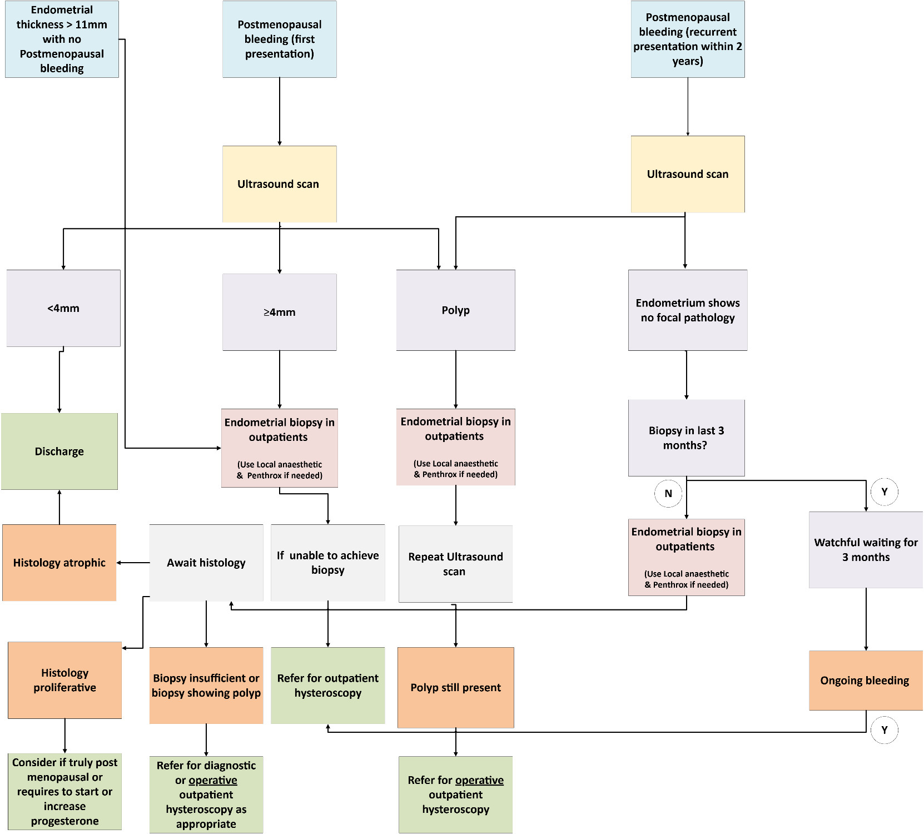
How might this change our current practice?
Notes:
Thoughts and suggestions welcome about this flow chart and how to best amend our guideline moving forward

Slide 22
Conclusions and Future Plans
Hypertension is a significant risk factor for endometrial Ca
Pipelle is a sensitive measure for detection endometrial cancer

