Slide 1
SWAG Network Colorectal Cancer Clinical Advisory Group
Research Update
22/10/2025

Slide 2
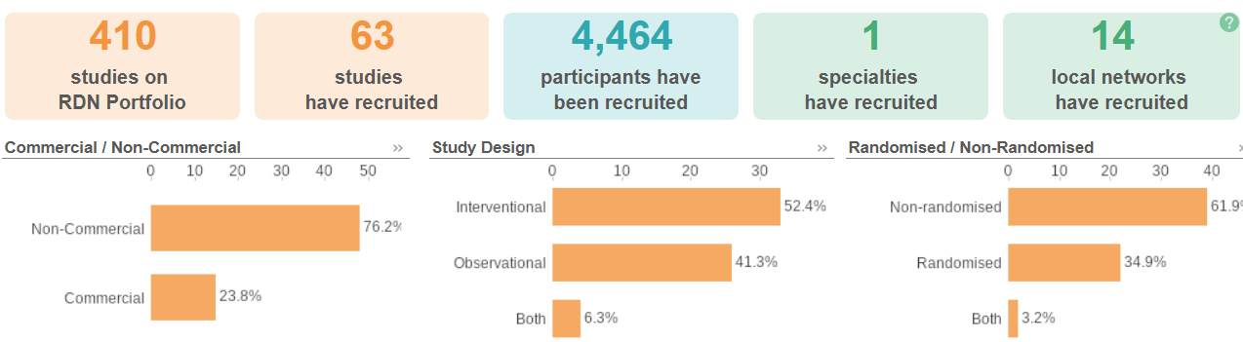
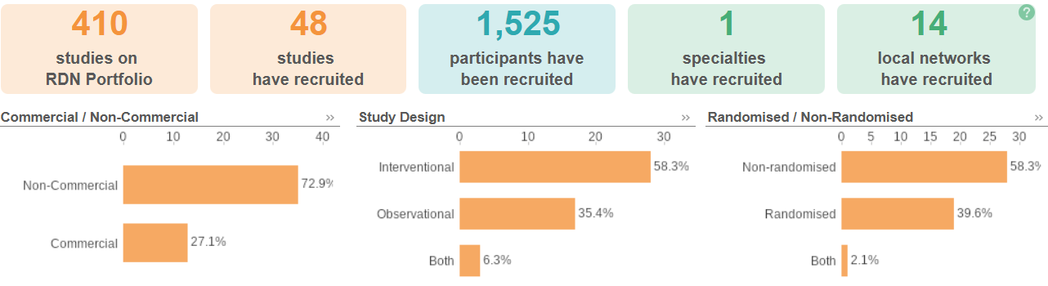
National Colorectal Cancer Research Recruitment
Apr 24 - Mar 25
Apr 25 - Sep 25
Data cut: 02/10/2025
Source: ODP All Portfolio

Slide 3
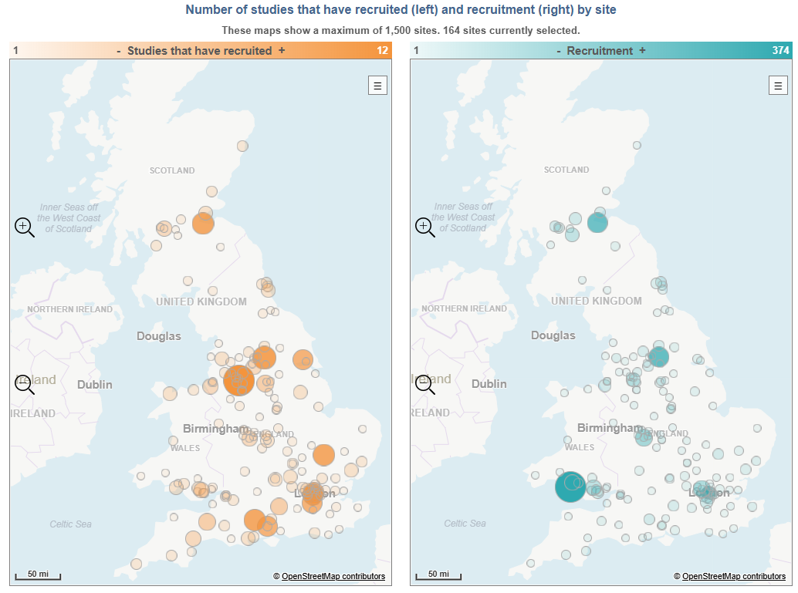
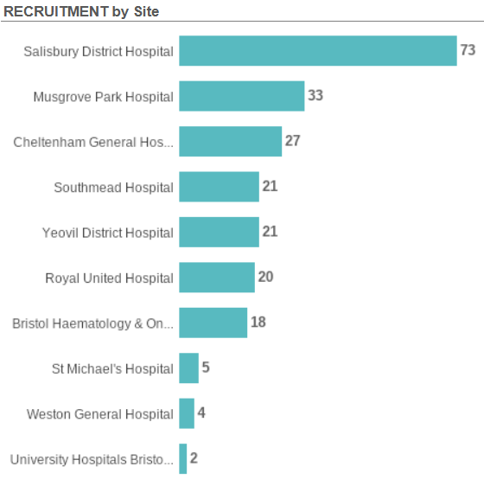
Colorectal Cancer Research Recruitment Apr 2024-current
Data cut 02/10/2025
Source: ODP All Portfolio

Slide 4
Open Studies in SWAG region
Study/Sites | Site Recruitment
ARIEL | 12
Royal United Hospitals Bath NHS Foundation Trust | 5
Somerset NHS Foundation Trust | 7
Yeovil District Hospital NHS Foundation Trust | 0
ARTEMIS | 8
Somerset NHS Foundation Trust | 8
Brief Intervention with Cyclophosphamide in Colorectal Cancer | 1
Royal United Hospitals Bath NHS Foundation Trust | 1
CANFit: home-based exercise programme for patients with cancer | 10
Somerset NHS Foundation Trust | 10
CORGI 2 | 25
University Hospitals Bristol And Weston NHS Foundation Trust | 25
FOxTROT Platform | 26
Royal United Hospitals Bath NHS Foundation Trust | 8
Salisbury NHS Foundation Trust | 0
Somerset NHS Foundation Trust | 14
University Hospitals Bristol And Weston NHS Foundation Trust | 4
Yeovil District Hospital NHS Foundation Trust | 0
IMPRESS Trial | 80
Salisbury NHS Foundation Trust | 55
Somerset NHS Foundation Trust | 16
Taunton and Somerset NHS Foundation Trust | 8
Yeovil District Hospital NHS Foundation Trust | 1
MOUNTAINEER-03
University Hospitals Bristol And Weston NHS Foundation Trust | 0
Data cut 06/10/2025
Source: ODP All Portfolio

Slide 5
OnCoRe | 4
Salisbury NHS Foundation Trust | 4
Yeovil District Hospital NHS Foundation Trust | 0
OrigAMI-2 | 0
Gloucestershire Hospitals NHS Foundation Trust | 0
PICCOS | 0
Royal United Hospitals Bath NHS Foundation Trust | 0
Somerset NHS Foundation Trust | 0
University Hospitals Bristol And Weston NHS Foundation Trust | 0
PRESERVE | 5
Salisbury NHS Foundation Trust | 5
SERENADE | 75
Salisbury NHS Foundation Trust | 75
The COMET Trial | 64
Salisbury NHS Foundation Trust | 64
The SCOTTY Study | 4
University Hospitals Bristol And Weston NHS Foundation Trust | 4
TRACC C | 76
Salisbury NHS Foundation Trust | 18
Somerset NHS Foundation Trust | 21
University Hospitals Bristol And Weston NHS Foundation Trust | 37
TRIGGER Trial | 24
North Bristol NHS Trust | 0
Salisbury NHS Foundation Trust | 16
University Hospitals Bristol And Weston NHS Foundation Trust | 8
Data cut 06/10/2025
Source: ODP All Portfolio

Slide 6
Studies in set-up/under consideration in SWAG region
KANDLELIT-012: A Phase 3, Randomized, Open-label, Multicenter Clinical Study to Evaluate the Safety and Efficacy of MK-1084 with FOLFOX plus Cetuximab versus FOLFOX with or without Bevacizumab as First-line Treatment of Participants with KRAS G12C Mutant, Metastatic Colorectal Cancer
Sites: UHBW, RUH, SomFT, SalFT. Opening 01/11/2025 Closing 01/12/2027, MERCK SHARP & DOHME CORP.
M24-533 - ABBV-400 in Subjects with Metastatic Colorectal Cancer: A Phase 2, Open-Label, Randomized, Master Protocol Study to Evaluate Safety and Efficacy of Multiple Treatment Combinations with ABBV-400 in Subjects with Metastatic Colorectal Cancer
Sites: UHBW, SomFT, GHFT Opening 30/04/2025 Closing 01/09/2026 ABBVIE INC.
Data cut 06/10/2025
Source: ODP All Portfolio

Slide 7
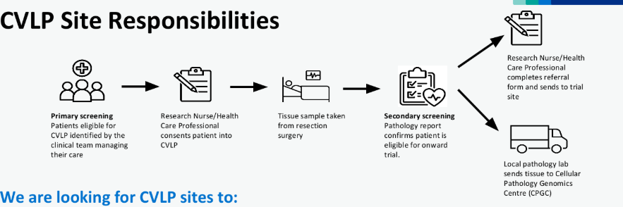
Cancer Vaccine Studies and CVLP
CVLP aims to establish the feasibility of pathways for patients with cancer to access cancer vaccine trials.
CVLP is investigating the optimum process for patients, across multiple cancer types, to receive personalised cancer vaccines by enrolment in the CVLP
Currently supporting two cancer vaccine trials:
BNT113-01 Head & Neck Squamous Cell Carcinoma
The SCOPE trial Advanced Melanoma

Slide 8
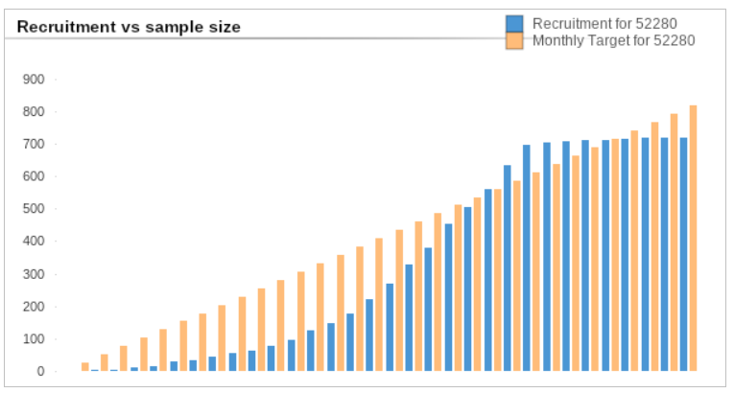
BNT122-01 BioNTech SE Colorectal Cancer 4781/0016
CVLP / BNT122-01 (Colorectal cancer) – 17 CVLP patients randomised to BNT122-01. Expecting 2 more participants to be randomised in September and October
BNT122-01 Additional Cohorts
BioNTech has decided not to proceed with the BNT122-01 additional cohorts (CLM and ctDNA surveillance cohorts). Thank you for everyone’s input into this study.
BNT122-01 Annual Follow up of CVLP participants
Sites to continue providing annual follow-up data for patients they have consented to the CVLP.
Data cut 06/10/2025
Source: ODP All Portfolio

Slide 9
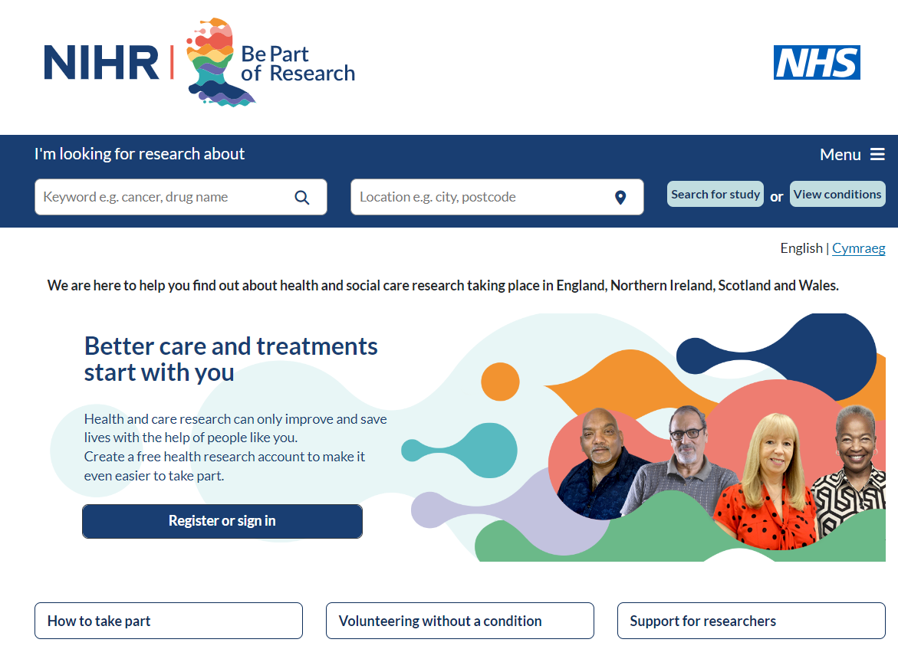

Be Part of Research is a UK-wide service that helps people find and take part in health and care research across nearly every health condition.
A resource for:
patients or their families keen to get involved in research
Researchers looking for target population for research
https://bepartofresearch.nihr.ac.uk/
Data cut
Source: ODP All Portfolio

Slide 10
Key messages for patients
Be Part of Research makes it easier than ever to find and take part in health and care research.
Simply sign up online and choose the areas of research you’re interested in.
You’ll then be matched to suitable studies and sent clear information about what’s involved and how you can take part.
The decision on whether to take part is always yours.

Slide 11

Associate Principal Investigator
Scheme
Six month in-work training opportunity, providing practical experience for healthcare professionals starting their research career.
People who would not normally have the opportunity to take part in clinical research in their day to day role have the chance to experience what it means to work on and deliver a NIHR portfolio trial under the mentorship of an enthusiastic Local PI.
CIs working with a CTU can register their study on the scheme
https://www.nihr.ac.uk/health-and-care-professionals/career-development/associate-principal-investigator-scheme.htm

Slide 12

Principal Investigator Pipeline Programme
(PIPP)
Overview
Research delivery nurses or midwives
12 to 18 months
Free if you’re eligible
Live virtual lessons, online learning and hands-on experience
Cohort 4 started in September 2025
Please email nursingandmidwifery@nihr.ac.uk for more information
https://www.nihr.ac.uk/career-development/clinical-research-courses-and-support/principal-investigator-pipeline-programme

Slide 13
NIHR Qlik Cloud https://rdn.uk.qlikcloud.com/
Data on performance across whole RDN, including all specialty areas
NIHR Be Part of Research https://bepartofresearch.nihr.ac.uk/
See which studies are open across the country
Find a Clinical Research Study https://sense.odp.nihr.ac.uk/public/sense/app/27f93da6-3ea4-404a-afce-24cfe1c613c8/sheet/d96836f0-c98b-4ee2-9991-351f5a2c659f/state/analysis
Search for a study to fit criteria. Good for horizon scanning, eligibility criteria

Slide 14
RRDN Contacts
swc.rrdn@nihr.ac.uk
Study Support Service Manager: claire.matthews@nihr.ac.uk
CAG Research Lead: thomas.strawson-smith@uhbw.nhs.uk

