Slide 1


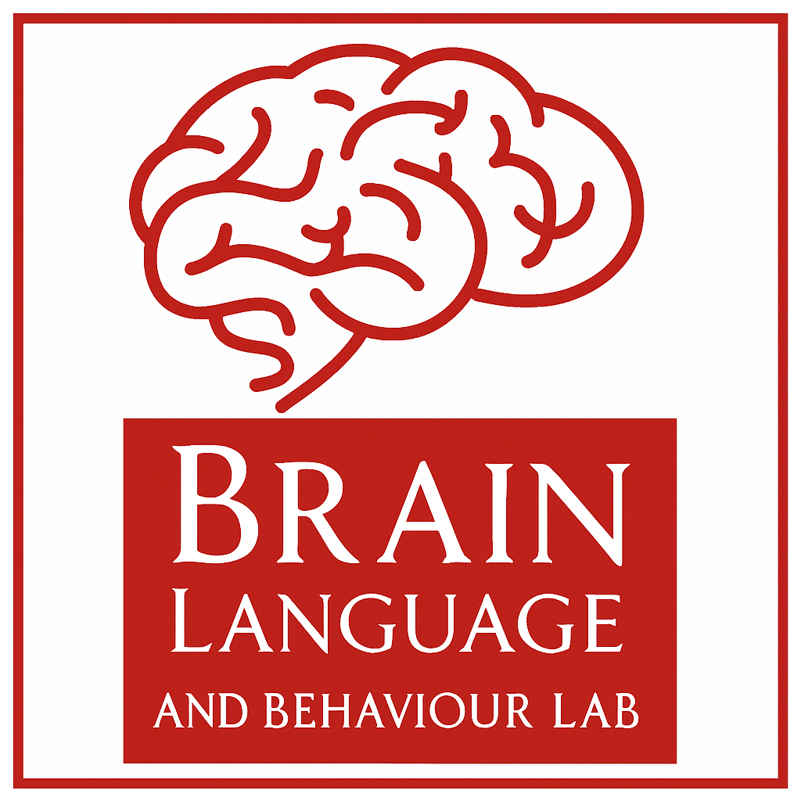
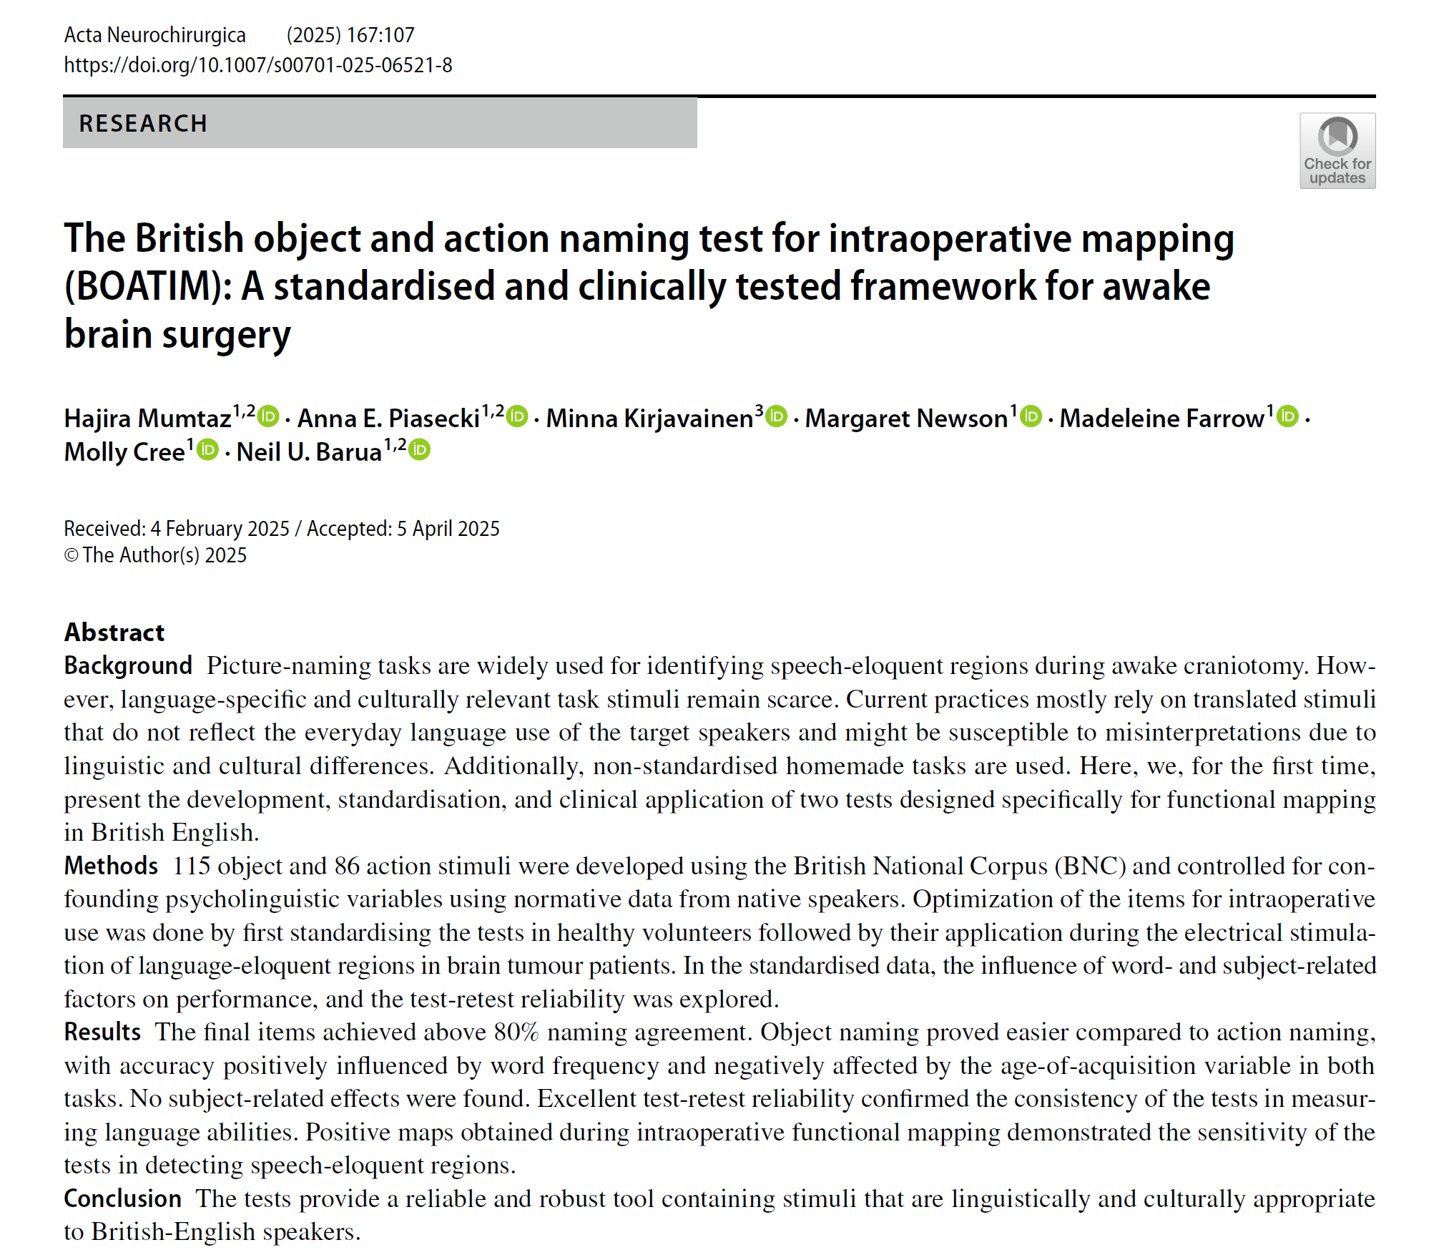
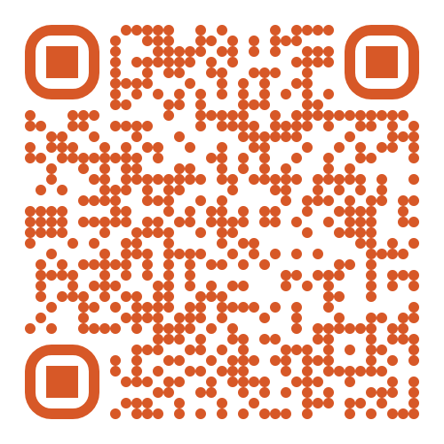
Contemporary Language Tests
Introducing BOATIM: The British Object and Action Naming Test for Intraoperative Mapping
(Hajira Mumtaz, Anna Piasecki, Minna Kirjavainen, Margaret Newson, Madeleine Farrow, Molly Cree, & Neil Barua)
Read BOATIM publication here

Slide 2
The clinical need
Language mapping during awake brain surgery requires standardized measures that are also linguistically and culturally relevant to the target speakers (Lucas et al., 2021)
Why standardized measures are essential:
  Provide controlled stimuli that have been pretested in healthy population (Rofes, 2015)
  Facilitate a clear and consistent interpretation of language performance across different clinical contexts, sessions and examiners (Rofes, 2015; Nieberlein et al., 2023)
Why linguistic and cultural specificity matters:
  Guarantee unbiased stimuli that are representative of the everyday language use of the target speakers (Papatzalas et al., 2022)
  Eliminate the influence of confounding factors (e.g., stimulus familiarity or relevance) on performance (De Martino et al., 2021)

Slide 3
Current practice
Extant perioperative assessment tools rely heavily on:
  Translated or adapted versions of the tests developed originally in other languages
  Home-made/unstandardized stimuli
Translated materials linguistically and culturally biased stimuli that are prone to misinterpretations
  Culturally unsuitable stimuli led to lower scores in French speakers from Canada compared to French speakers in France [5]
Home-made tasks lack control of the variables influencing performance (e.g., stimulus familiarity, frequency of use) and baseline data (i.e., pretesting in healthy volunteers)

Slide 4
The case for a UK-native framework
No standardized intraoperative test yet exists for British-English
Previous English-based tools are translations of Dutch (Ohlerth et al., 2020) and Spanish tests (Gisbert-Munoz et al., 2021)
A national survey (Mariotti et al., 2025) targeted at revealing language mapping practices across the UK found that most surgical centres rely on:
  ❌Homemade tasks
  ❌Translated stimuli from the Dutch Linguistic Intraoperative Protocol (DuLIP) battery (De Witte et al., 2015)
  Practice varies widely between institutions, with no unified framework

Slide 5

Meet BOATIM (Mumtaz et al. 2025)
The first standardized and clinically tested picture-naming tool for intraoperative mapping in British-English
A framework built, not borrowed!
What BOATIM offers:
  Two picture-naming tasks containing 115 stimuli representing daily-life objects (e.g., table) and 86 stimuli representing everyday activities (e.g., to run)
  Linguistically and culturally relevant stimuli developed using the spoken British National Corpus (BNC) and controlled for key linguistic variables using native speakers’ data

Slide 6
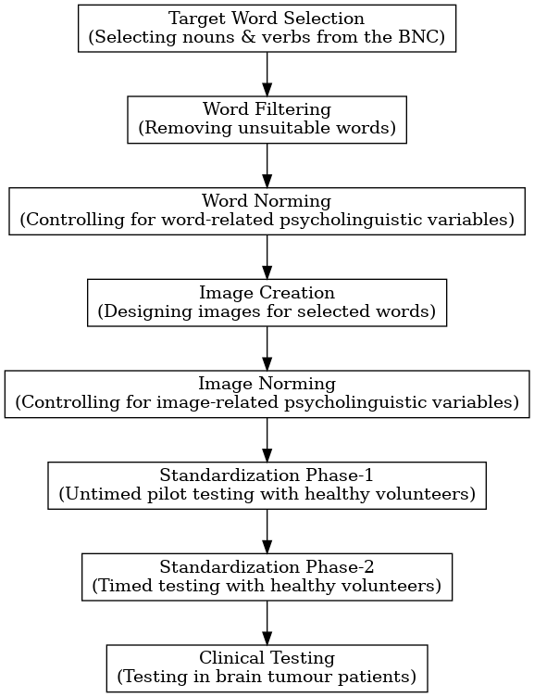
BOATIM development - overview

Slide 7
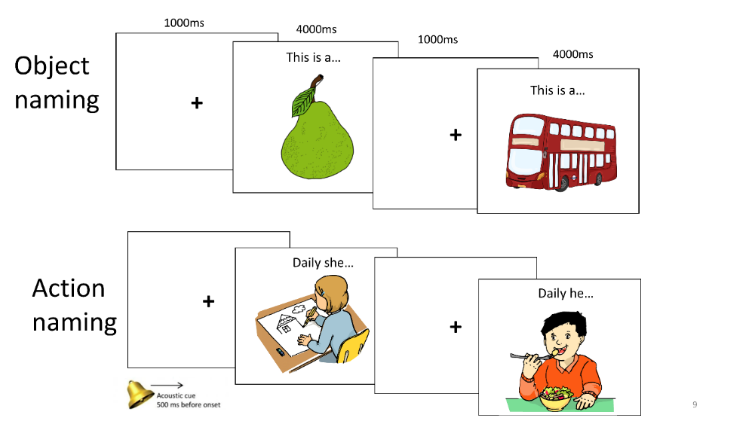
Key results: BOATIM standardization
N=54 monolingual native British speakers named BOATIM tasks in a short sentence context under simulated awake craniotomy conditions (i.e., each image presented for 4000ms)
115 object stimuli and 86 action stimuli named consistently by over 80% of participants
Task | Median accuracy (%) | W | p
Object naming | 98.26 | 1399.5 | 0.002*
Action naming | 95.35 | - | -
Task | Exclusion rate (%) | S | p
Object naming | 8.4 | - | -
Action naming | 18.7 | 2.49 | 0.016*

Slide 8
Key results: BOATIM standardization
Variable | Task | X² | p
Age | Object naming | 0.87 | 0.350
 | Action naming | 0.01 | 0.090
Education | Object naming | 0.14 | 0.700
 | Action naming | 0.11 | 0.737
 | rho | p value after Bonferroni corrections
Object naming
Frequency | 0.239 | 0.050*
Imageability | 0.111 | 1.000
AoA | -0.296 | 0.006*
Concreteness | 0.005 | 1.000
Number of phonemes | -0.190 | 0.206
Animacy | 0.022 | 1.000
Action naming
Frequency | 0.386 | 0.001*
Imageability | 0.132 | 1.000
AoA | -0.293 | 0.030*
Concreteness | 0.269 | 0.060
Number of phonemes | 0.035 | 1.000
Transitivity | -0.071 | 1.000
Instrumentality | -0.225 | 0.256
Task | rho | p | ICC (95% CI) | p
Object naming | 0.92 | p < 0.001 | 0.93 (0.88-0.96) | p < 0.001
Action naming | 0.98 | p < 0.001 | 0.99 (0.98-0.99) | p < 0.001
Notes:
Removing the

Slide 9
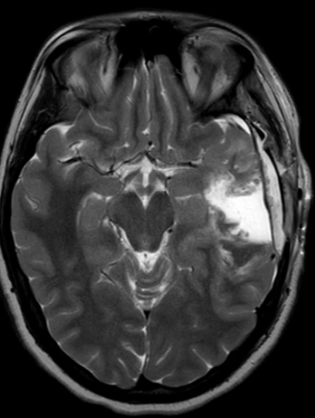
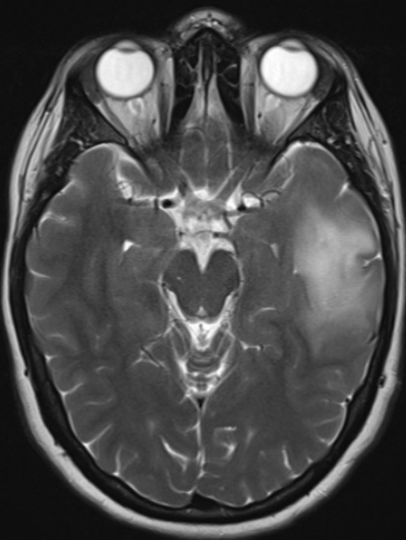
Clinical testing; an example
  27-year-old female
  left-temporal tumour
  Impaired action word fluency and auditory naming pre-op
  Positive maps in STG were obtained with BOATIM object naming

Slide 10
Further work
Developing standardized and clinically tested measures that allows testing of larger than single word units
My old school friend Emma came on a flying visit this weekend. We had a girls’ night out on Saturday with a couple of other friends. Even though it was raining cats and dogs, but we still went out for a meal to a local restaurant. Emma kept ordering all the junk food that the restaurant had, while continuously having a whinge about her weight and not being able to stick to her diet.
Clinical testing to start soon!
Increasing patient data for the newly developed test batteries

Slide 11
Further work
Extending our test design to other languages both in and outside the UK
Using our standardized measures in other paradigms (e.g., fMRI)
Improving task design further (e.g., IMPACT project with NBT)

Slide 12
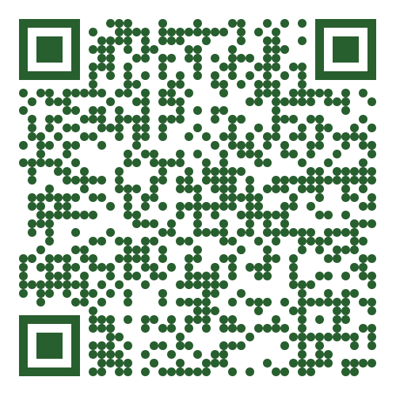
Access to the BOATIM resource
Read BOATIM publication
Download BOATIM stimuli

Slide 13
References
De Martino, M., Talacchi, A., Capasso, R., Mazzotta, A., & Miceli, G. (2021). Language assessment in multilingualism and awake neurosurgery. Frontiers in Human Neuroscience, 15. https://doi.org/10.3389/fnhum.2021.750013
De Witte, E., Satoer, D., Robert, E., Colle, H., Verheyen, S., Visch-Brink, E., & Mariën, P. (2015). The Dutch linguistic intraoperative protocol: A valid linguistic approach to awake brain surgery. Brain and Language, 140, 35–48. https://doi.org/10.1016/j.bandl.2014.10.011
Gisbert-Muñoz S, Quiñones I, Amoruso L, Timofeeva P, Geng S, Boudelaa S, Pomposo I, Gil-Robles S, Carreiras M (2021) MULTIMAP: multilingual picture naming test for mapping eloquent areas during awake surgeries. Behav Res Methods 53(2):918–927. https:// doi. org/ 10. 3758/ s13428- 020- 01467-4
Mariotti, S., Barua, N. U., Williamson, T. R., Mumtaz, H., Kinsey, K., & Piasecki, A. E. (2025). Language testing in awake craniotomy for brain tumor resection: A survey of current perioperative practice in the UK. *Neuro-Oncology Practice. https://doi.org/10.1093/nop/npaf027
Nieberlein, L., Rampp, S., Gussew, A., Prell, J., & Hartwigsen, G. (2023). Reorganization and plasticity of the language network in patients with cerebral gliomas. NeuroImage: Clinical, 37, 103326. https://doi.org/10.1016/j.nicl.2023.103326
Ohlerth A-K, Valentin A, Vergani F, Ashkan K, Bastiaanse R (2020) The verb and noun test for peri-operative testing (VAN-POP): standardized language tests for navigated transcranial magnetic stimulation and direct electrical stimulation. Acta Neurochir. 162(2):397–406. https://doi. org/10.1007/ s00701- 019- 04159-x
Rofes, A. (2015). Verbs and nouns in awake neurosurgery: Needs and answers [PhD dissertation, University of Trento]. http://eprints-phd.biblio.unitn.it/1572/
Papatzalas, C., Fountas, K., Kapsalaki, E., & Papathanasiou, I. (2022). The use of standardized intraoperative language tests in awake craniotomies: A scoping review. Neuropsychology Review, 32 (1), 20–50. https://doi.org/10.1007/s11065-021-09492-6
Weiss, L. C., Pieczewski, J., Kochs, S., Nettekoven, C., Grefkes, C., Goldbrunner, R., & Jonas, K. (2021). The Cologne picture naming test for language mapping and monitoring (CoNaT): An open set of 100 black and white object drawings. Frontiers in Neurology, 12. https://doi.org/10.3389/fneur.2021.633068

